Slide 1

TIF
WEDA 2023 Summer Conference
August 10, 2023

Slide 2
Presentation Topics
TIF Overview
Recent TIF Changes
Summary of Some TIF Projects

Slide 3
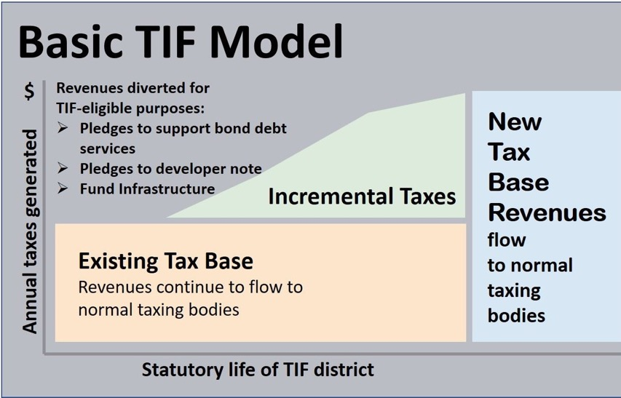
Tax Increment Financing
Washington State Legislature Passed Bill 1189 authorizing TIF in 2021. Now Codified as Chapter 39.114 RCW
Model
Generally, TIF captures property taxes generated from the increased assessed valuation on the site that results from private development following infrastructure investment.
Washington State TIF law excludes State property tax and voter approved school levies.
Revenues from REGULAR property taxes assessed against the Increment Value only, are captured:
To pay “public improvement costs”
To repay bonds issued for “public improvements”

Slide 4
Overview of Tax Increment Financing
SUMMARY
Available to cities, counties, and ports.
Powerful economic development tool.
Designed for specific project/site – Not build infrastructure and hope/wait for development.
Projects will not occur “but for” the public investment in infrastructure – “But-For” Requirement.
Results in creation of new assessed value, public benefits, construction of desired development and short/long-term jobs.
Taxes from the development fund the public infrastructure needed by the development; no impact on individual property owners.
Designed to not harm existing taxing district.

Slide 5
Overview of Tax Increment Financing
KEY ELEMENTS
City, county, or port adopts an ordinance designating increment area, and identifying the public improvements to be financed, and whether bonds will be issued. Limitations:
  No more than two active increment areas per sponsoring jurisdiction and they may not overlap.
  Increment areas may not total more than $200 million in assessed valuation, or more than 20% of the total assessed valuation of the sponsoring jurisdiction, whichever is less.
  Cannot add additional public improvements or change the boundary of the increment area once adopted.
  Must include a deadline by when construction of public improvements will begin.
  The local government may only receive TIF revenues for the period of time necessary to pay the costs of the public improvements.
  If the local government finances the public improvements, the increment area must be retired no more than 25 years after the adoption of the ordinance designating the increment area.

Slide 6
Overview of Tax Increment Financing
KEY ELEMENTS
Eligible Infrastructure improvements owned by a local government within or outside of and serving the increment area that include:
Street and road construction;
Water and sewer system construction and improvements;
Sidewalks and other non-motorized transportation improvements and streetlights;
Parking, terminal, and dock facilities;
Park and ride facilities or other transit facilities;
Park and community facilities and recreational areas;
Stormwater and management systems;
Electric, broadband, or rail service;
Mitigation of brownfields; or
  Eligible expenditures for any of the following:
  Purchasing, rehabilitating, retrofitting for energy efficiency, and constructing housing for the purpose of creating or preserving long-term affordable housing;
  Purchasing, rehabilitating, retrofitting for energy efficiency, and constructing child care facilities serving children and youth that are low-income, homeless, or in foster care;
  Providing maintenance and security for the public improvements; or
  Historic preservation activities authorized under RCW 35.21.395.

Slide 7
Overview of Tax Increment Financing
KEY ELEMENTS
Must Prepare a Project Analysis
  A description of the expected private development within the increment area, including a comparison of scenarios with and without proposed public improvements
  An assessment of any impacts and necessary mitigation to address the following:
    Affordable and low-income housing
    Local business community
    Local school districts
    Local fire service
    If 20% of the assessed value in the fire district impacted or the fire district’s annual report demonstrates an increase in the level of service directly related to the increment area, a mitigation plan must be negotiated

Slide 8
Overview of Tax Increment Financing
KEY ELEMENTS
Hold two public hearings exclusively on the project.
Submit to the state office of the treasurer for review.
Publish notice in public newspaper.
Notice to county treasurer, county assessor, and governing body of each taxing district where the increment area is located.
Increment area effective June 1 of any year.

Slide 9
Overview of Tax Increment Financing
Recent TIF Changes – 2023 Legislative Session
  Clarification that Public Notice must be filed prior to any TIA ordinance adoption.
Allows for any private improvements on publicly owned land within a TIA to be reflected in the increment value.
Allows for infrastructure facilities owned by the State as eligible improvements to be funded with TIF revenues.
Clarifies that TIF revenues may be used to acquire real property within the increment area.
Allows local taxing districts are to increase their property tax levy capacity for increases in AV within the TIA following consolidation or annexation of taxing districts.

Slide 10
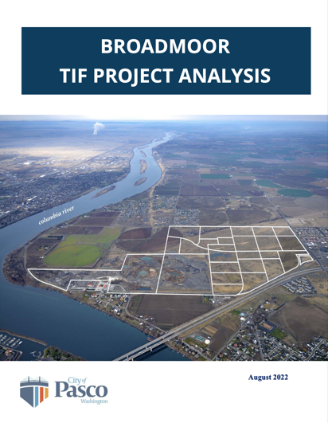
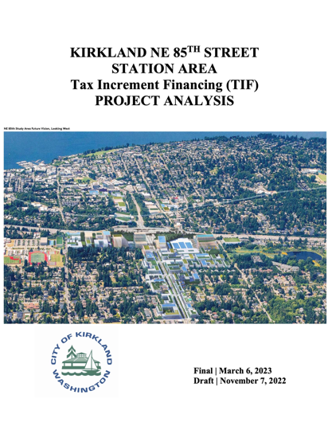

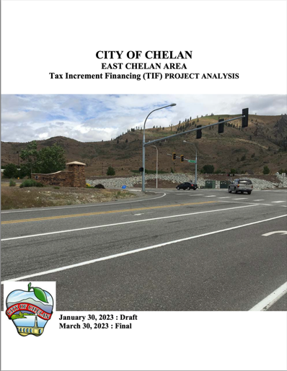
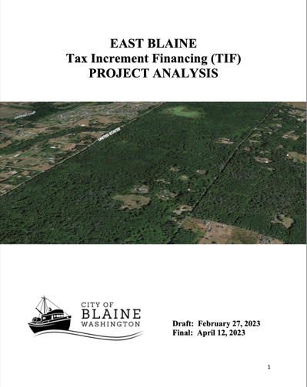
TIF PROJECTS
Project Analysis Completed by Stowe Development & Strategies/EcoNorthwest

Slide 11
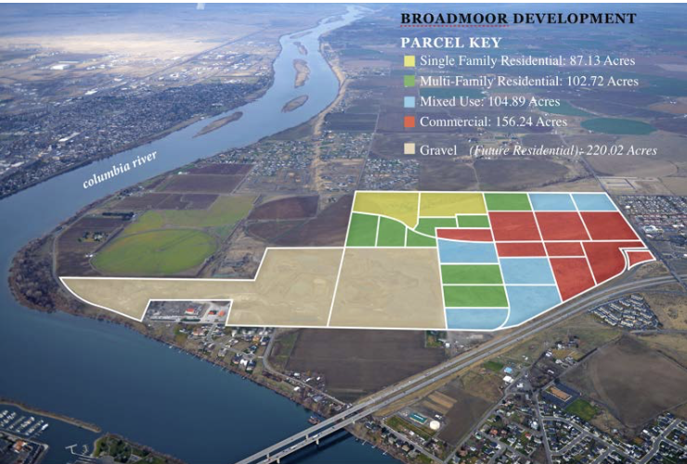
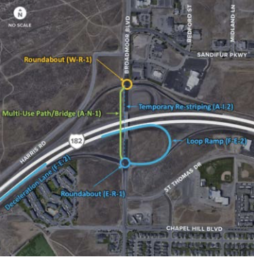
TIF PROJECTS: City of Pasco
Public Improvements | TIF Improvement Supported | Private Development Value | Private Development Type | Gross Acres
Streets, Utilities, Signalization & Highway Lop Ramp | $32M - $39M (max) | $500M to $1.7B | Vacant Land: Horizontal/vertical Mixed-Use, Retail, Commercial Big Box, some Single Family | 451
4,900 residential homes and over 1 million SF of commercial space (Retail/Office)

Slide 12
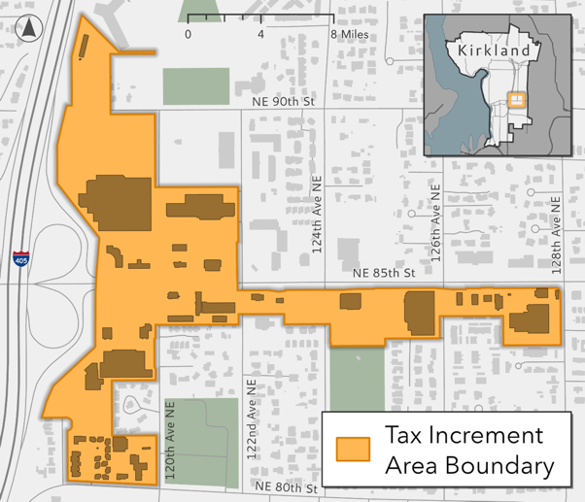
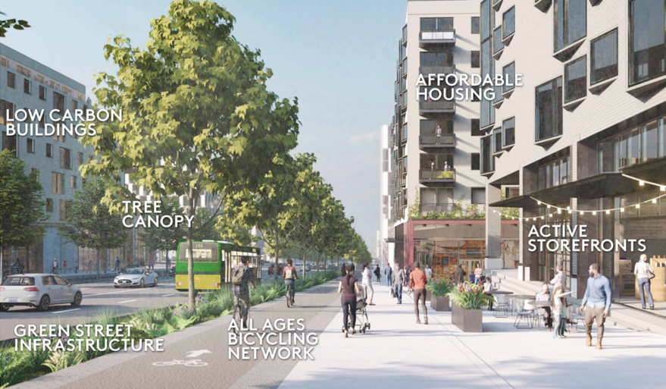
TIF PROJECTS: City of Kirkland
Public Improvements | TIF Improvement Supported | Private Development Value | Private Development Type | Gross Acres
Sewer Main, Park Development, Roadway Widening | $18M - $58M (max) | $2.7B | In-fill Development Horizontal/vertical Mixed-Use – Office, Tech, Retail, Housing | 52.5
2,700 MF homes, technology campus 1.8 million SF; Retail of 456,000 SF, Office of 2.8 million SF
.

Slide 13
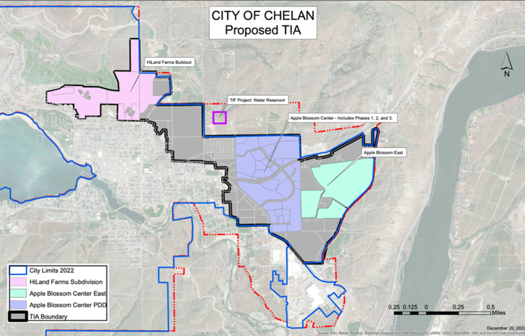
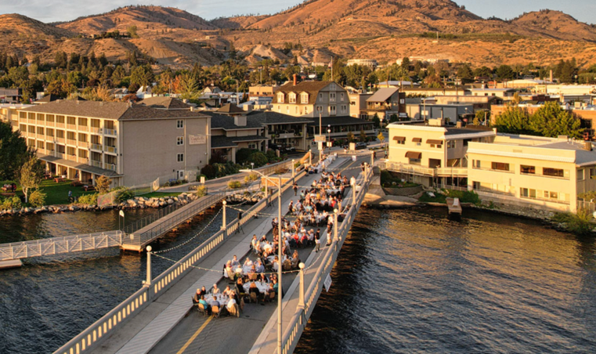
TIF PROJECTS: City of Chelan
Public Improvements | TIF Improvement Supported | Private Development Value | Private Development Type | Gross Acres
Reservoir/Booster Pump and related Water Main Extensions | $9M - $16M (max) | $312M | Largely Vacant Land: Horizontal/vertical Apartments, Town Homes, Senior Housing, Retail, Winery | 758
868 residential homes; 50,000 SF of commercial space and 8,000 SF of light industrial space when fully built-out.

Slide 14
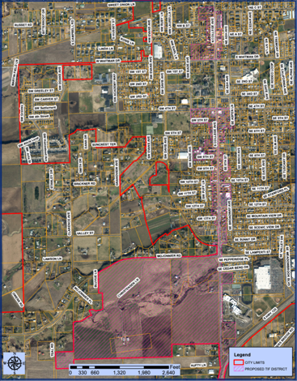
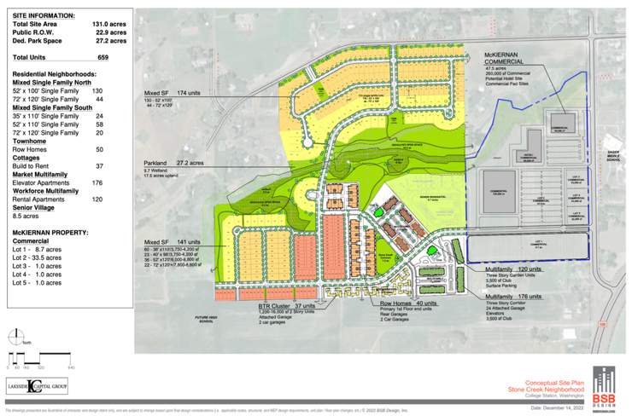
TIF PROJECTS: City of College Place
Public Improvements | TIF Improvement Supported | Private Development Value | Private Development Type | Gross Acres
Streets, Signalization, & Downtown Parking Lots | $9M - $16M (max) | $414M | Largely Vacant Land: Apartments, Town Homes, Single family, Retail, Hospitality | 259
829 residential homes and 290,000 SF of commercial space; 200-room hotel when fully built-out.

Slide 15
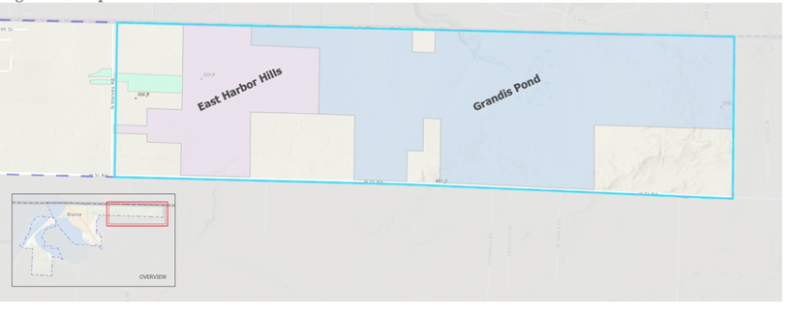
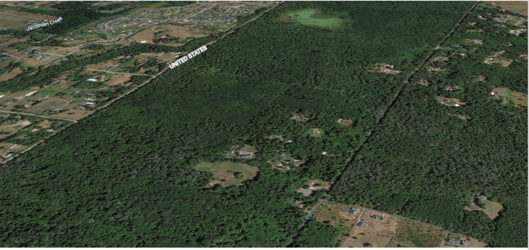
TIF PROJECTS: City of Blaine
Public Improvements | TIF Improvement Supported | Private Development Value | Private Development Type | Gross Acres
Streets, Electrical, Sewer, Water | $3.5M (max) | $628M | Vacant Land: Single Family, Apartments, and Some Retail | 833
1,442 residential homes and 50,000 SF of commercial space when fully built-out.

Slide 16
Observations
Subject to the scope and timing of private development, TIF revenues may be sufficient to pay for some or all of the identified infrastructure costs. Likely that most of the annual debt service will need to be paid by the TIF sponsor (without sufficient TIF revenues) in initial years while private development is being constructed and stabilizes.
Likely that sales tax revenue (one-time and on-going) plus other local taxes that are generated by private development, will equal or exceed the amount of property tax allocated from TIF.
A TIF sponsor can mitigate some its risk by:
  Development agreement that identifies both private and public development responsibilities and timing to help reduce surprises and mitigate any revenue shortage to cover annual debt payments.
  Financial agreement in which developer(s) will financially backstop (some to all) annual debt not covered by TIF revenues.
But-For elements of TIF are important because these are public tax dollars and TIF sponsors should demonstrate that they are needed for the private development to exist.
TIF works best when you have a project ready to go “but-for” the infrastructure and is looking for TIF funding rather than a TIF looking for a project.
More education is needed about complexity of Washington State’s property tax law with intersection of TIF to better understand the no harm provisions of the legislation.

Slide 17

www.stoweds.com

