Slide 1
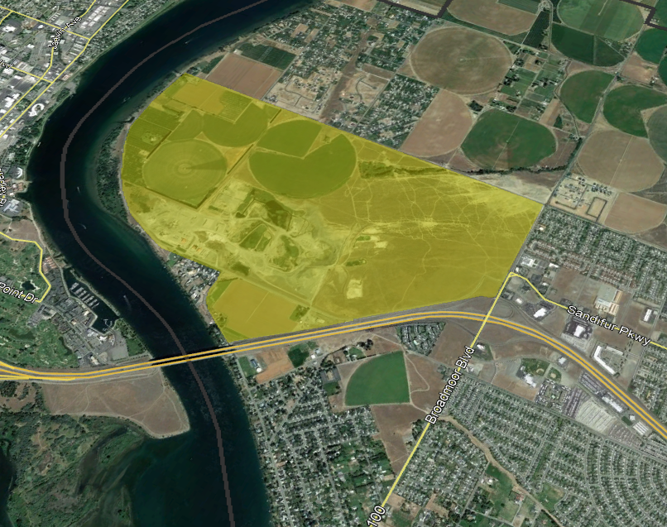
BROADMOOR Master Plan + Environmental Report
TIF for Jobs Update: Creating Economic Vitality through Tax Increment Financing (TIF)
August 10, 2023
Washington Economic Development Association Conference

Slide 2
Planning for Growth: Broadmoor
Action & Implementation
Master Plan and Environmental Review
Mitigations
  Transportation
  Water and Sewer
New Zoning and Land Use Standards
Tax Increment Financing
Vision & Goals
Regional HUB
7,000 + Housing Units
2,500 + Jobs
Walkable
Multi-Modal
Access to Parks & Recreation

Slide 3
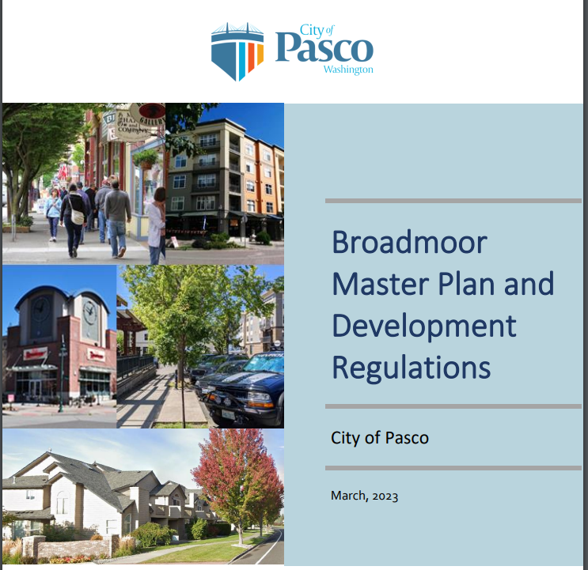
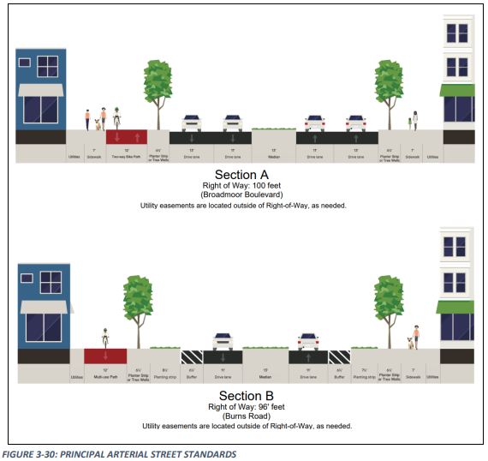
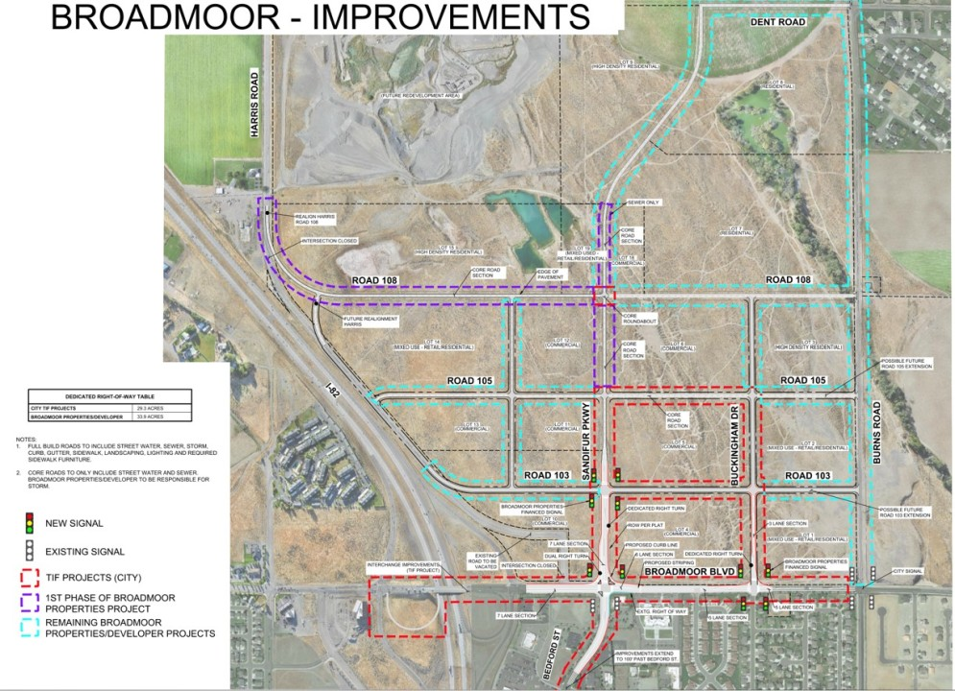
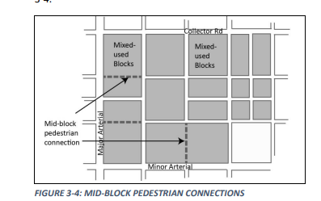

Slide 4
