Slide 1
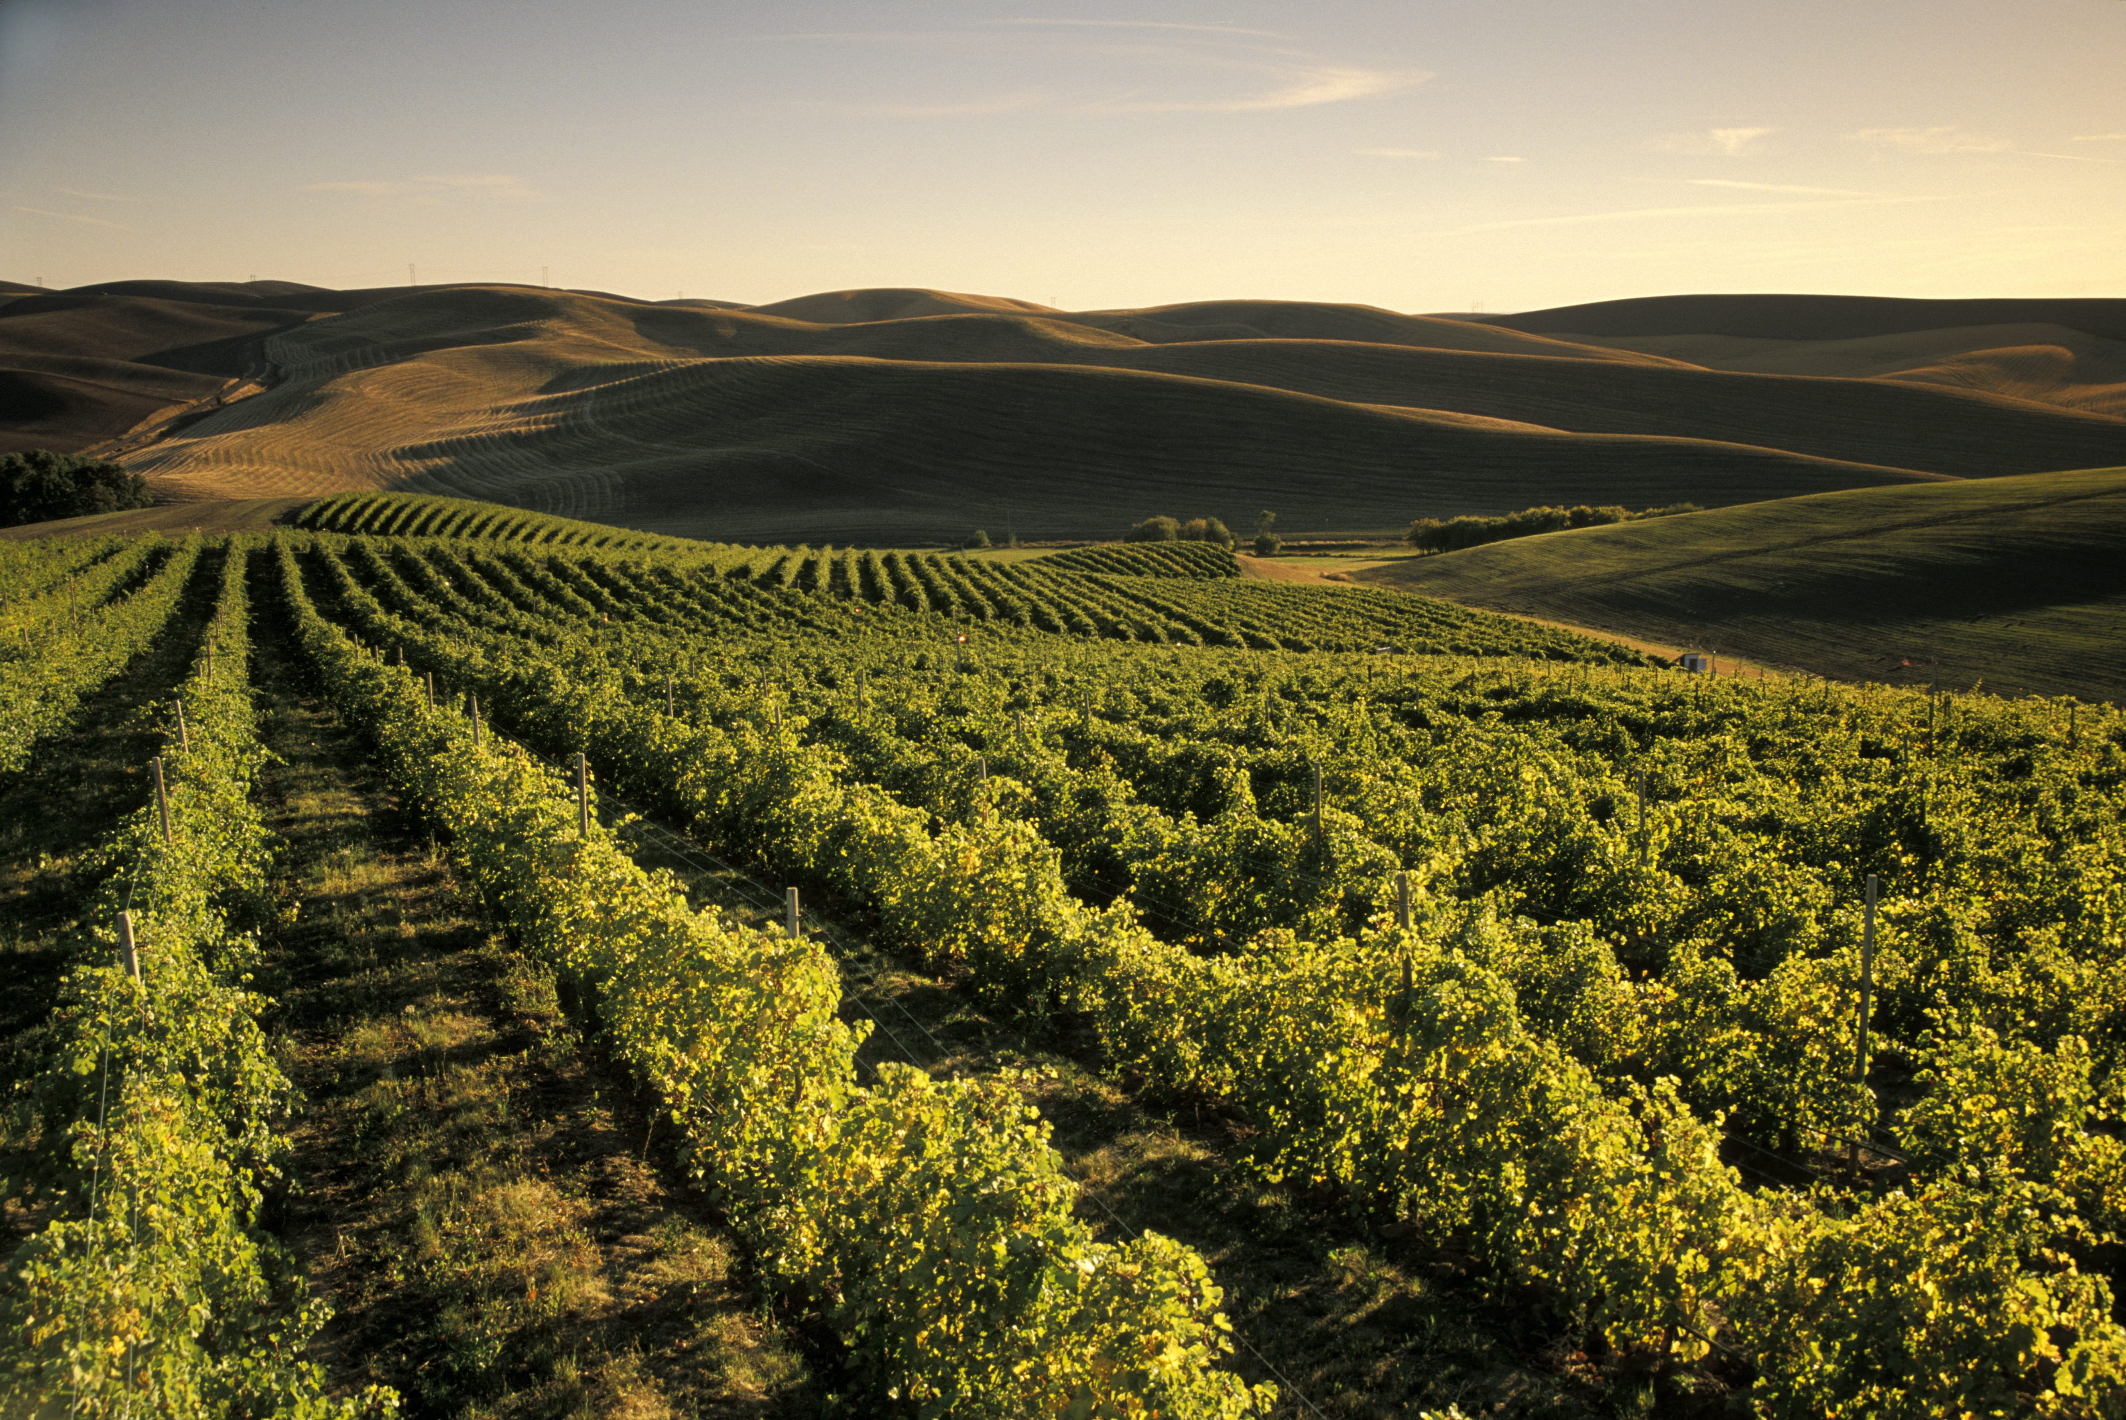
Washington Economic Development Association Annual Conference
Walla Walla, WA
School of Economic Sciences
Eric Jessup
Research Professor
Director: Freight Policy Transportation Institute
eric_jessup@wsu.edu
509-335-4987
August 9, 2023

Slide 2

Transportation is fundamental to Economic Vitality……?
Transportation creates time and place utility
Movement of people & products
Creation of markets . . . and value that otherwise would not exist
This is not a recent phenomenon (driven by technological change)
Transportation affects almost everything
  Necessary for economic development and growth
Change has occurred…..it will continue to occur!

Slide 3
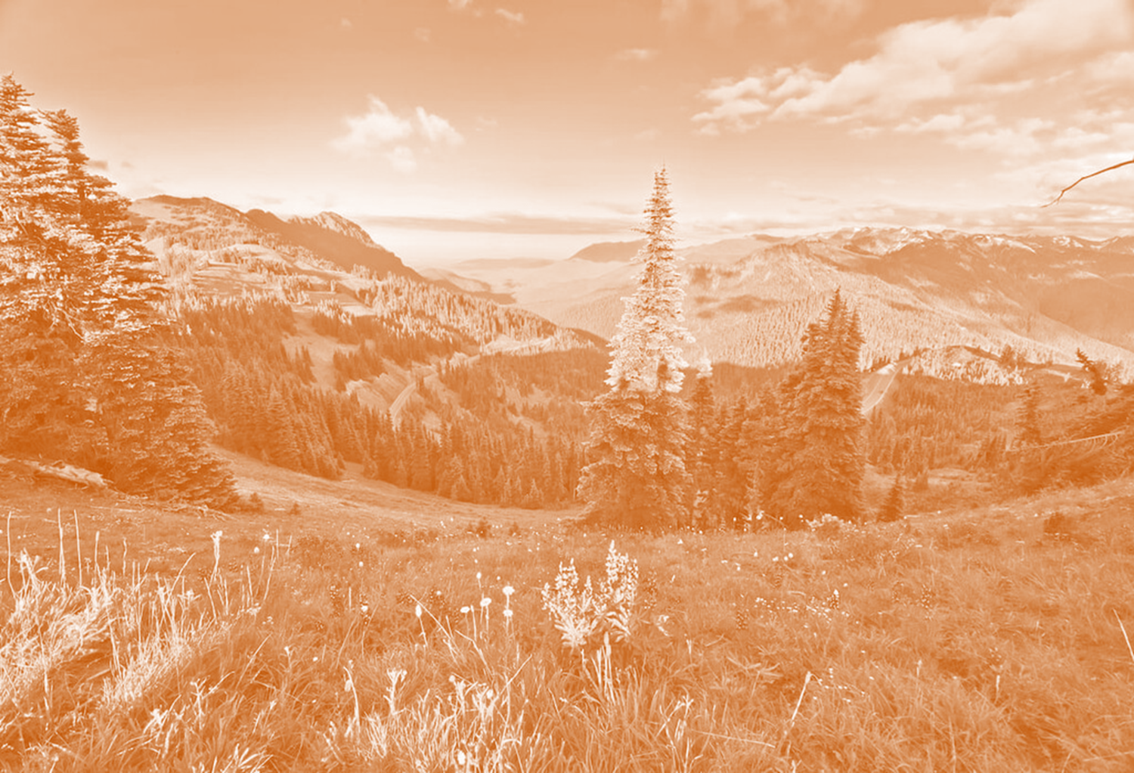
Proactive Planning for Economic Vitality
Structural Changes
(Causes)
Outcomes / Effects
Challenges Ahead
    Pandemic
    Technology (AI)
    Trade Agreements / Disagreements
    Geo-Political
    Labor demand
    Remote work
    Online / E-commerce
    Changed Export Markets
    Mobility/Transportation Needs
    Demand for urban/rural property & real estate
    Supply Chain Resiliency, Responsiveness and Dependability
    Polarized Communities / Constituents
    Climate Extremes
    Federal Debt
    The big Transition
      How to build advanced cities & communities while maintaining legacy systems (transportation infrastructure)

Slide 4
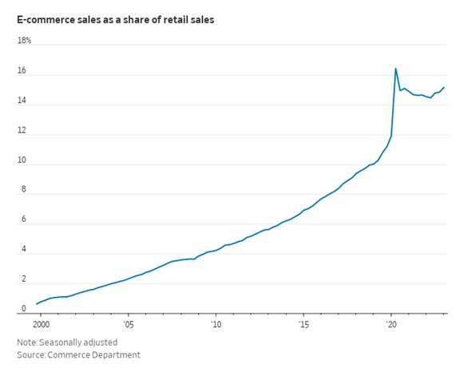
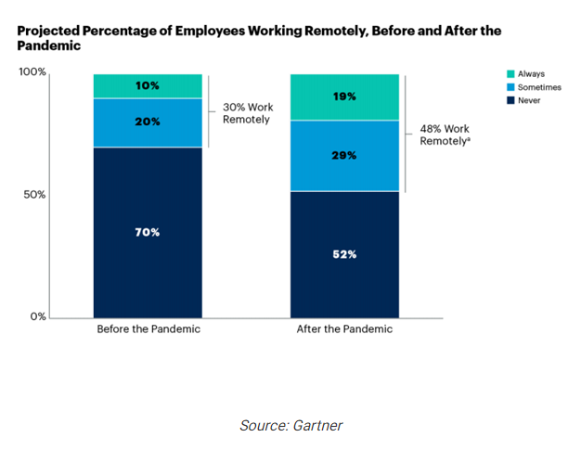
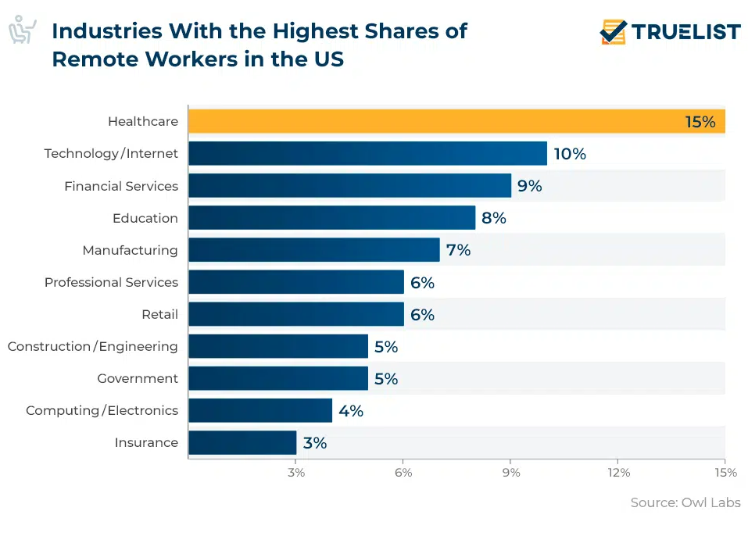
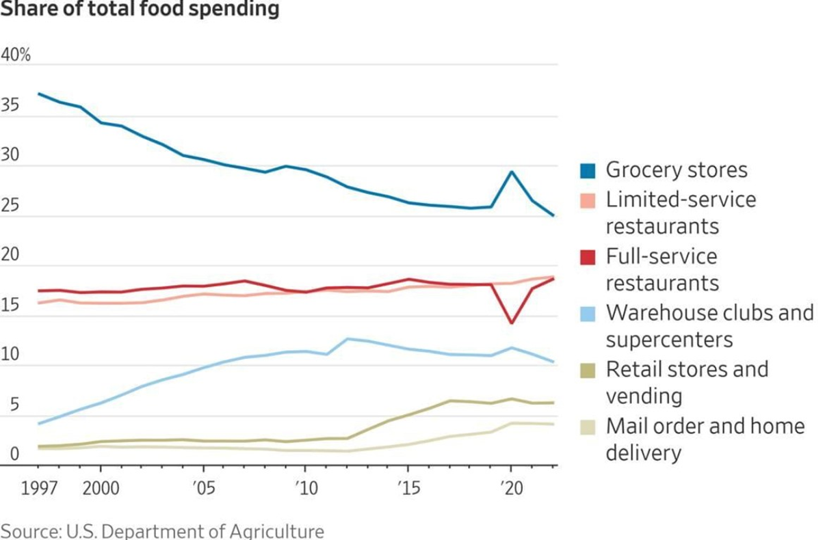

Slide 5
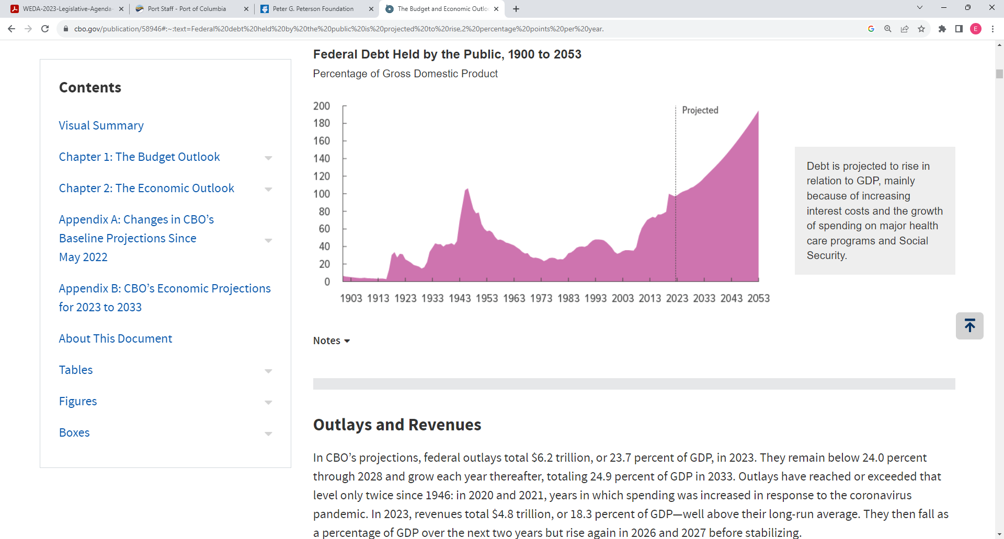
WWII
Pandemic
Great Depression
Great Recession
WWI

Slide 6

Washington State University
School of Economic Sciences
Eric Jessup
Director: Freight Policy Transportation Institute
Research Professor
eric_jessup@wsu.edu
509-335-4987
https://ses.wsu.edu/fpti/freight-data-warehouse/

