Slide 1

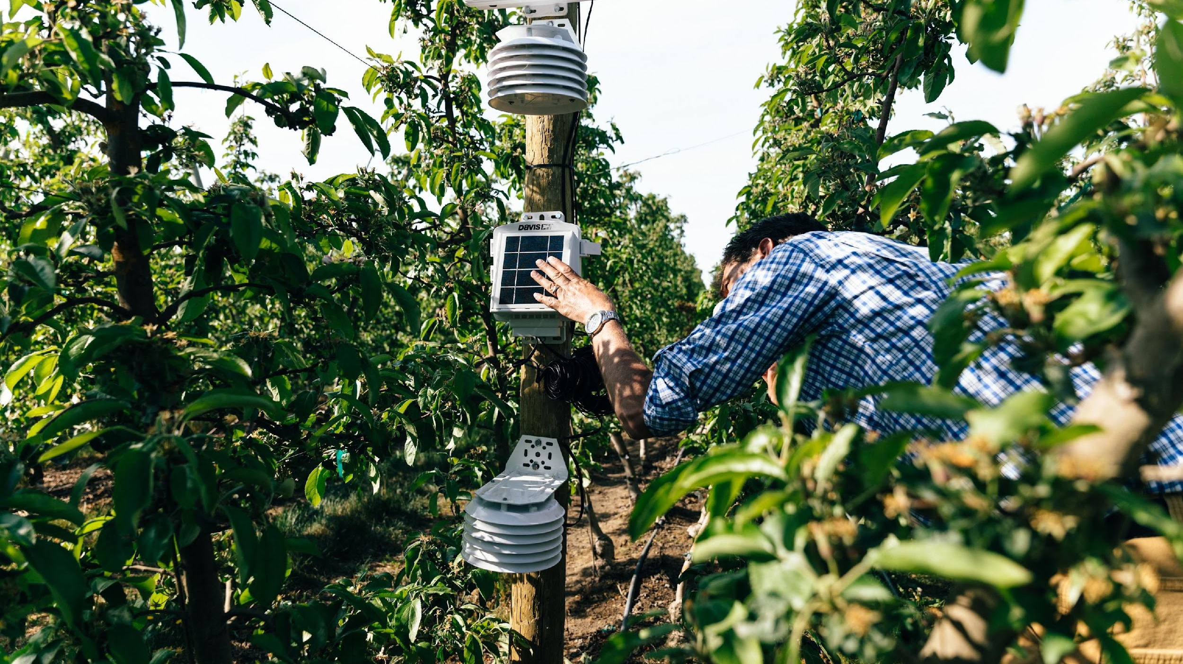

WEDA: Sustainable Ag & Innovative Resource Management
Sustainability
Ag Tech
Data
Innovation
Steve Mantle, Founder & CEO
Steve@innovate.ag / 509-473-0252

Slide 2
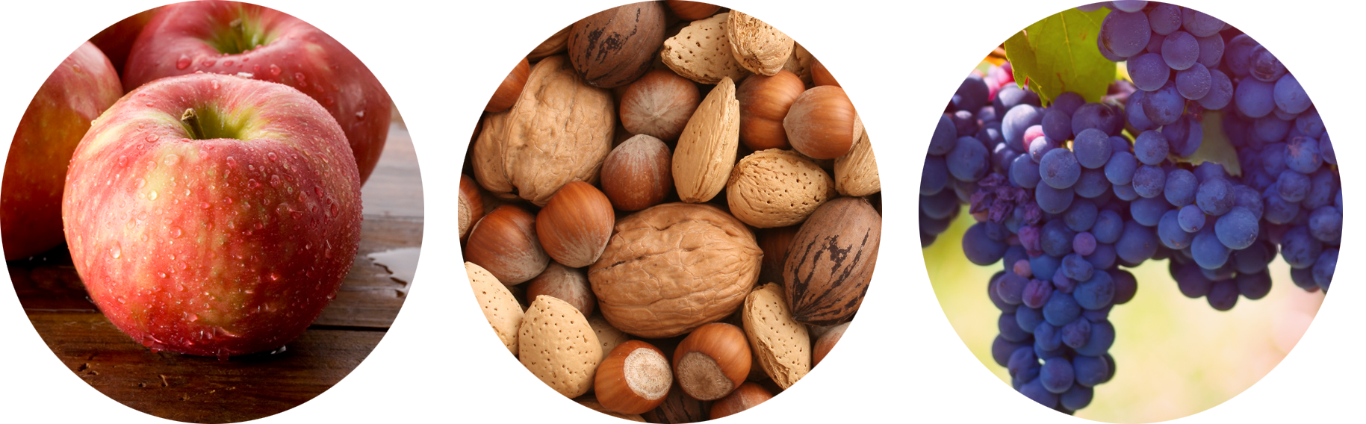
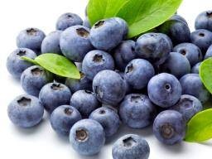
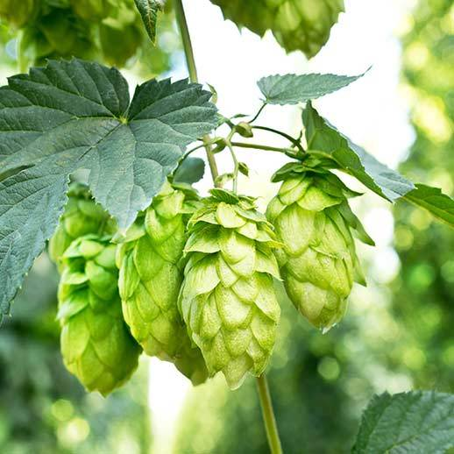
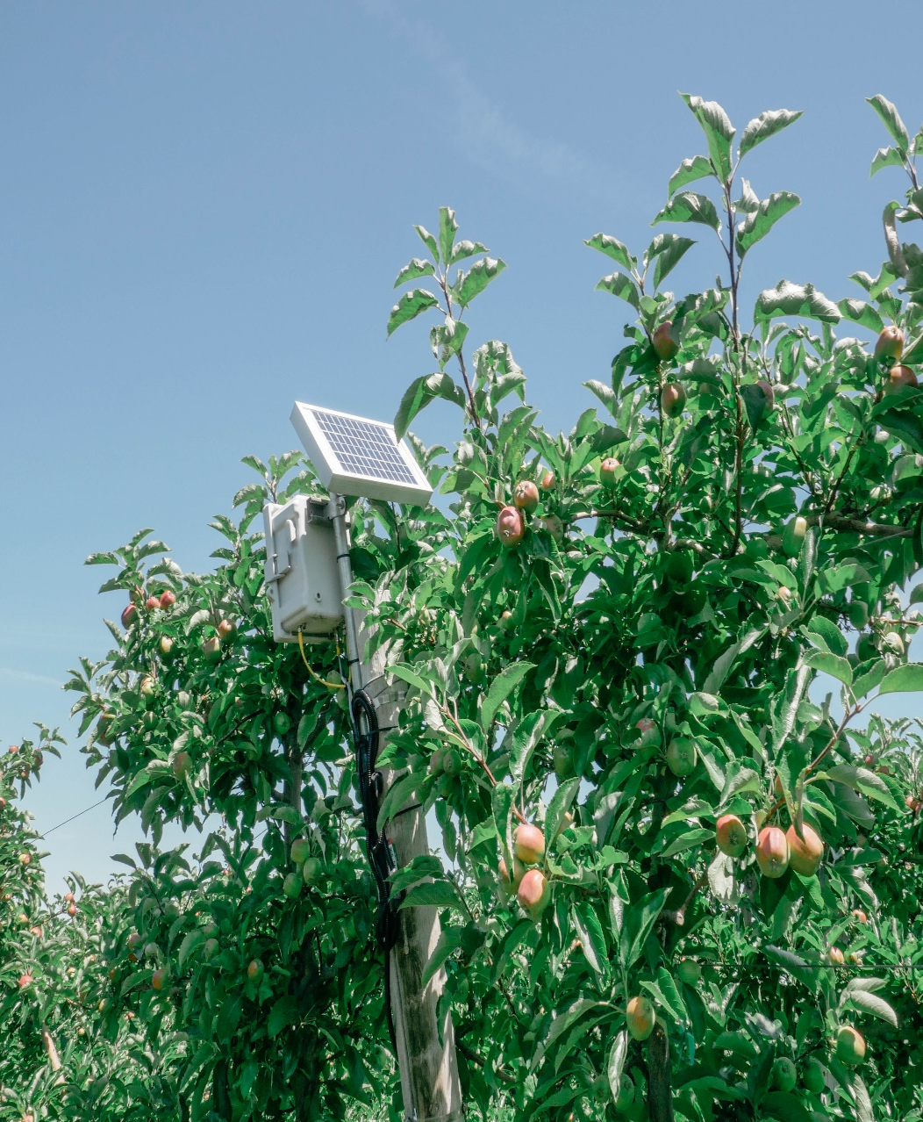
Growers Challenges
Growers need to increase yields – they want higher volumes and a better grade of crop.
But across their orchards and vineyards they see variability – there is a significant “yield gap” between the high and low performing blocks of crops.
Their lives are complicated by the effects of climate change and the imperative to plan for a more sustainable future.
And they lack the tools and data to navigate the complex set of inter-relations between nutrients, water, weather, and economy.
Notes:
Huge demand for food to feed a growing population
In the US alone, ___ farms w/ ___ acres
Midsize farms in the U.S. are dealing with increased regulatory & competitive pressures while facing costs of $14-$20 million a year for irrigation, labor, and chemicals.
Increase pressures is creating more risk for bankers & insurers
Fruit & Nut farms are dealing with increased economic pressures
Foreign competition, labor availability, ​
labor regulations, and environmental changes create undue hardships for growers every year

Slide 3


Yield Estimation Data
Providing yield data representing crop productivity and performance, allowing for more informed decision making and improved efficiency.
Our Promise
Management: Providing precise data to inform company decisions and goal development
Grower: We support efficient, profitable, and sustainable farming
Sales: We support accurate and timely sales operations
Field Optimization Data
Unified farm data empowering precise control of inputs supporting efficient and sustainable farming practices.
Data is the universal language supporting all growing operations
block-to-block & year-to-year
Notes:
Huge demand for food to feed a growing population
In the US alone, ___ farms w/ ___ acres
Midsize farms in the U.S. are dealing with increased regulatory & competitive pressures while facing costs of $14-$20 million a year for irrigation, labor, and chemicals.
Increase pressures is creating more risk for bankers & insurers
Fruit & Nut farms are dealing with increased economic pressures
Foreign competition, labor availability, ​
labor regulations, and environmental changes create undue hardships for growers every year

Slide 4

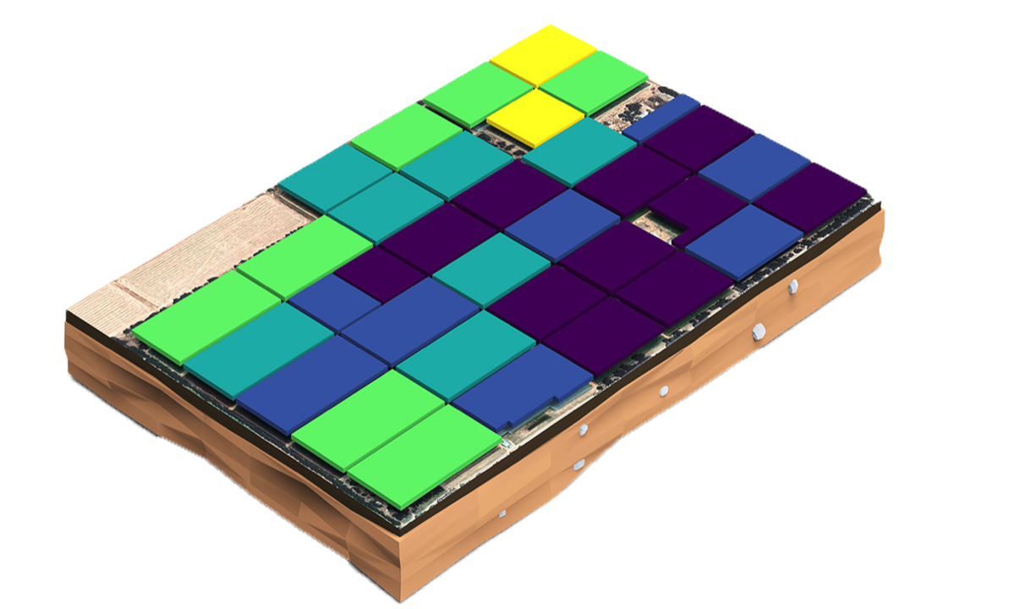
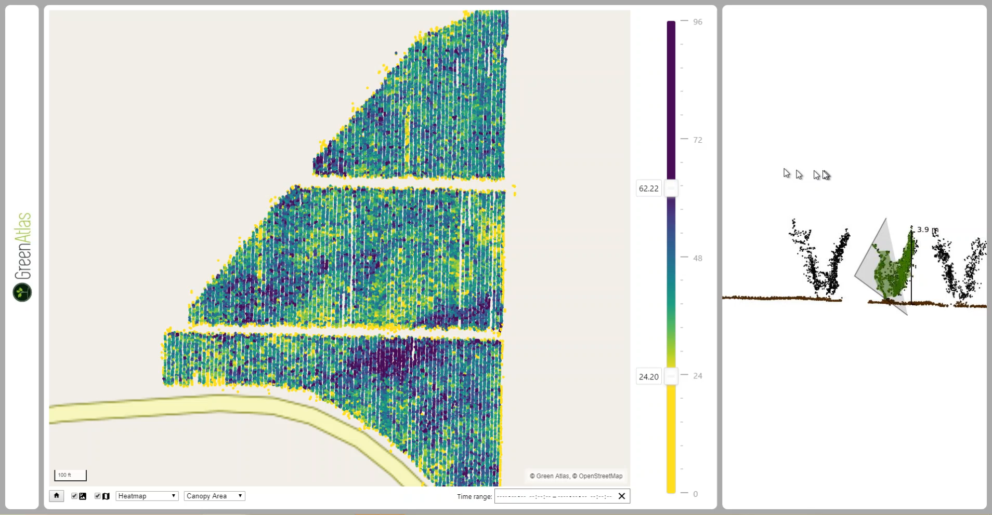
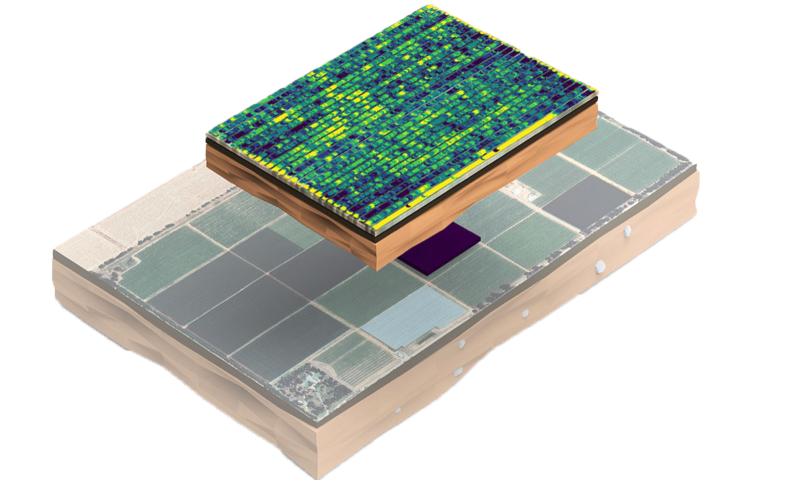
Detail Driven Yield Estimations
Holistic Data Presentation
Tree-to-Tree, Block-to-Block, Farm-to-Farm

Slide 5

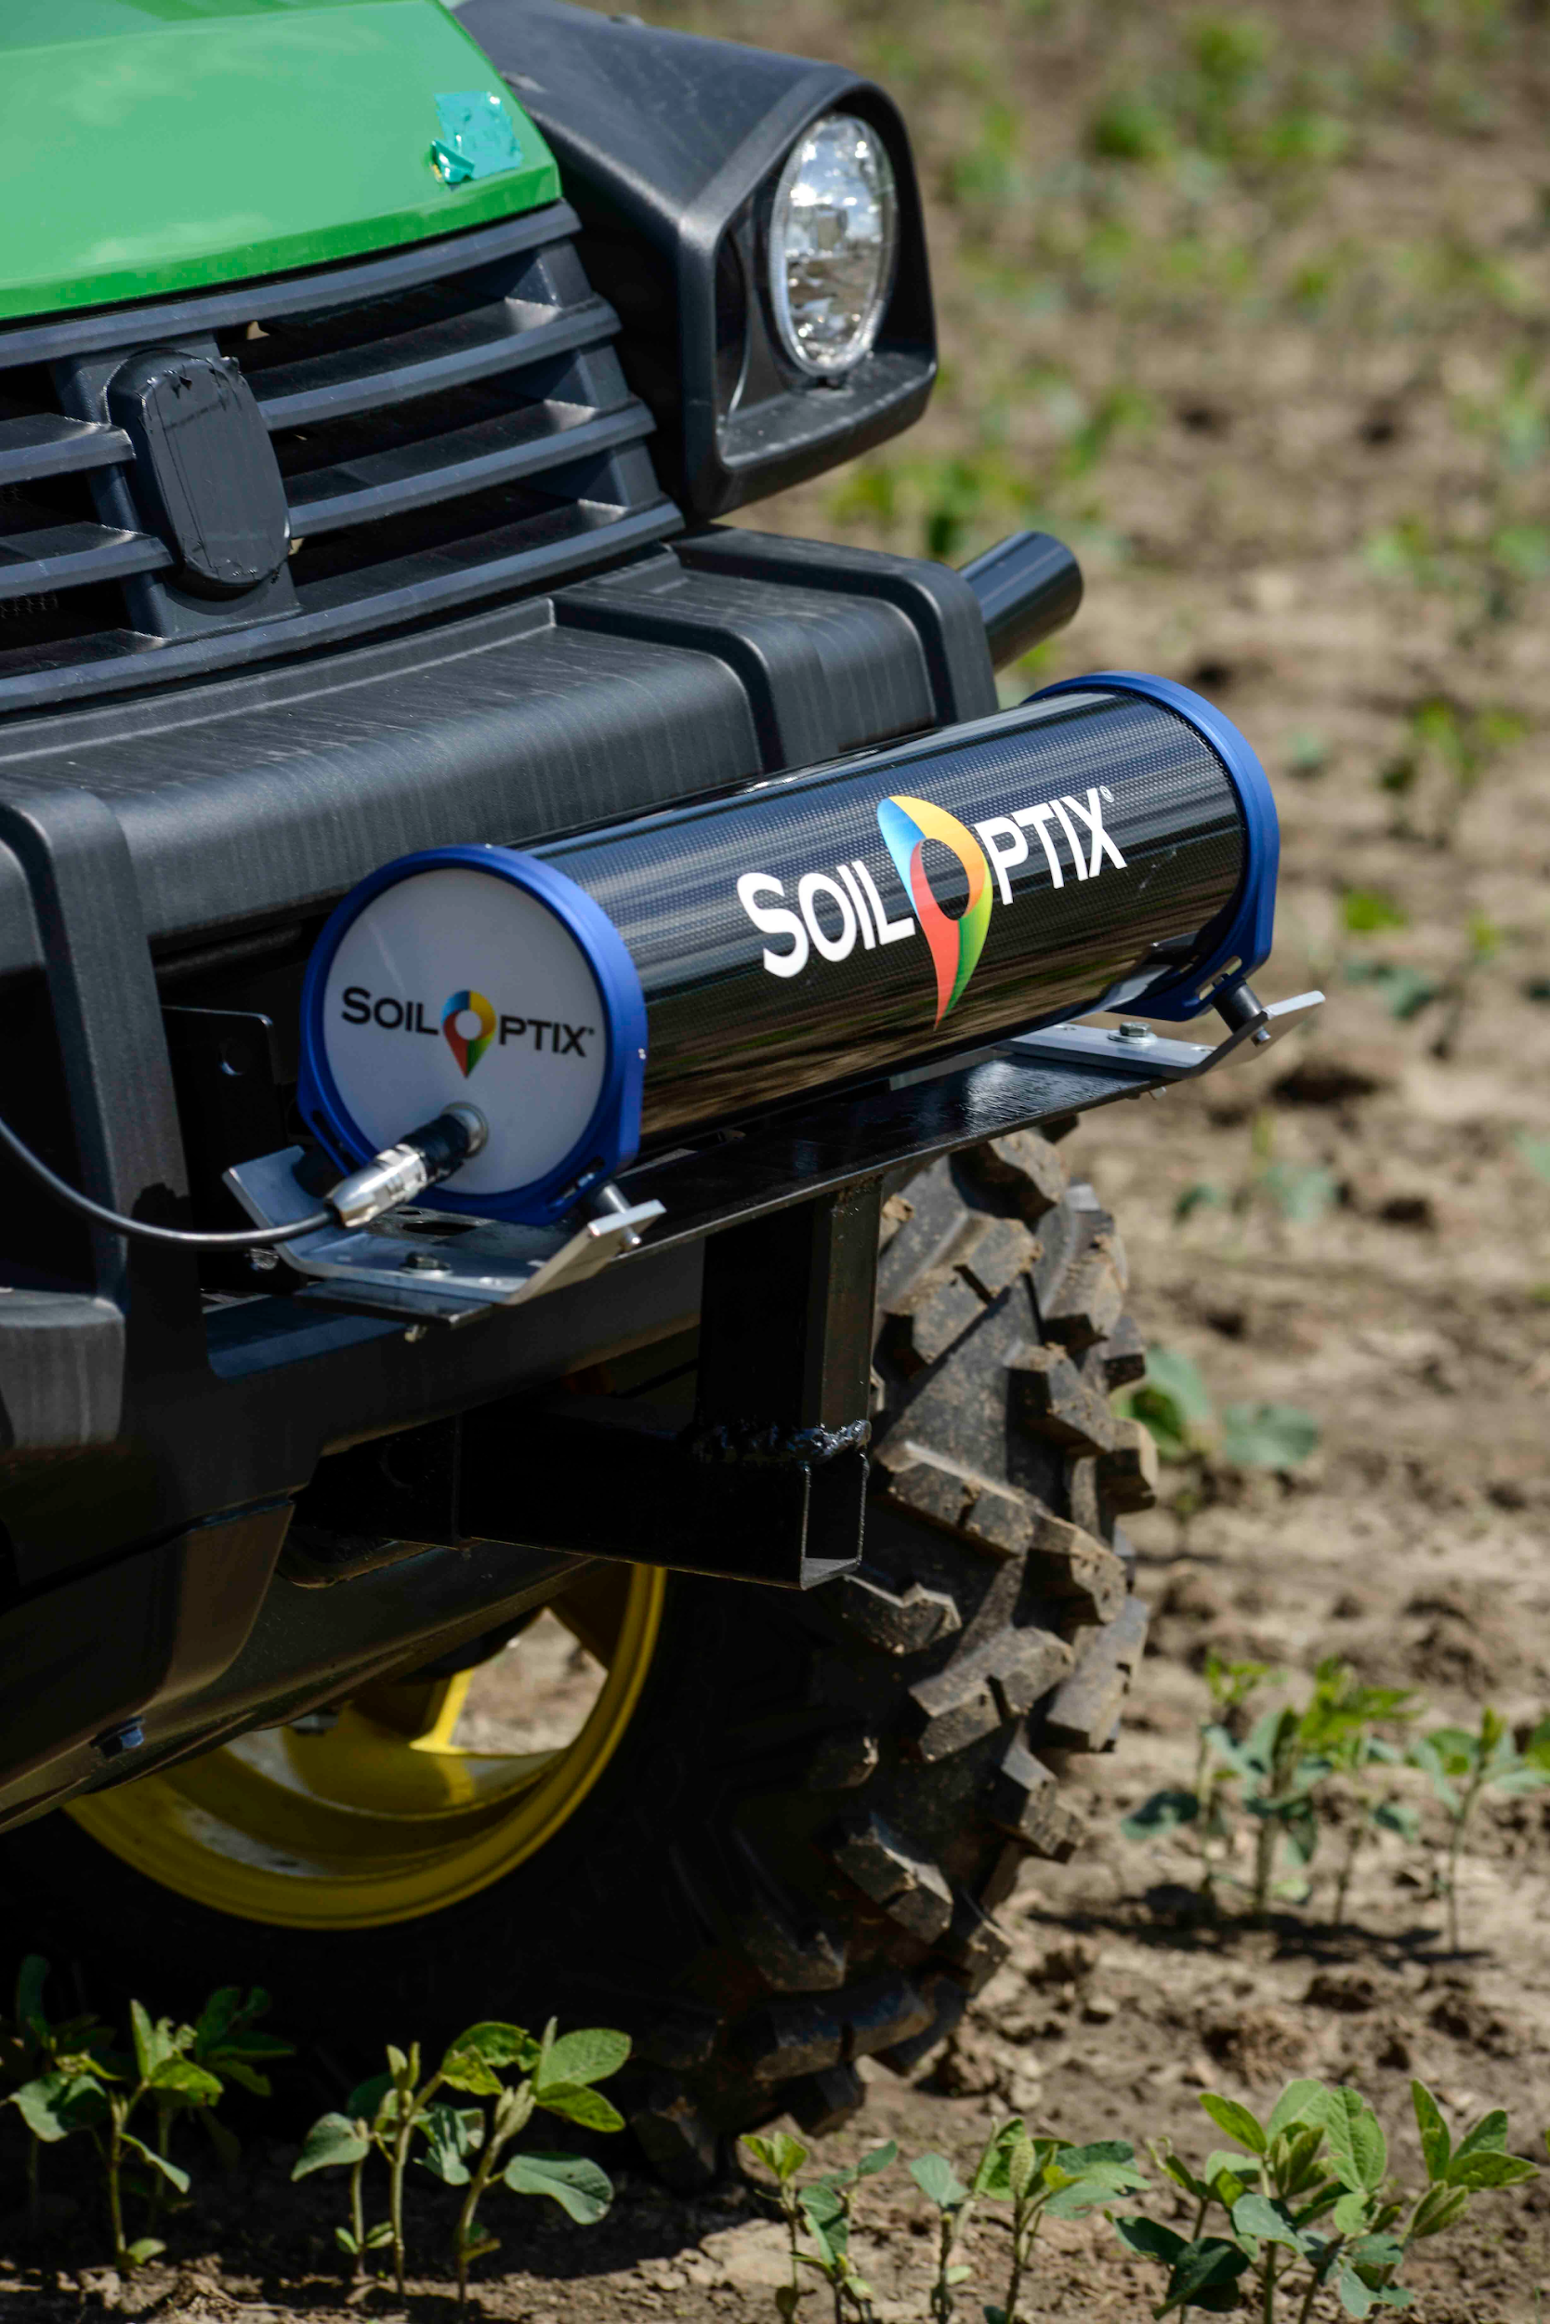
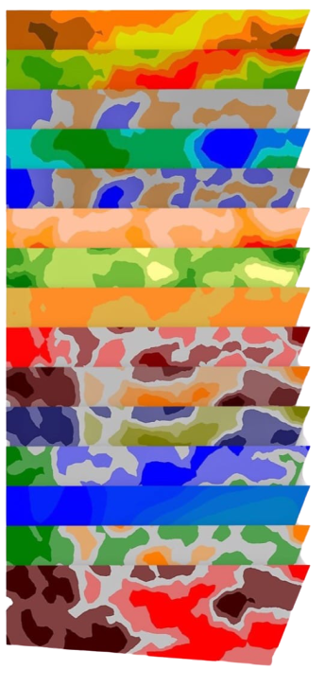
Soil Mapping
Physical Properties
Complex Models
Clay
Cation Exchange Capacity
Silt
Loam
Sand
Organic Matter
Bulk Density
Plant Available Water
Leak ability
Elevation
Micronutrients
Macronutrients
Aluminum
Copper
Manganese
Sulfur
Boron
Iron
Sodium
Zinc
Calcium-Magnesium Ratio
Magnesium Base Saturation
Phosphorous-Bray
Potassium Base Saturation
Calcium Base Saturation
Potassium-Magnesium Ratio
Phosphorus-Ratio
Calcium
pH
Magnesium
Potassium
Nitrate as N
SoilOptix® Soil Mapping- Soil health directly correlates to improved fruit quality. With the highest definition and most detailed field nutrient maps attainable today, growers are now empowered to make better decisions for management and soil stewardship. In order to capture the full potential of their field, growers need to know what the soil is providing them with. With SoilOptix®, growers and agronomists get the most in-depth analysis of their soil with a resolution of approximately 335 points per acre.

Slide 6
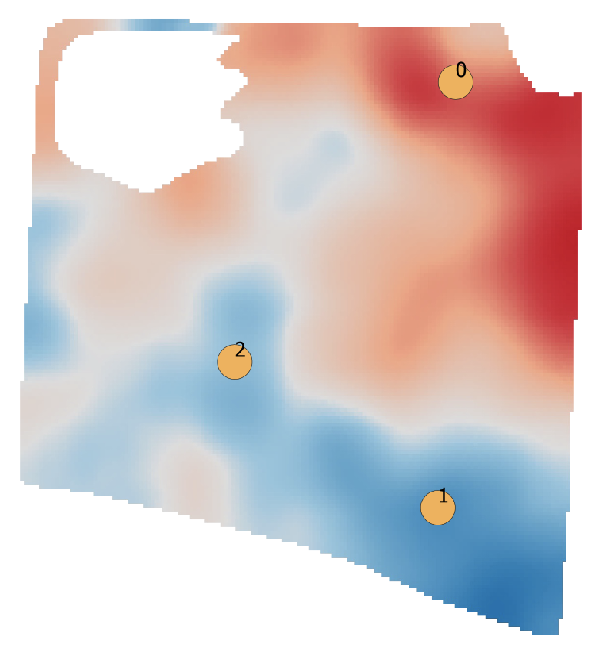
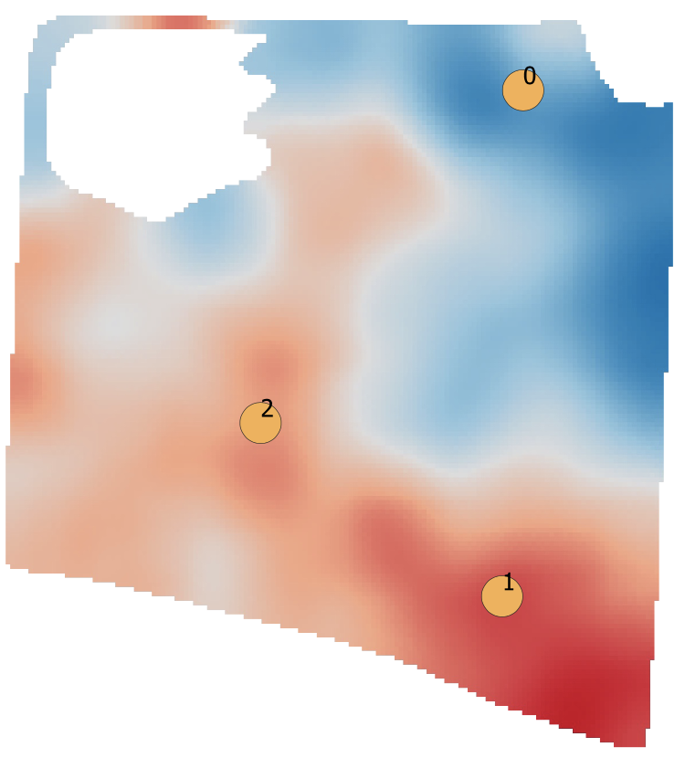
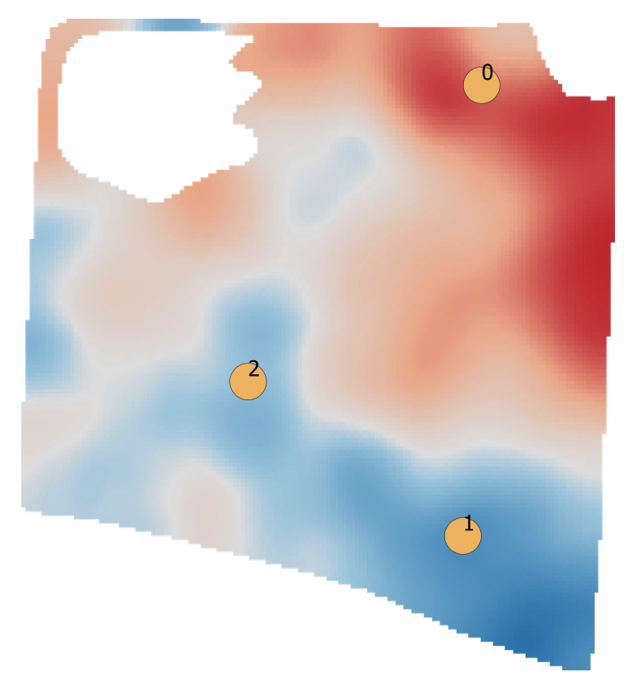
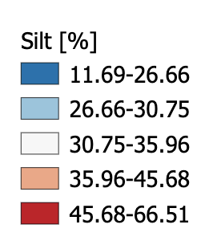
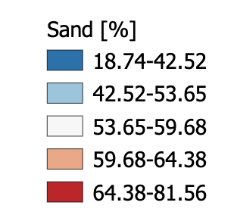
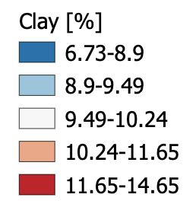
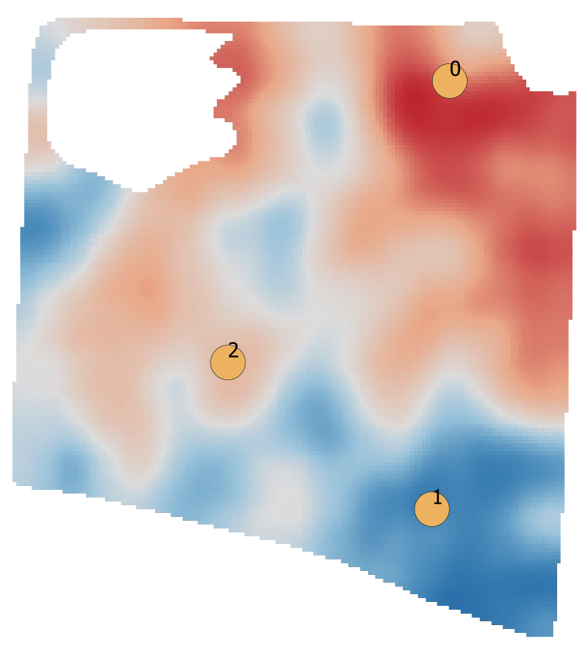

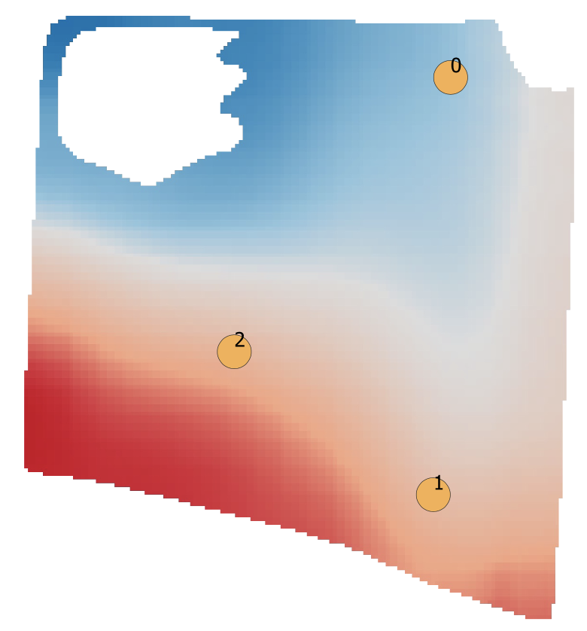
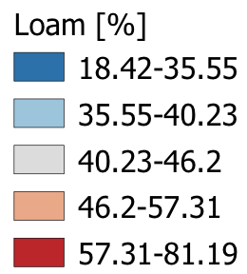
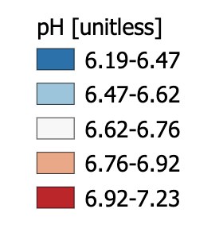
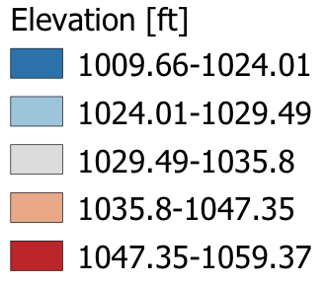
2 scans/year
335 points/acre
Mapping Soil Variability
Silt
Sand
Clay
pH
Loam
Elevation

Slide 7
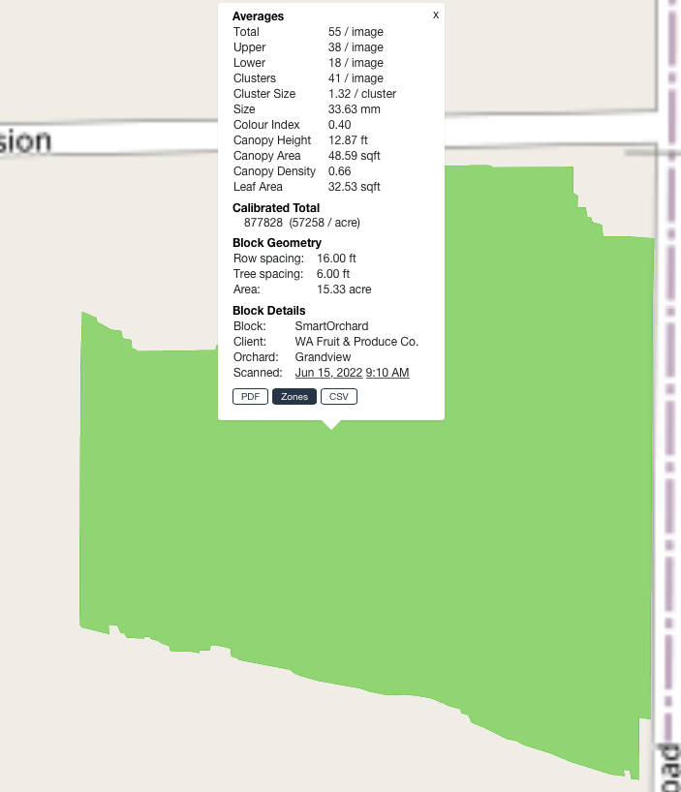
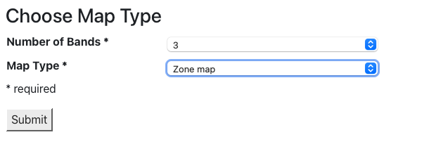
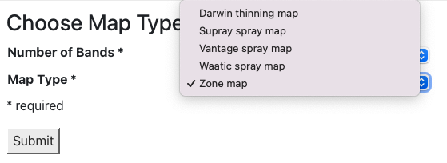
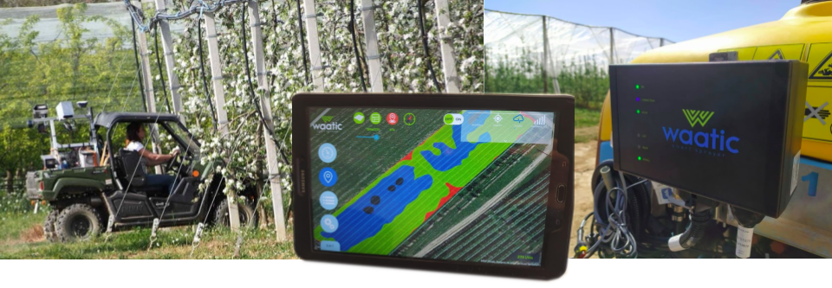
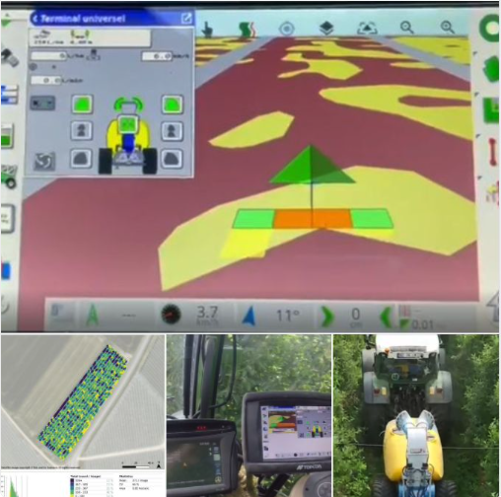
Enabling Spray & Fertility Applications With Task Maps

Slide 8
WEDA: Sustainable Ag & Innovative Resource Management
Sustainability
Ag Tech
Data
Innovation
Steve Mantle, Founder & CEO
Steve@innovate.ag / 509-473-0252

