Slide 1
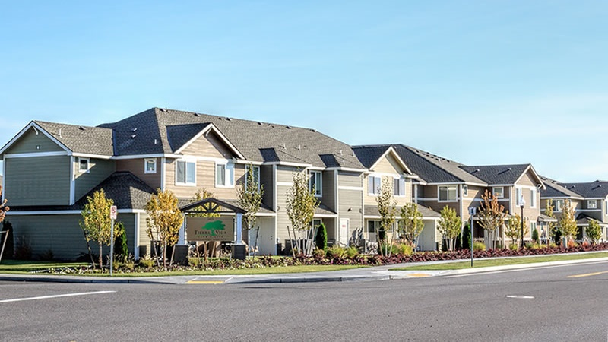
Workforce & Affordable Housing
WEDA Conference
August 2023

Slide 2
Pasco Housing Summary
5.2%
Severely Crowded HHs
54.1%
Cost-Burdened Senior Renters
146%
Population Growth 2000
-58%
Housing Units
2010-2020 vs 2000-2010

Slide 3
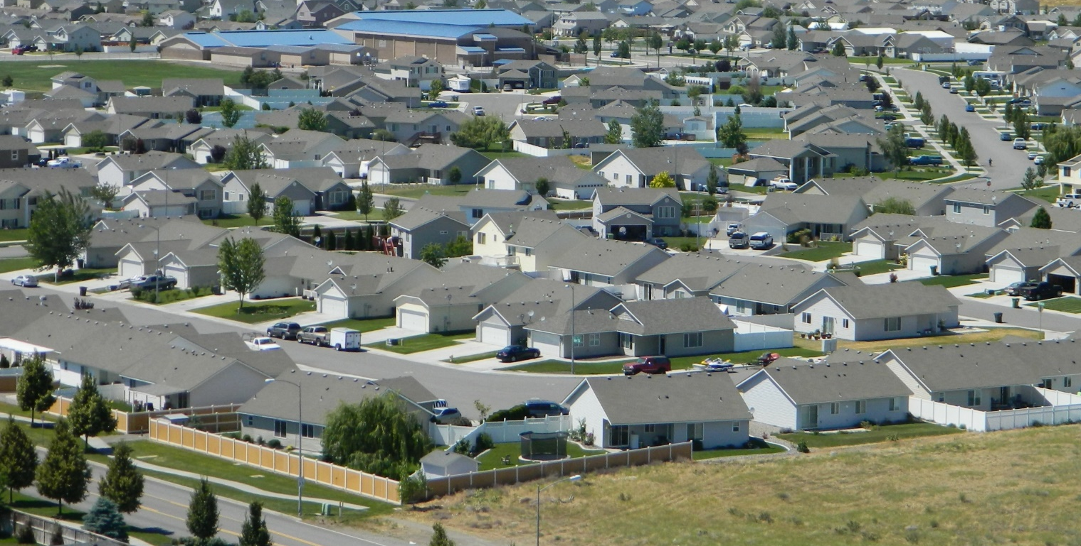
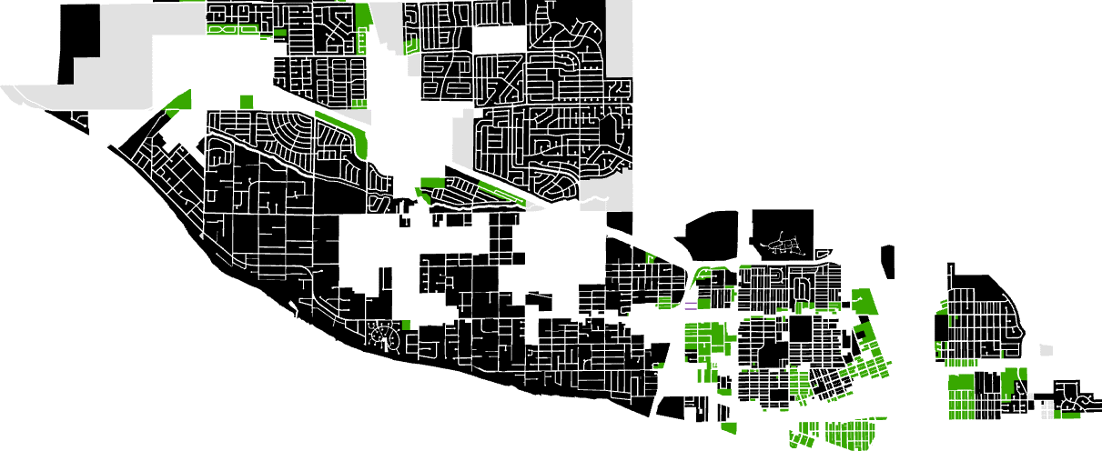
Housing Policies
Prioritized large lots, low-density, single-family detached
Restriction of multi-family homes
Limited flexibility

Slide 4




Increasing Options to Meet Demand
Practical zoning and development standards – Flexibility
Utilize existing and planned infrastructure
Access to destinations:
  Public Schools
  Parks and Recreation
  Hospitals/Health Services
  Public Transportation

Slide 5
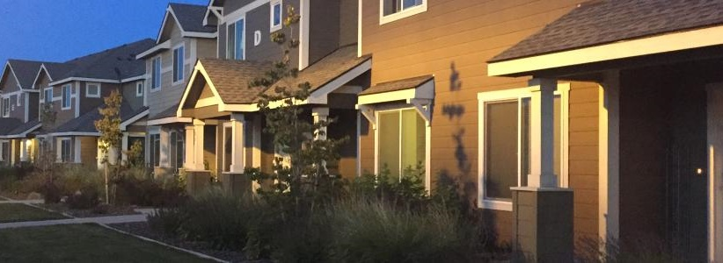
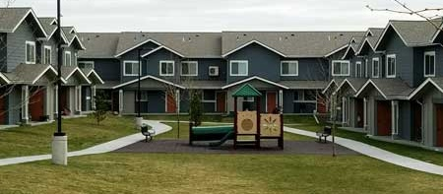
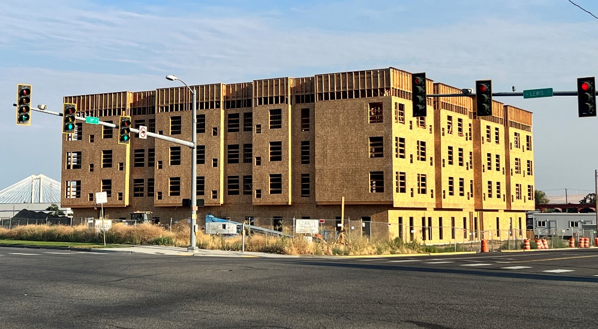

Early Results
- 3,500 + Housing Units Pending
- Accessory Dwellings are POPULAR
- Mixed Housing Type Developments
Jacob B. Gonzalez, Director
Community & Economic Development
gonzalezjb@pasco-wa.gov

