Slide 1

Rural Broadband Infrastructure
Jennie Dickinson, Executive Director, Port of Columbia
August 9, 2023

Slide 2
History of Internet in Columbia County
To what extent have residents, businesses, and public entities in our port district been unable to access affordable and reliable broadband?
Pre-2000 - Everyone using dial-up
Qwest and other phone companies started offering DSL in some communities.
Circa 2000 – local rural electric company formed a subsidiary and started offering point-to-point wireless service. Limited to line of sight.
Circa 2000 - Qwest Long Distance Settlement in the State of Washington. Applied for funds through the Port of Columbia and were awarded $450,000. Funds went to Qwest to install DSL in Dayton.
2010 – NoaNet brought a fiber backbone through Dayton, only hooked up some anchor institutions. Port and City Hall were not included.
2011 to 2020 – ISPs worked to improve service through wireless and cable hybrid systems. No one expressed any interest in building a fiber network.

Slide 3
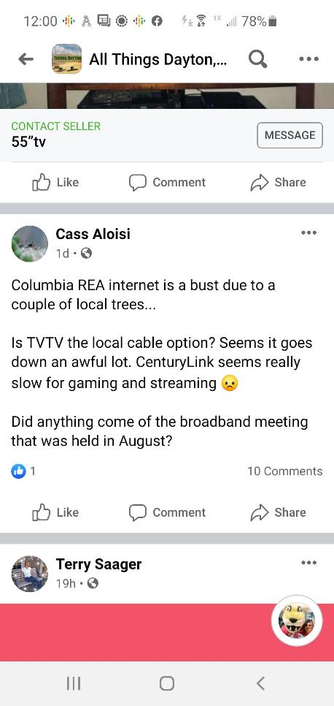
Last Straw
2020 – Pandemic hit. My office used CenturyLink DSL service, which was barely tolerable before and became almost unusable after. The top speed at my office was 10/1 – meaning 10 MB download speed, and 1 MB upload. By state standards this is so slow my office was considered UNSERVED. Only one computer at a time could use Zoom, and that was sometimes sketchy. The DSL became further and further oversubscribed and was barely usable.
2021 – TVTV, the cable company that offered the fastest speeds in the community, shut down with no notice. 35% of the community was left with no service!
2022 – Oversubscribed wireless and DSL in town, many rural customers only have ViaSat as an option, which is terrible, and Starlink is only available in certain areas, still has line of sight issues, and costs $600 for equipment and $120 a month. Yeah, its decent service, but how many rural residents can afford it?

Slide 4
Why the Port?
Private businesses don’t want to invest, or can’t afford to wait for a return on investment, in our small communities.
We’ve waited 20 years for the private sector to step up. It hasn’t happened.
We believe our Port’s role is to make the investment in infrastructure that the private sector is reluctant to make, and lease fiber strands to the private ISPs so they can focus on providing service.
The private sector’s role in our case will be “drive” on the fiber “road” we are constructing and deliver service to the customer.
We can leverage our ability to find grant and low-interest loan dollars for infrastructure along with our ability to tolerate a longer return on investment time frame, which reduces the risk to the private sector and makes them more willing to provide service in our community.
What is the role of the public sector in expanding access to affordable broadband? What is the role of the private sector? How does the port leverage public resources to encourage or support private investments in broadband?

Slide 5
Phase 1 - Dayton Community Broadband Project
Applied for funds to CERB in May of 2021. Received word in July that we were awarded a $2 million grant, but must match it with $500,000.
Wrote grants and made presentations to city and county to pull together matching funds. Received $13,500 from the Dayton/Columbia County Fund, $15,000 from Warren Community Fund, $20,000 from Sherwood Trust, $90,000 from Columbia County (ARPA funds), and $330,000 from the City of Dayton (ARPA funds). Port is paying the remainder ($65,000)

Slide 6
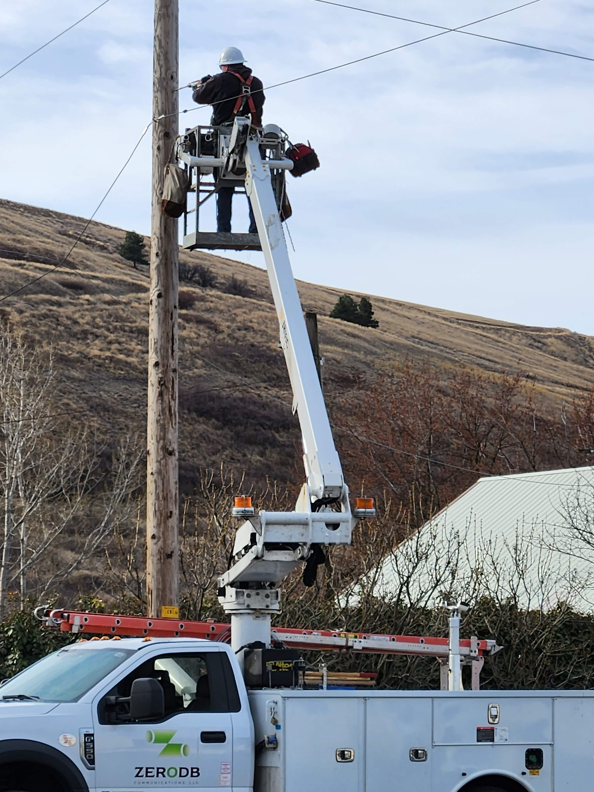
Dayton Project - infrastructure
Last Mile, Dark Fiber Project
Fiber-to-the-Premises – 1,287 homes and businesses encompassing
the entire City of Dayton and adjacent, more dense areas in
the unincorporated county
Port of Columbia will construct and own the fiber plant and will own
the drops to each premises.
Private sector ISPs will lease fiber from the Port and provide service
to the customer. The lease revenue will be used to operate and
maintain the fiber plant - $20 per customer per month.
Port will remodel an existing space in a Port-owned building in the
Rock Hill Industrial Park to serve as the Colocation Center
(brains of the system).
Both the NoaNet and CenturyLink fiber backbones run through this
industrial park in a utility corridor 50 feet from this building.
Port of Columbia will contract with an outside company for maintenance and operations support.

Slide 7
Service
The Port will own the fiber network – basically, the wires.
The ISPs will place equipment at each end - in the Port’s colocation center, the “brains” of the system, and in the customer’s homes. They will light the fiber in between and provide internet service.
The project will offer speeds that meet or exceed 1 GB symmetrical service. That means 1 gigabyte upload and download speeds.
Because the system is open access, the private companies will have to compete for customers. This will drive prices down.
Two ISPs are offering 1 GB symmetrical service for $70 per month!
ISPs must offer low-income options.

Slide 8
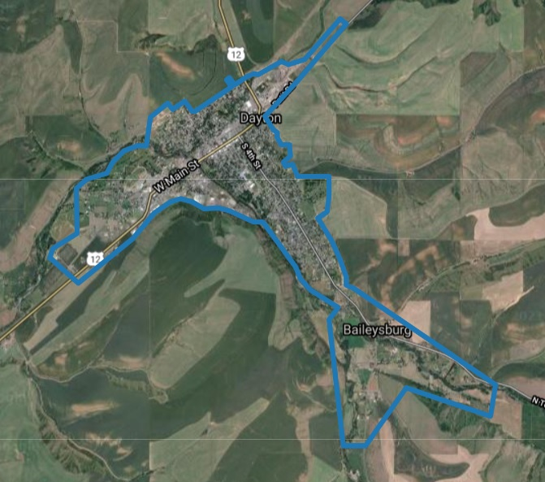
Project Area
Project encompasses 100% of premises in the City of Dayton and a portion of the county.
Will serve the Port’s Rock Hill Industrial Park (city) and the Blue Mountain Station Artisan Food Park (county), which house a total of 24 business tenants.
Designed to reach the Columbia County Fire District Station to the east, a low-income mobile home park to the west, and several business located in the county to the south.
Network Operations Center
Rock Hill
Industrial Park
Blue Mountain
Station

Slide 9
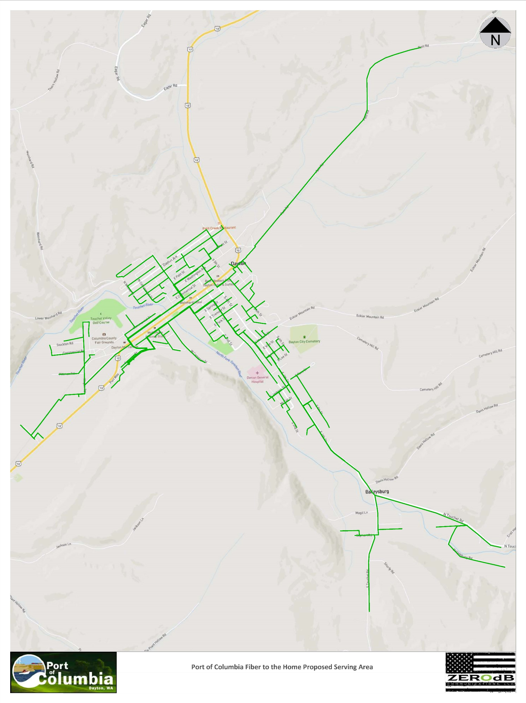
Private Partners
Emerge by Inland Cellular
Columbia iConnect
PocketiNet
Each private partner is required to participate in federal programs that offer lower-priced service to income-qualified residents.

Slide 10
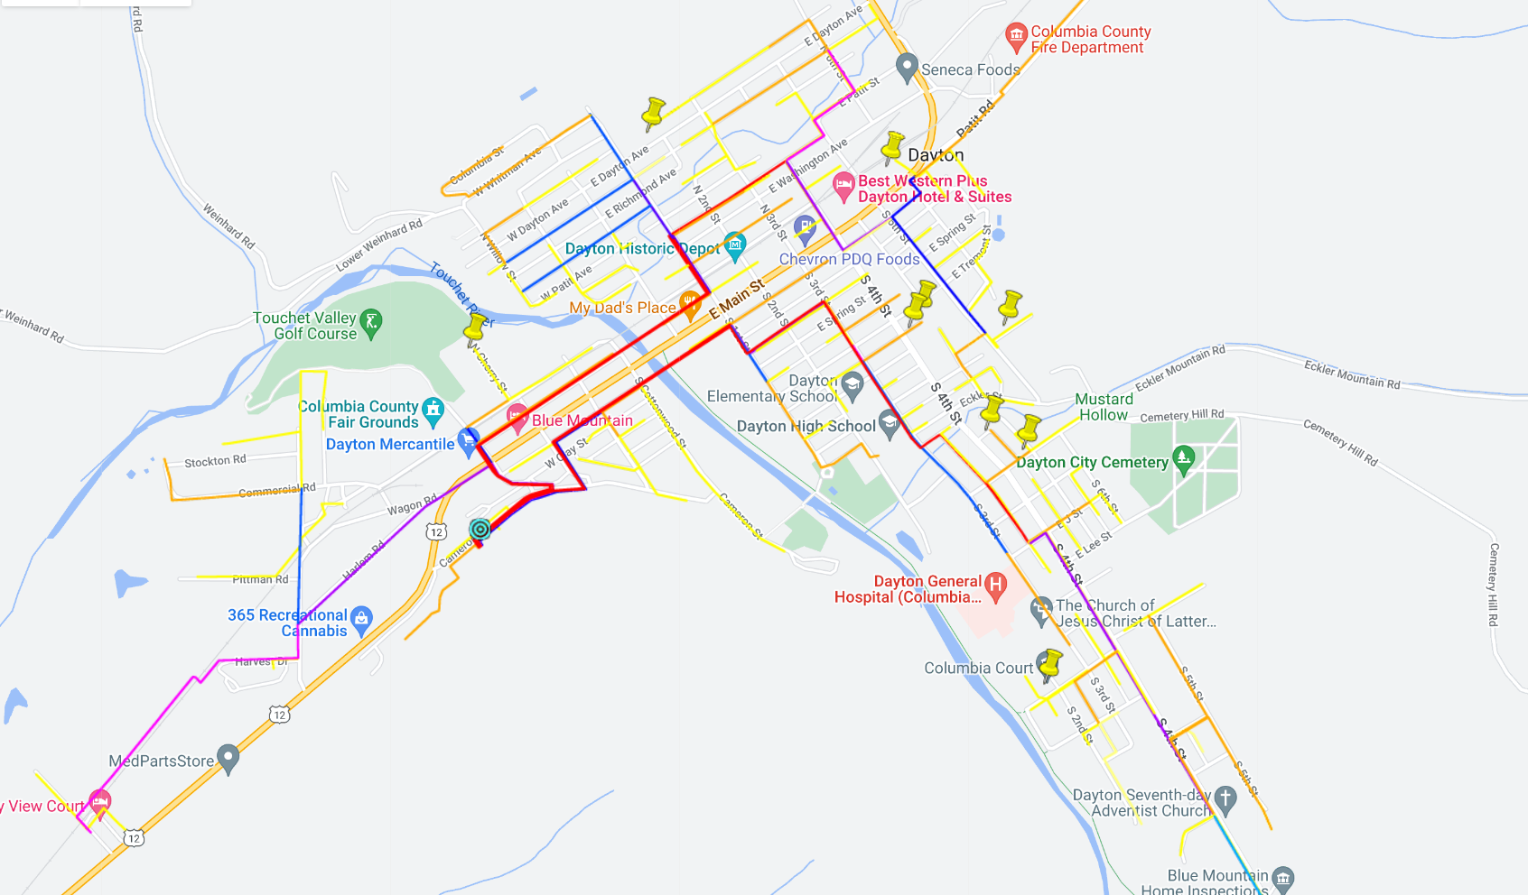

Slide 11
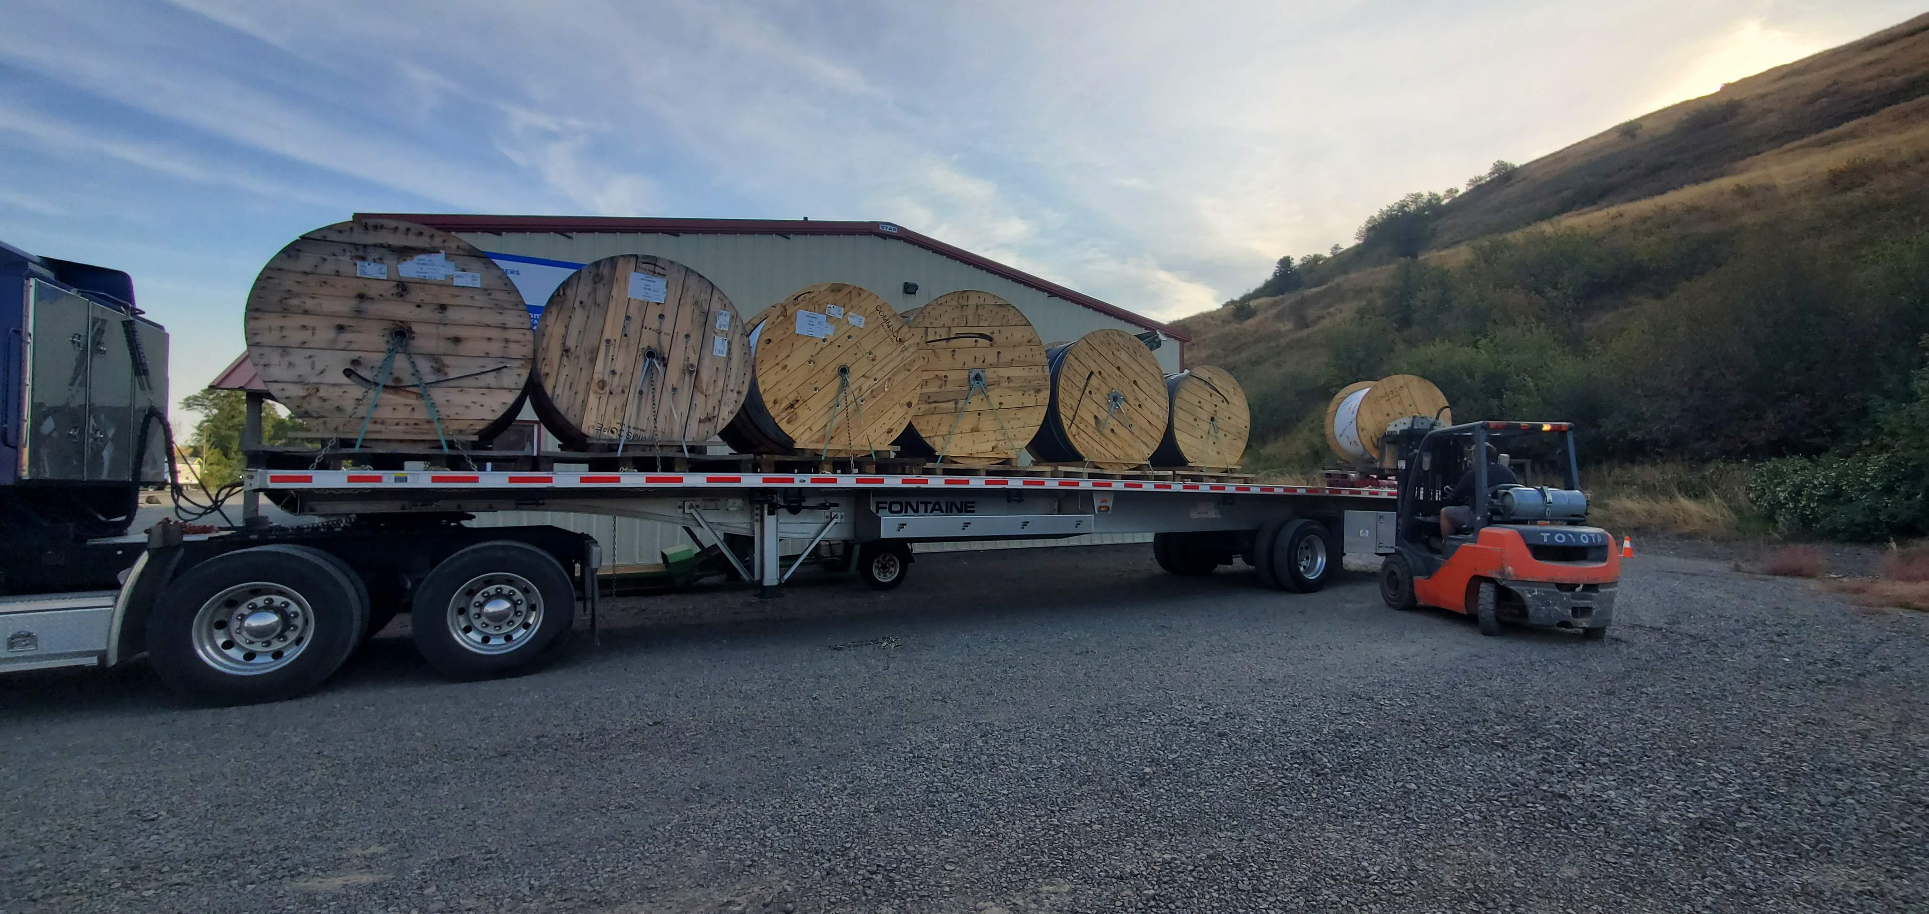

Slide 12
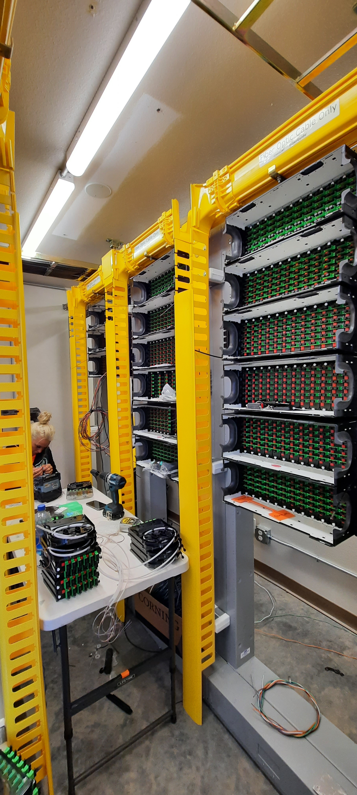
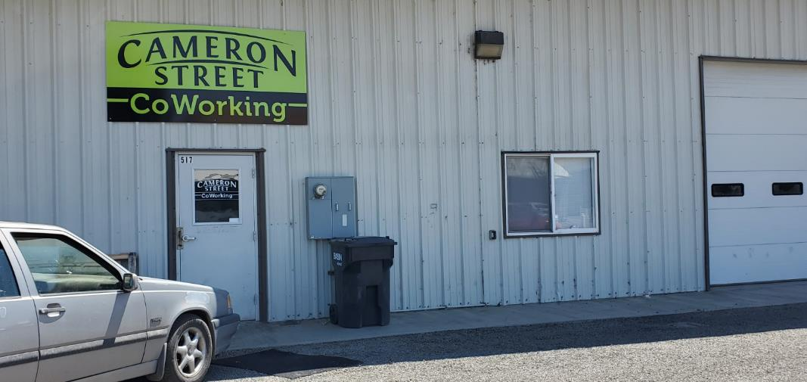
Repurposed a room in an existing Port building for the Colocation Center.

Slide 13

Phase 2 - Touchet Valley Broadband Project
Applied for and received $1.165 million from the Public Works Board to extend the fiber optic system west of Dayton along Highway 12.
Project includes a cell tower, a state park, and about 48 farms and residences.
The cost per premises to connect to fiber is way more than the Dayton project.
Dayton – Approx. $2,000 per premise; Touchet Valley – approx. $23,000
We have a philosophical decisions to make as a community, a state, and a country: Do we consider broadband internet service to be an essential utility that warrants the type of investment we made in rural electrification? Or do we extend fiber as far as we can, offer the best wireless and other service we can to the rural areas, and call it good?
WHO DECIDES THIS!?!
This Photo by Unknown Author is licensed under CC BY-SA

Slide 14
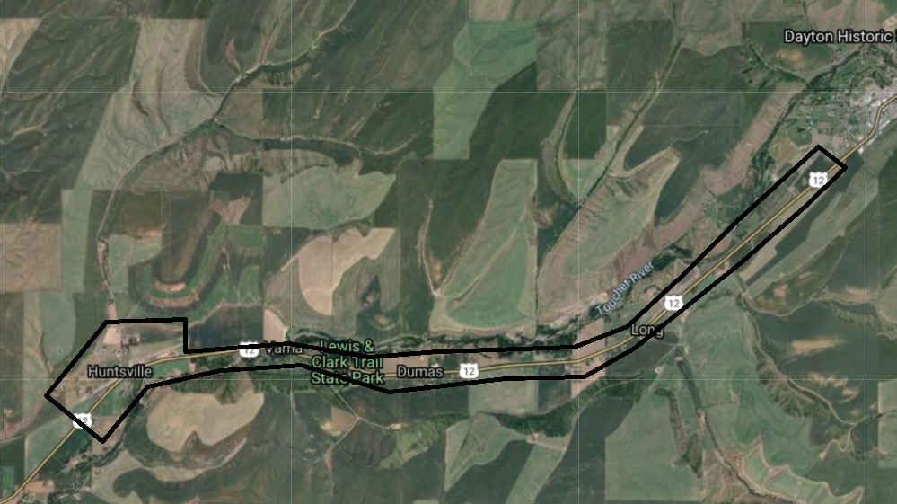

Slide 15
Phase 3 – The Wheatfields
Our Port District, which is the ADO for Columbia County, led the effort on behalf of our county to write a Digital Equity Plan and an Infrastructure Plan for submission to the State Broadband Office.
This plan will be used to determine the best way to serve the sparely populated areas of the county.
The cost to bring fiber to every home is extremely high – upwards of $80,000 per connection, with some over $200,000.
Our beautiful hills and valleys make line-of-site wireless service difficult at best and unable to serve most of the area, and the large distances between homes drives up the cost of direct fiber.
StarLink is expensive and also has line-of-site issues. You must have a clear view of the north sky.
Back to my philosophical question of…What do we do? That’s the infrastructure puzzle we’ll be working to sort out next.

Slide 16
How Will This Infrastructure Help Dayton & Columbia County?
Improve our attractiveness to young people and professionals – imperative!
Improve ability to telework – COVID Lesson!
Help us attract workforce.
Meet health insurance directives to keep the elderly and chronically ill in their homes longer with remote monitoring and access to records. They have to have reliable internet service to be able to do this.
Enable our youth and residents of all ages to access education online.
Business development, retention, and attraction.
Quality of life!!!

Slide 17

Conclusion
Our community was desperate for reliable, affordable internet service.
We waited and waited for the private sector to step up. They never did.
This infrastructure investment is
the right thing to do for our
residents and businesses and for
the future of our community!

