Slide 1
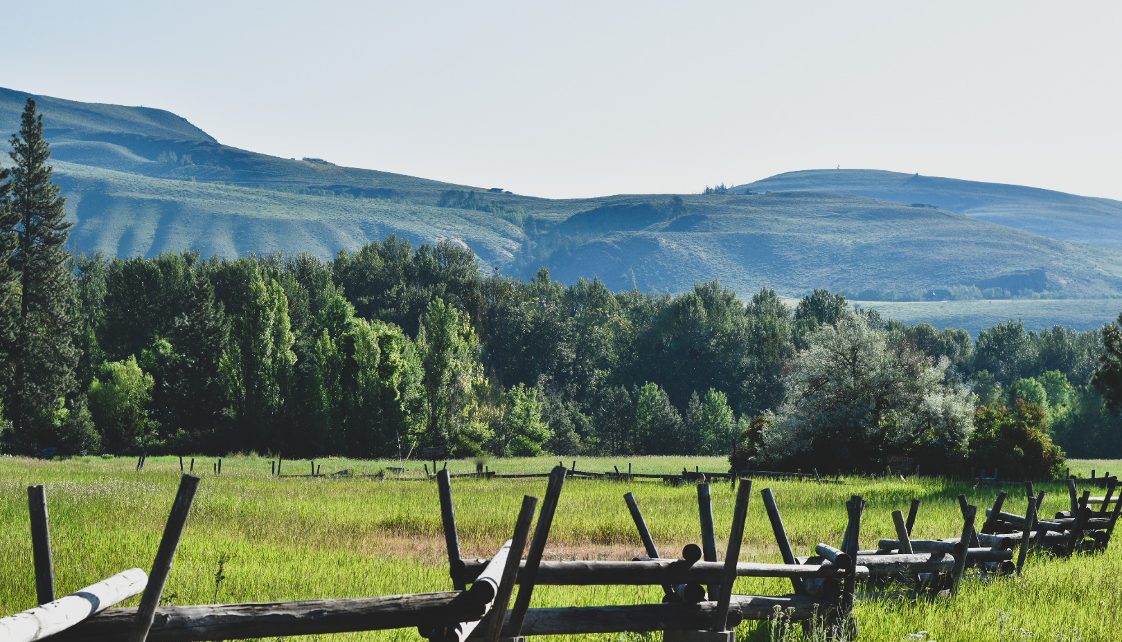
Film Office
Production Directory
Location Database
Permit Information
Film Liaison Network
WASHINGTON FILMWORKS
Creating Opportunities in Film Since 2006
a
Film Funding
Production Incentive
Small Budget Production
Workforce Development
Notes:
Amy Lillard, ED of Washington Filmworks and Whipsmart
Washington Filmworks: Two Divisions
Production Incentive Program
Funding Assistance for Projects
Film Office
Abundance of resources
Location Database
Crew and Production Resource Database
Real Live Person in our Office to Answer Your Questions
Whipsmart
Information
Business resources for creatives (in language we can all understand)
Finances: How to pay your taxes as a freelancer
Equity: How to be a better ally
Inspiration
Stories from creative entrepreneurs about how they are making a living being creative
Trivia

Slide 2
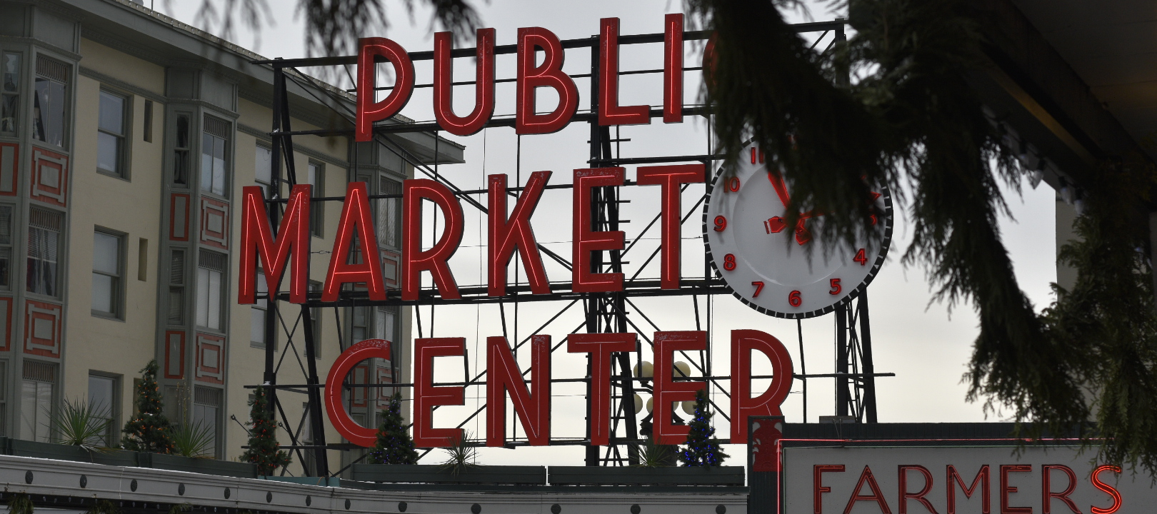
INCENTIVE IMPACT
131
PROJECTS
$418M
ECONOMIC IMPACT
25,900
JOBS
Notes:
Sample of what’s happened here.

Slide 3




ECONOMIC IMPACT: Z NATION
5 SEASONS: 69 EPISODES
~$34.5M
DIRECT SPEND INTO ECONOMY
$34/HR
100+
125-150
4+ MONTHS
AVGERAGE WAGE WITH BENEFITS
WASHINGTON RESIDENTS HIRED FOR EVERY EPISODE
DIFFERENT LOCAL WA BUSINESSES USED PER EPISODE
PRODUCTION PER SEASON PLUS ADDITIONAL PREP + POST
PHOTO CREDIT: DANIEL SCHAEFER

Slide 4
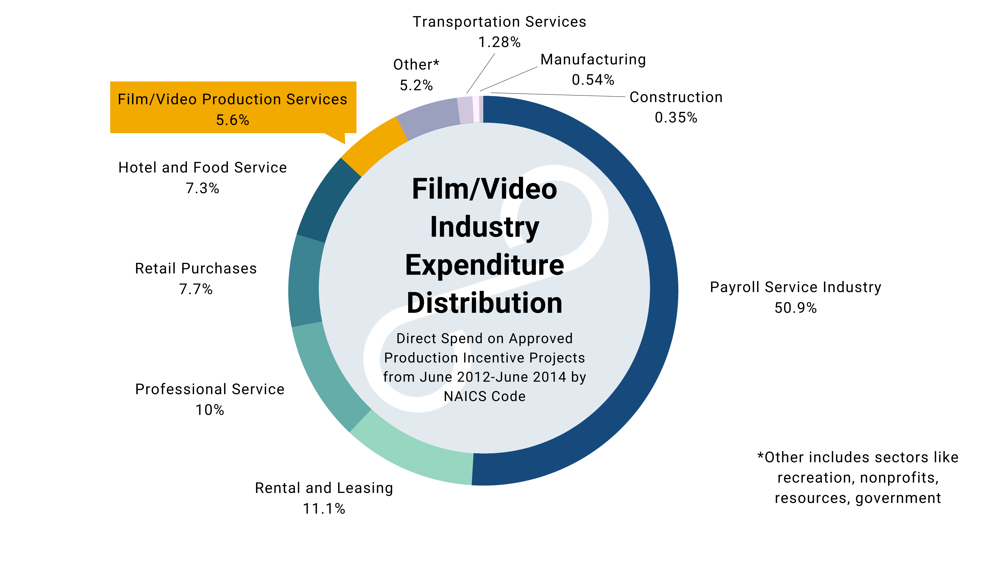

COMMUNITY IMPACT

Slide 5






UNAPOLOGETIC ADVOCATES
FOR CREATIVE PEOPLE
Resources
HOW TO GUIDES
CHEAT SHEETS
NETWORKING
+ MORE
Kevin |
NW CORNER GOODS + ROVER
Betania |
BRISTLE + STICK
Umi + Perris |
eTc TACOMA/eTceTera
INSPIRATION + INFORMATION

