Slide 1
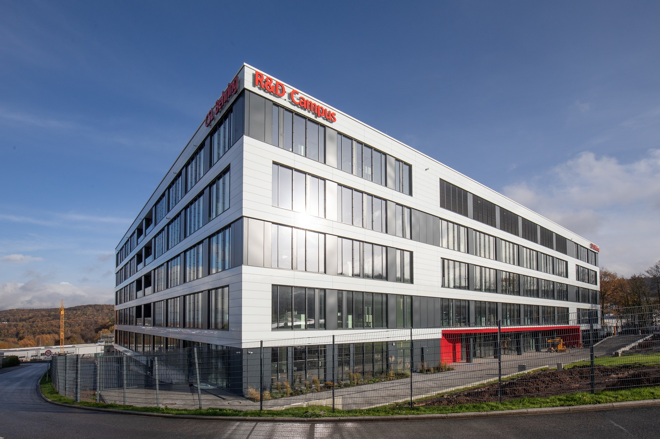
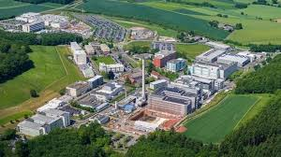
Using stable producer cell lines for manufacturing of lentiviral vectors in perfusion mode
Holger Laux

Slide 2
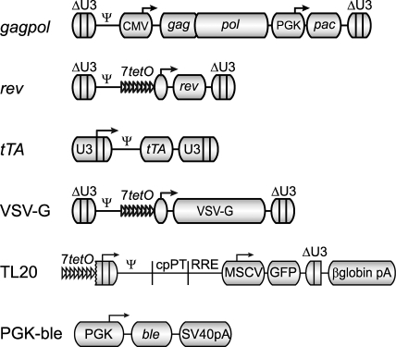
Stable packaging cell lines GPRG and GPRTG (CYTEGRITY™)
HEK293T
γ -retroviral transductions
gag
pol
GP
Adherent
tTA
Rev
tTA
Rev
Tat
Packaging Cell line
GPR
GPRT
VSVG
VSVG
GPRG
GPRTG
Inducible lentivirus production (TET-OFF system)
  → Reproducible, scale-up options, lower costs
Improvement by suspension adaptation
  → Facilitates scalability, product consistency and safety (serum-free), increase titers
Challenge
  TET-OFF system: large scale doxycycline removal
Producer cell line

Slide 3
Stable adherent pools from GPRTG expresses higher titer compared to GPRG and HSC transduction capacity of LVV expressed in GPRTG is higher compared to GPRG
GPRG (G)
GPRTG (TG)

Slide 4
Bioreactors show superior process performance over flatware
Advantages of bioreactor processes
High automation
Robust perfusion process
3-times higher yield (Carbo vs. Flatware)
Advantages of bioreactor processes
Smaller footprint
Highly automation
Robust 8 harvest-day perfusion process
3-times higher yield per cm² (Carbo vs. Flatware)
Univercells Carbo 10 m² | Univercells Hydro 2.4 m² | CS10 cell stack
7.3E+06 TU/cm² /run | 4.7E+06 TU/cm² /run | 2.4E+06 TU/cm² /run

Slide 5
Robust purification platform delivering high yields from adherent bioreactor harvests
H1
H2
H3
H4
H5
H6
H7
Process step | Infectious titer step yield | Volume
Bioburden filtration | 95 – 100 % | 3 x 45-55 L
Mustang Q AEX | 40- 60 % | 3 x 3 L
TFF | 90 – 100 % | 3 x 110 mL
Freeze/thaw | 95 - 100 % | 3 x 110 mL
Sterile filtration | 80 – 90 % | 330 mL
Total process | 35 - 45 %
Filtration
AEX
TFF
Freeze
Filtration
AEX
TFF
Freeze
Filtration
AEX
TFF
Freeze
Thaw
Sterile Filtration
LVV produced from 10 m² Carbo bioreactor:
330 mL at 1-2 e9 TU/mL (3.3 – 6.6 e11 TU per run)
One lot purified LVV (frozen)

Slide 6
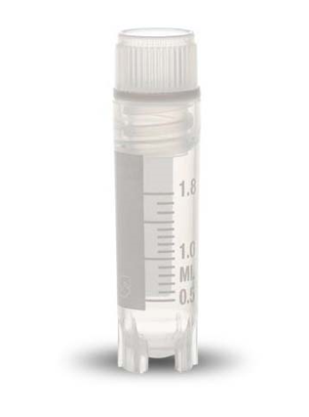
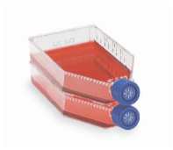
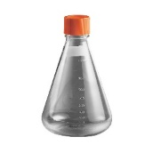
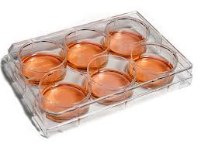
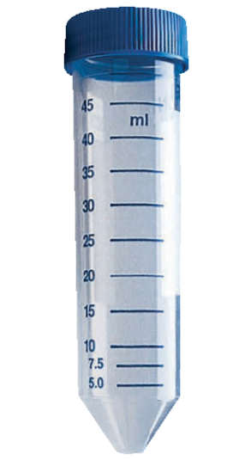
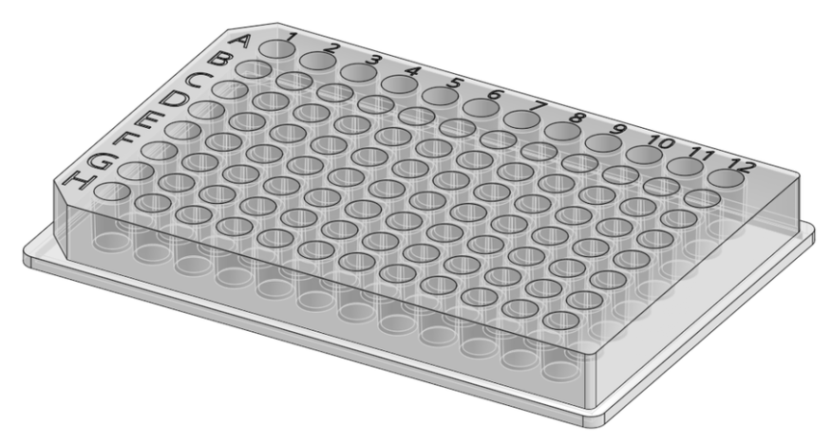
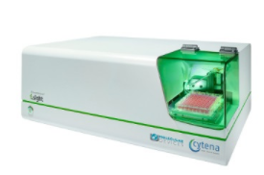
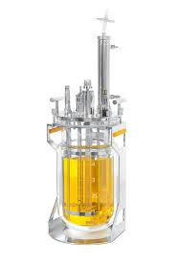
Suspension adaptation and stable producer cell line generation
I. Suspension adaptation
FBS removal
Cell banking
MCB
24 h
II. Stable producer pool generation
Antibiotic selection
Pool evaluation in semi-perfusion mode by daily centrifugation
GPRG/GPRTG suspension
Stable producer pools
Concatemer transfection
Stable producer pools
Monoclonal producer cell lines
III. Single cell sorting
250 clones
Single cell printer
Screening and 70 days stability assessment
IV. Manufacturability assessment
Perfusion process development

Slide 7
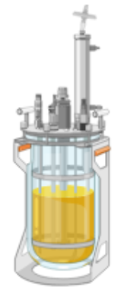
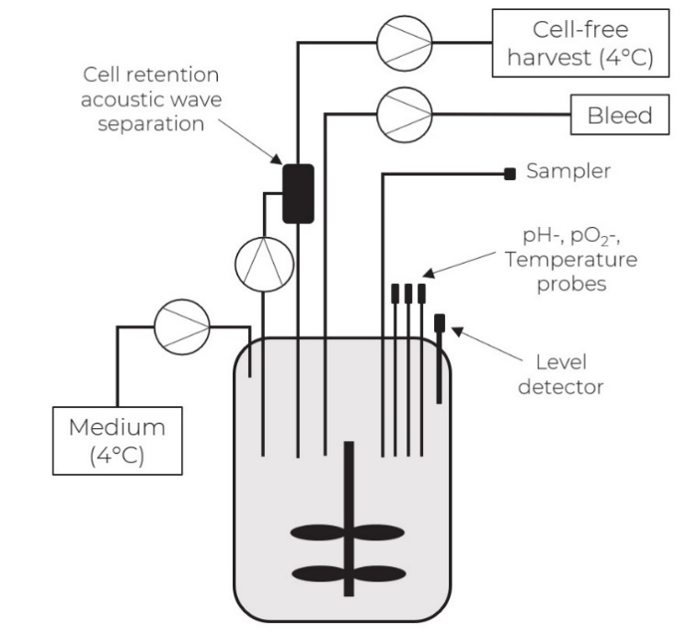
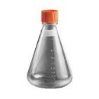
Removing doxycycline in 5 L bioreactor scale ➔ Comparison of three induction methods
Bioreactor seed expansion with doxycycline to high VCD
I. Manual centrifugation
II. Cell washer
III. „Dilution method“
Set-up production bioreactor
5 min @ 200 g
Medium
Direct inoculation
~1:7 dilution
Medium change
Based on acoustic wave separation
Waste
Satellite (shake flask)

Slide 8
Infectious titers and cell specific productivities
Comparable results between induction methods
Yield per bioreactor up to > 6 x 10¹¹ TU

Slide 9
Maximilian Klimpel
Why moving to suspension cell culture and is it worth the effort? Yes!
Suspension pools have in average a 2.5 fold higher infectious titer/ml compared to adherent pools
Increased safety profile for suspension process (no FBS)
Significant cost savings by use of chemically-defined medium for suspension process (35 €/L vs. 90 €/L)
Better scalability
* Cell number/ml is ca. 2 fold higher in suspension compared to adherent process

Slide 10
Maximilian Klimpel
Outstanding long productivity for LVV producer cell lines
Manufacturability assessment
TET-OFF challenge solved by dilution-upon-inoculation method
3 of 4 clones show stable productivity for > 15 days → expected target duration for commercial production
Process at least two times longer compared to the adherent bioreactor process (up to 8 days)
Significant higher overall TU yields

Slide 11
Tobias Brandt & Jessica Vogel
Downstream suspension process adaptation completed
Infectious titer yield adherent/suspension
Infectious titer yield suspension process 2.0
Bioburden filtration
>90% / 80-85 %
80-85 %
Round 1 process parameter optimization
Process 2.0 with new process steps
→ Still acceptable
Mustang Q purification
30-40 % / <2%
40-50 %
Process yield about 50-60%
→ Mustang Q failed
est. Q2-24
TFF
>90 % / 30-50%
>90 %
→ TFF performed badly
Sterile Filtration
>80 % / >80 %
>80 % / >80 %
Process yield about 30%

Slide 12

Stability study of 3 clones per cell type
14 days
14 days
14 days
14 days
15 days
6 clones
(3 per cell type)
5 productions
Stability criterium < 25 % titer decrease
  GPRTG 2 of 3 clones stable for 71 days
  GPRG 1 clone stable for 71 days
  Production in semi-perfusion mode

Slide 13
Summary and outlook
Fully developed adherent cell culture bioreactor perfusion process at scale for Phase 1/2 studies
High yield purification process including sterile filtration of highly concentrated solutions
Optimized suspension bioreactor perfusion process for further process intensification
Cytegrity cell line available for licensing! Want to know more?
Check out the literature
  Cytegrity cell line: Throm, RE, et al. (2009), Blood. May 21;113(21):5104-10. doi: 10.1182/blood-2008-11-191049
  Suspension bioreactor: Klimpel, M, et al. (2023), Biotechnology and Bioengineering,1-17. https://doi.org/10.1002/bit.28413
  Sterile Filtration: Vogel, JE, et.al. (accepted at Journal of Biotechnology, coming soon)
Contact us
  Meet me here at the conference (Holger.Laux@cslbehring.com)
  Licensing questions: Jason Newman (Jason.newman@cslbehring.com

Slide 14
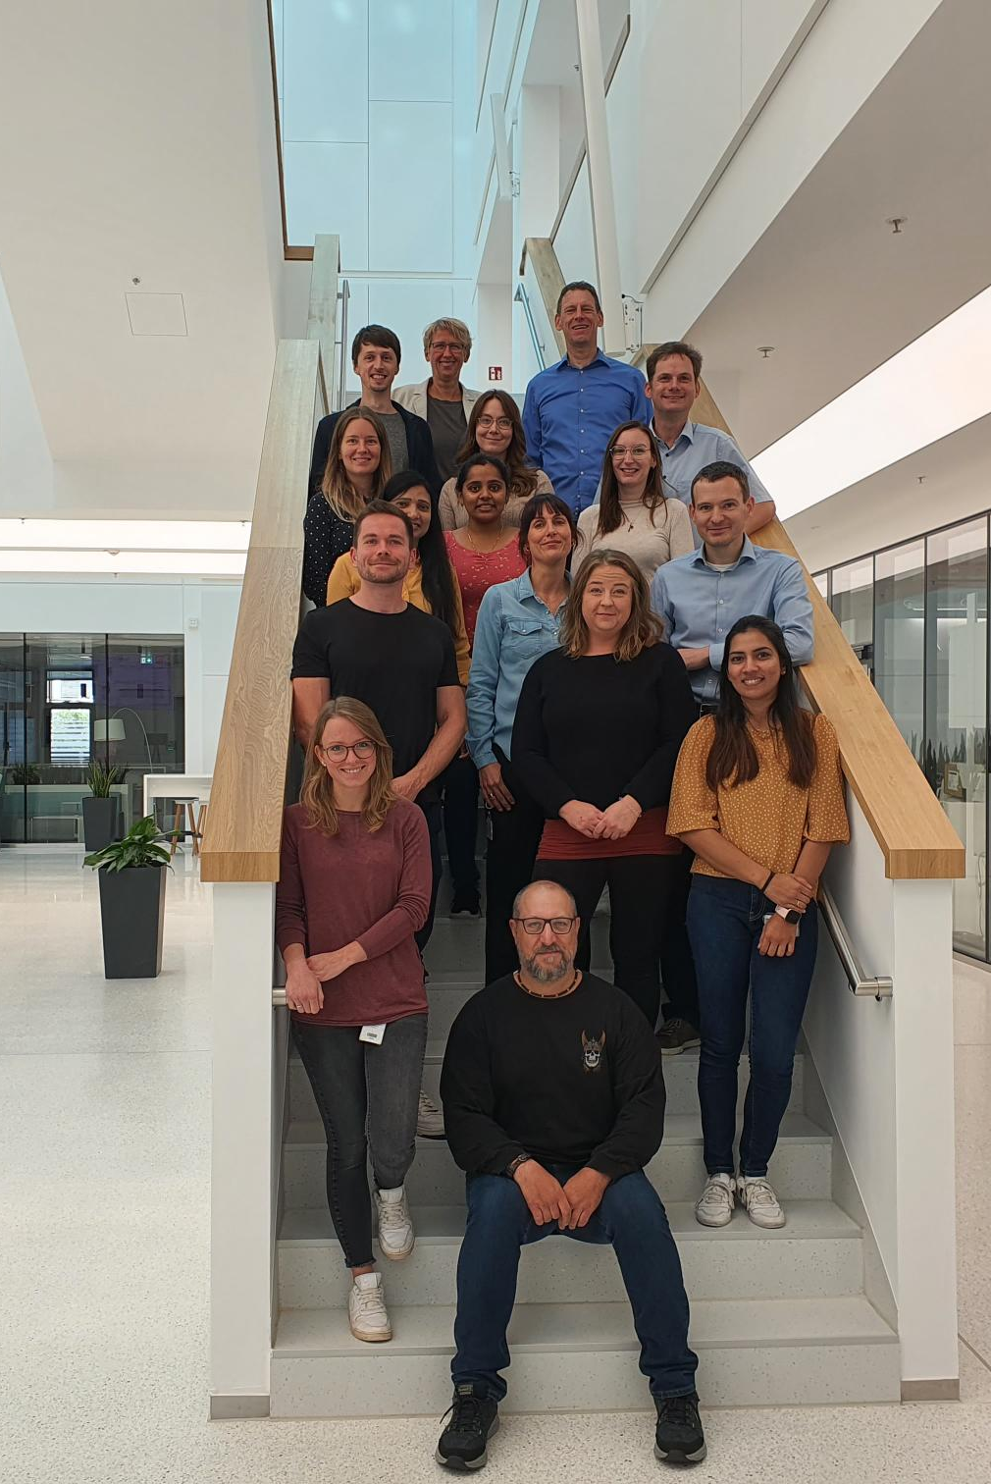
Thank you!
The PD Team
Parameswari Govindarajan
Maximilian Klimpel
Nikki Indresh Lal
Vathsalya Pabbathi
Jessica Klös
Cathrin Ferlemann
Vanessa Climenti
Janina Hoffmann
Holger Laux
Analytical Development and Support:
Monica Terrao
Sarah Schwingal
Christin Obert
Larissa Melo Do Nascimento
Michael Kahse
Beatrice Pflüger-Müller
Silke Wissing
CSL Viral Vector Team

