Slide 1
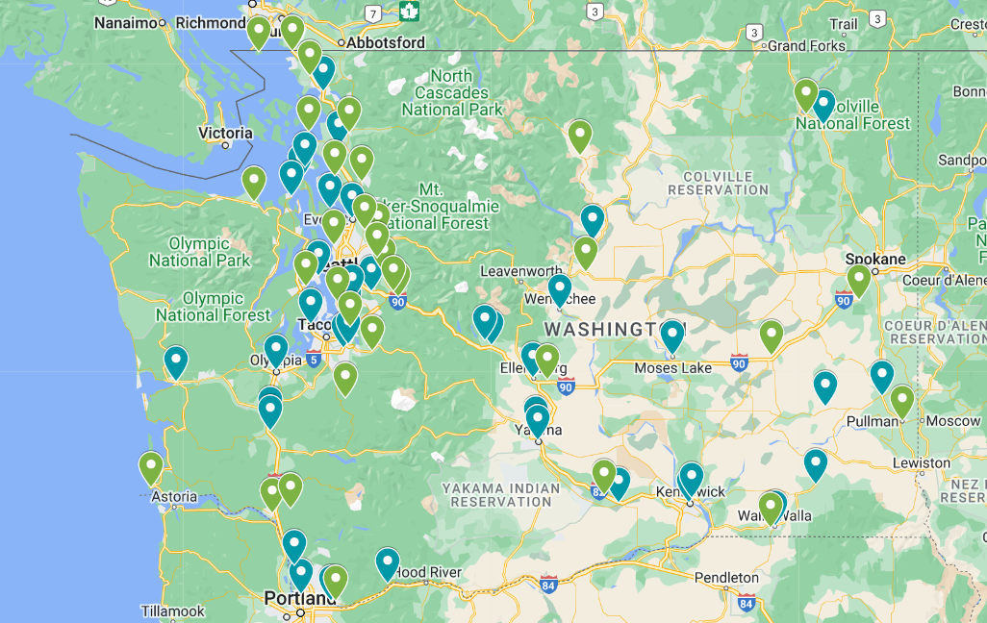

WASHINGTON STATE MAIN STREET PROGRAM
38 MAIN STREET COMMUNITIES & 34 AFFILIATES
Notes:
Breanne – size and scope of network, two types of designations
Transition to Four Points – Luke up first

Slide 2
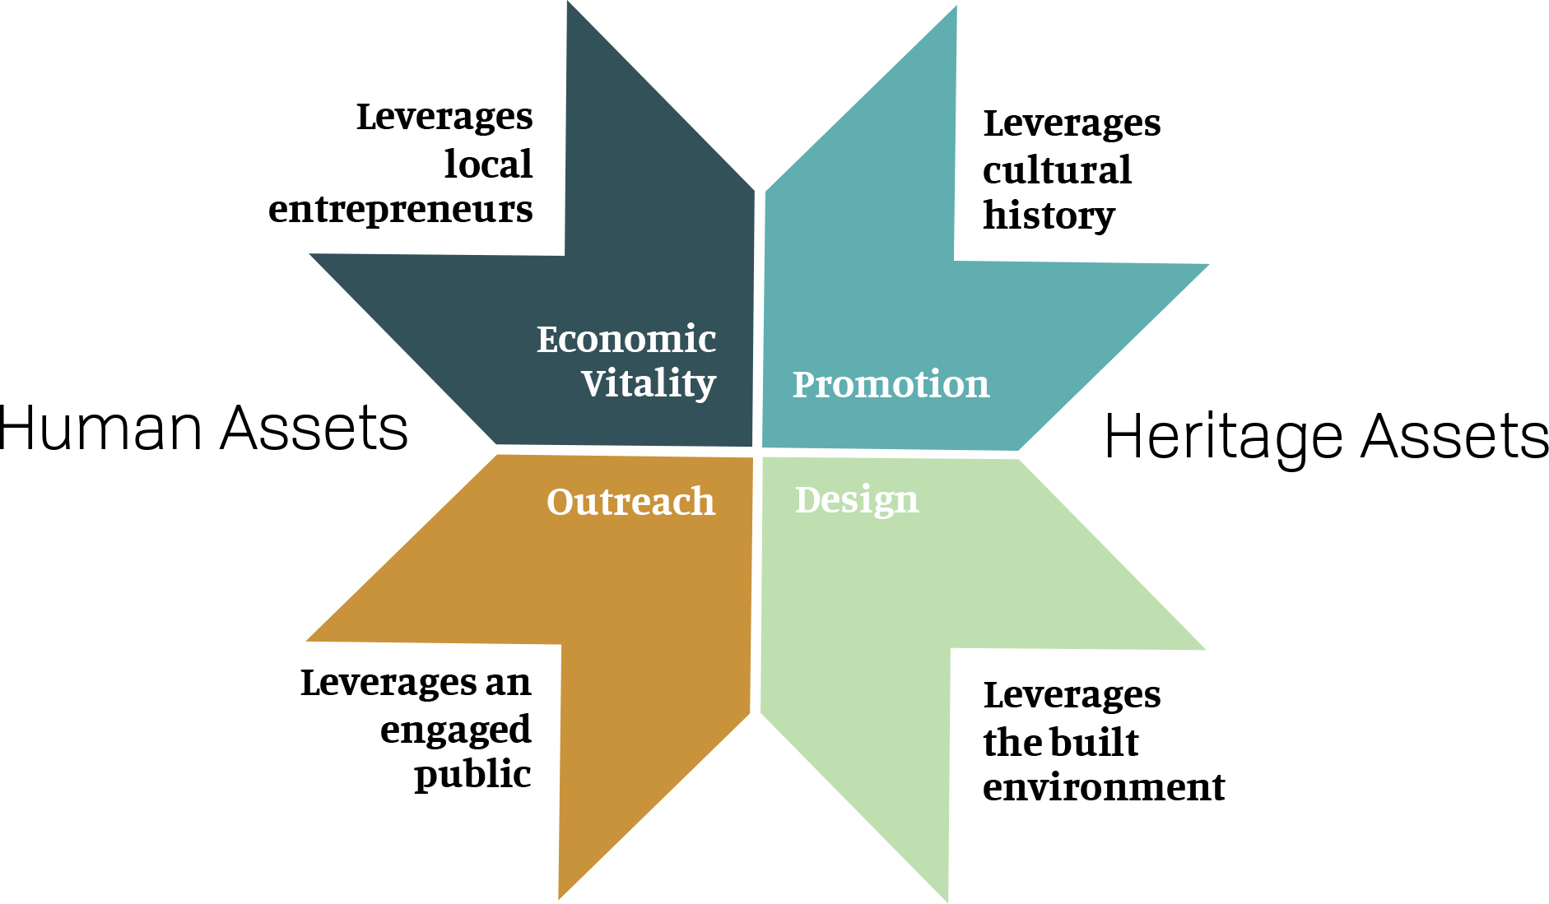
PUTTING THE APPROACH INTO PRACTICE
THE APPROACH

Slide 3




WASHINGTON STATE MAIN STREET PROGRAM
ECONOMIC VITALITY
Economic development within the context of an evolving built environment, with the existing economy
SUPPORTING: SMALL BUSINESSES
Build strong relationships with those who have already invested
Provide targeted assistance
PROMOTING OPPORTUNITIES:
Work with property owners and partners to promote strategic use of space and development
ASSEMBLE RESOURCES:
WITH PARTNERS
Entrepreneur and start-up
Business-friendly environment
Catalyze investment

Slide 4
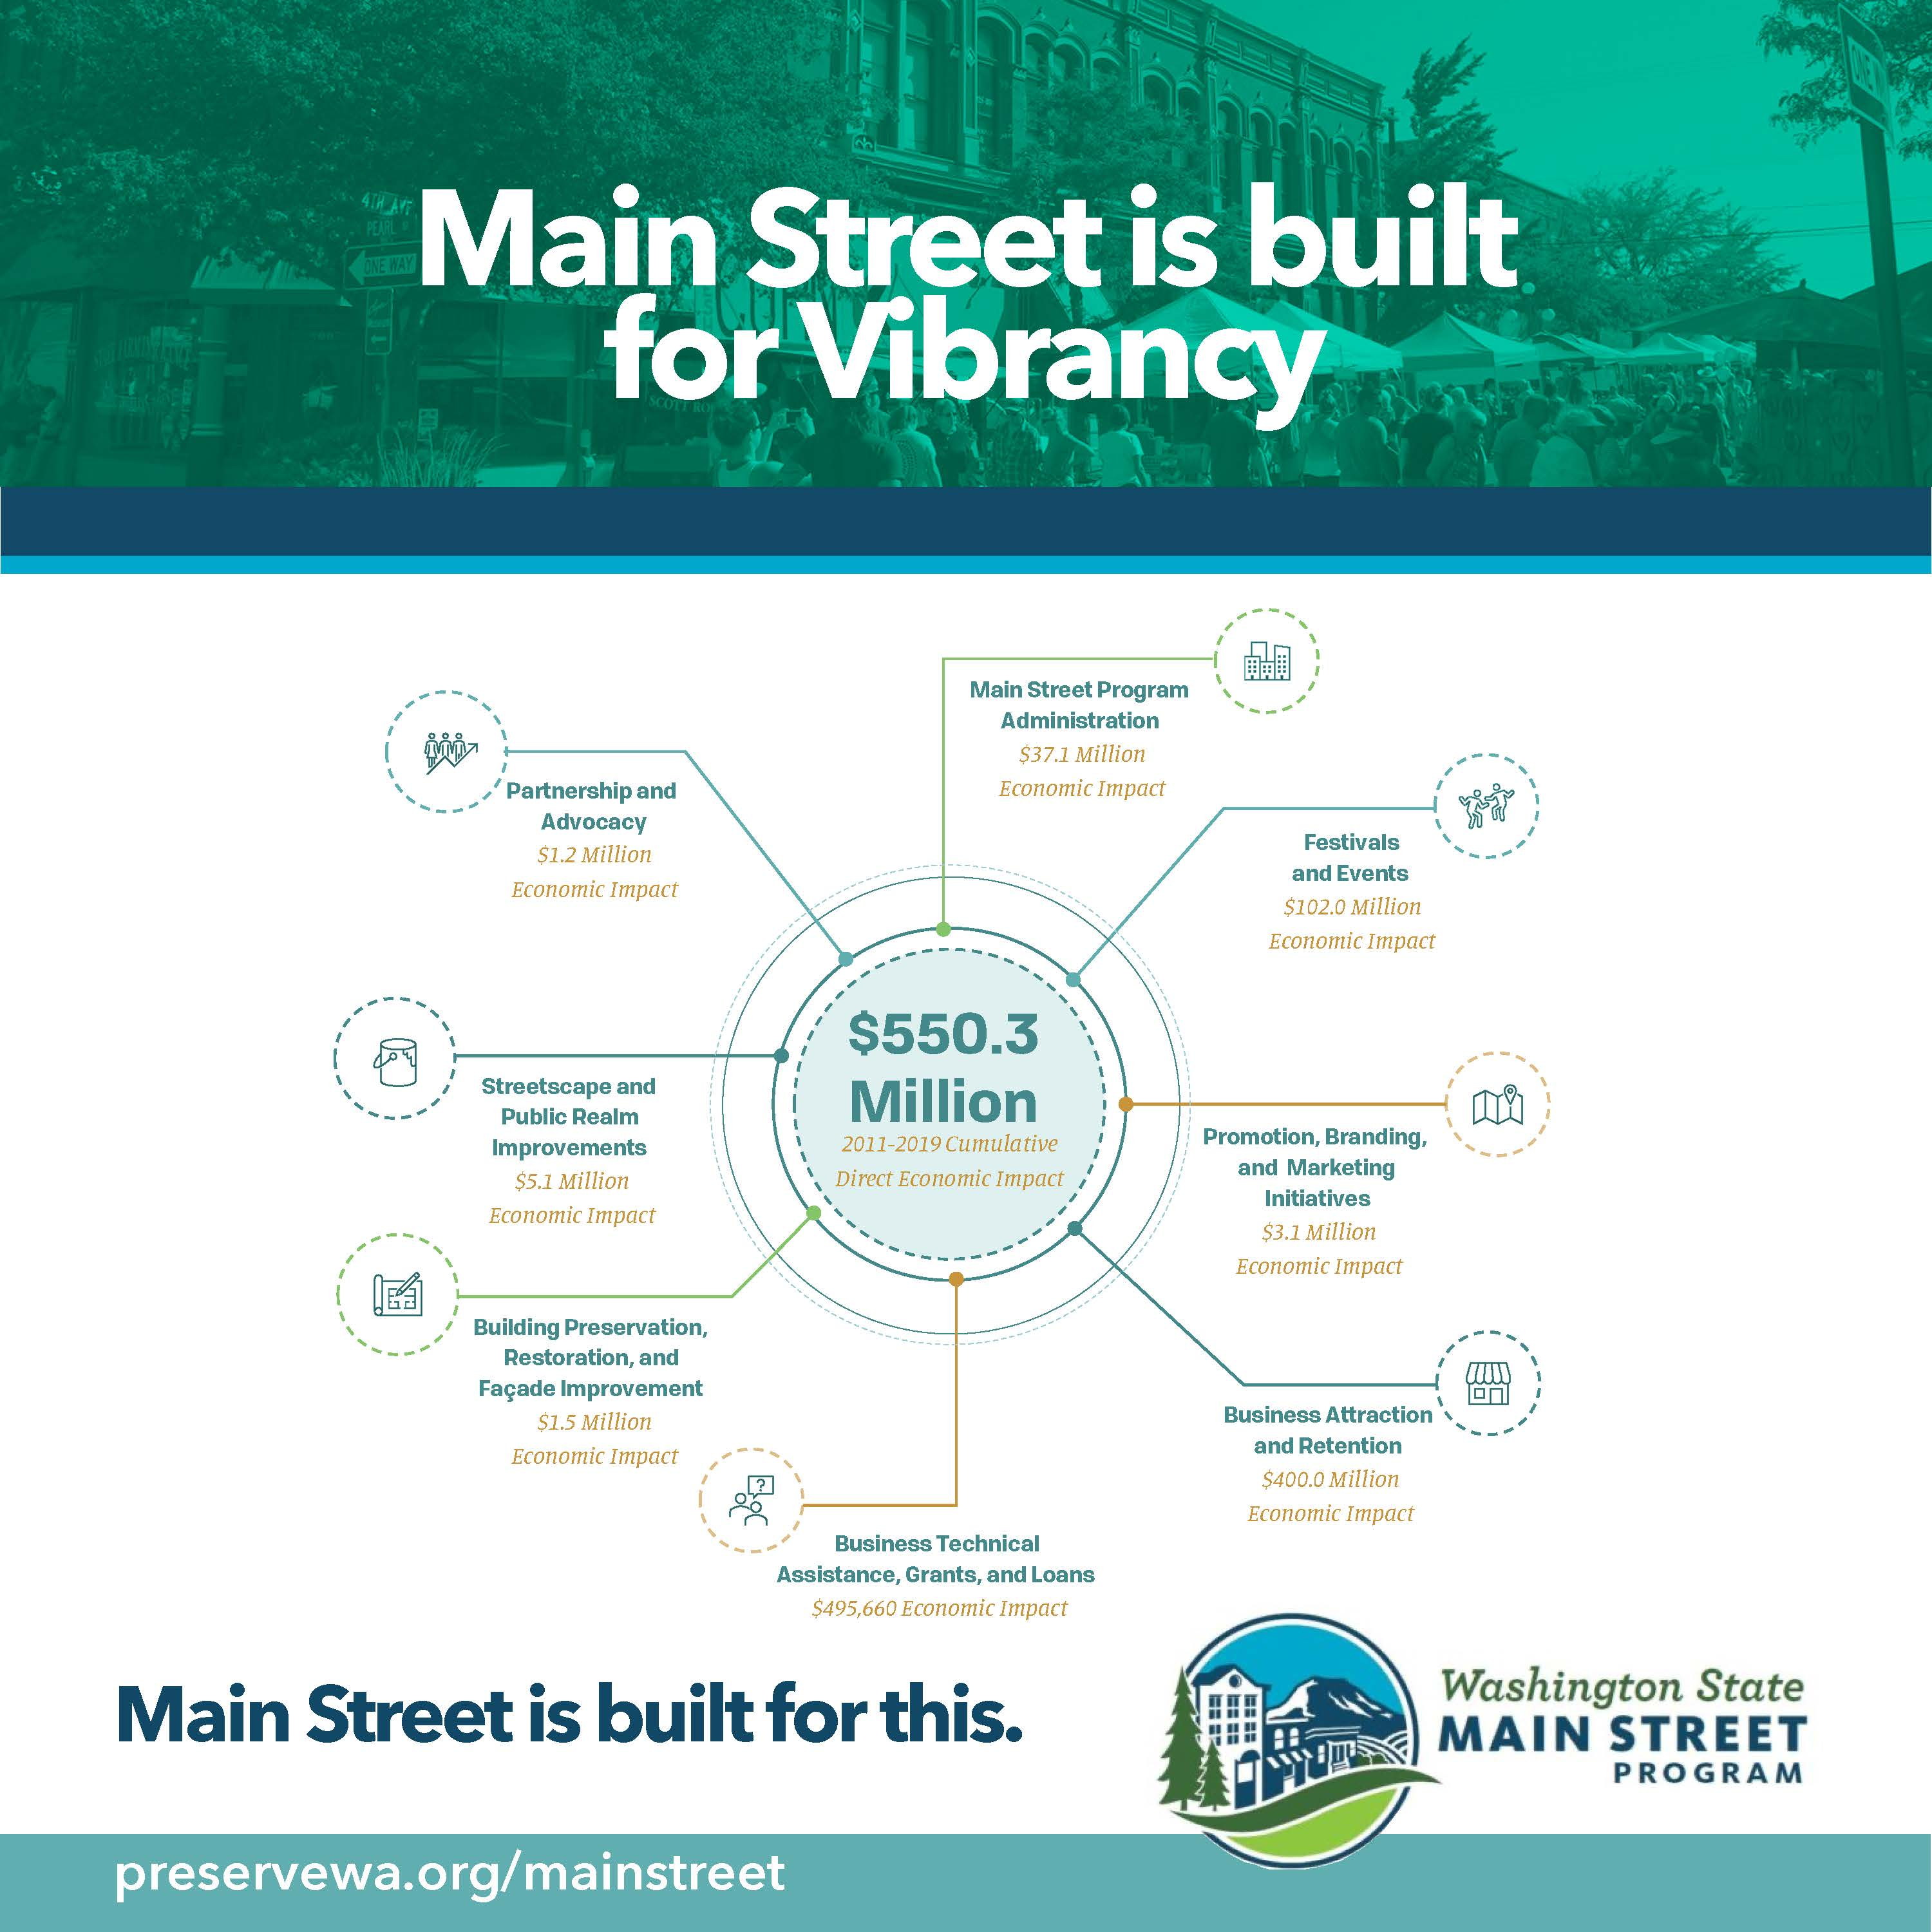
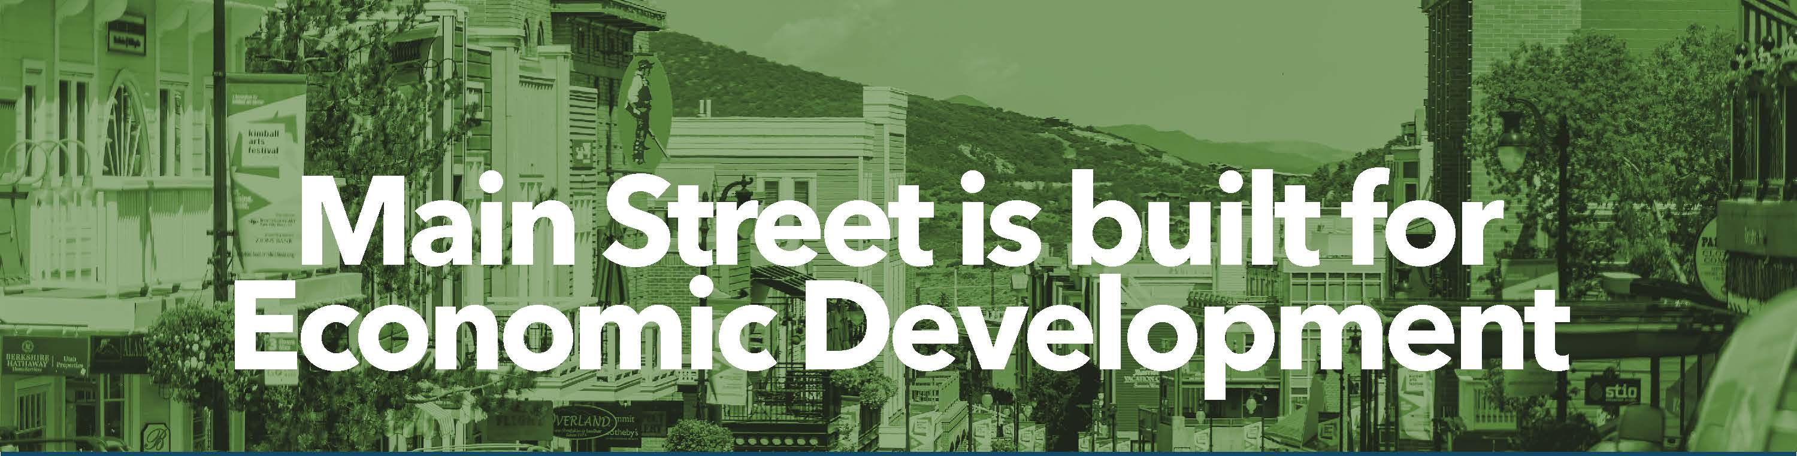

Slide 5
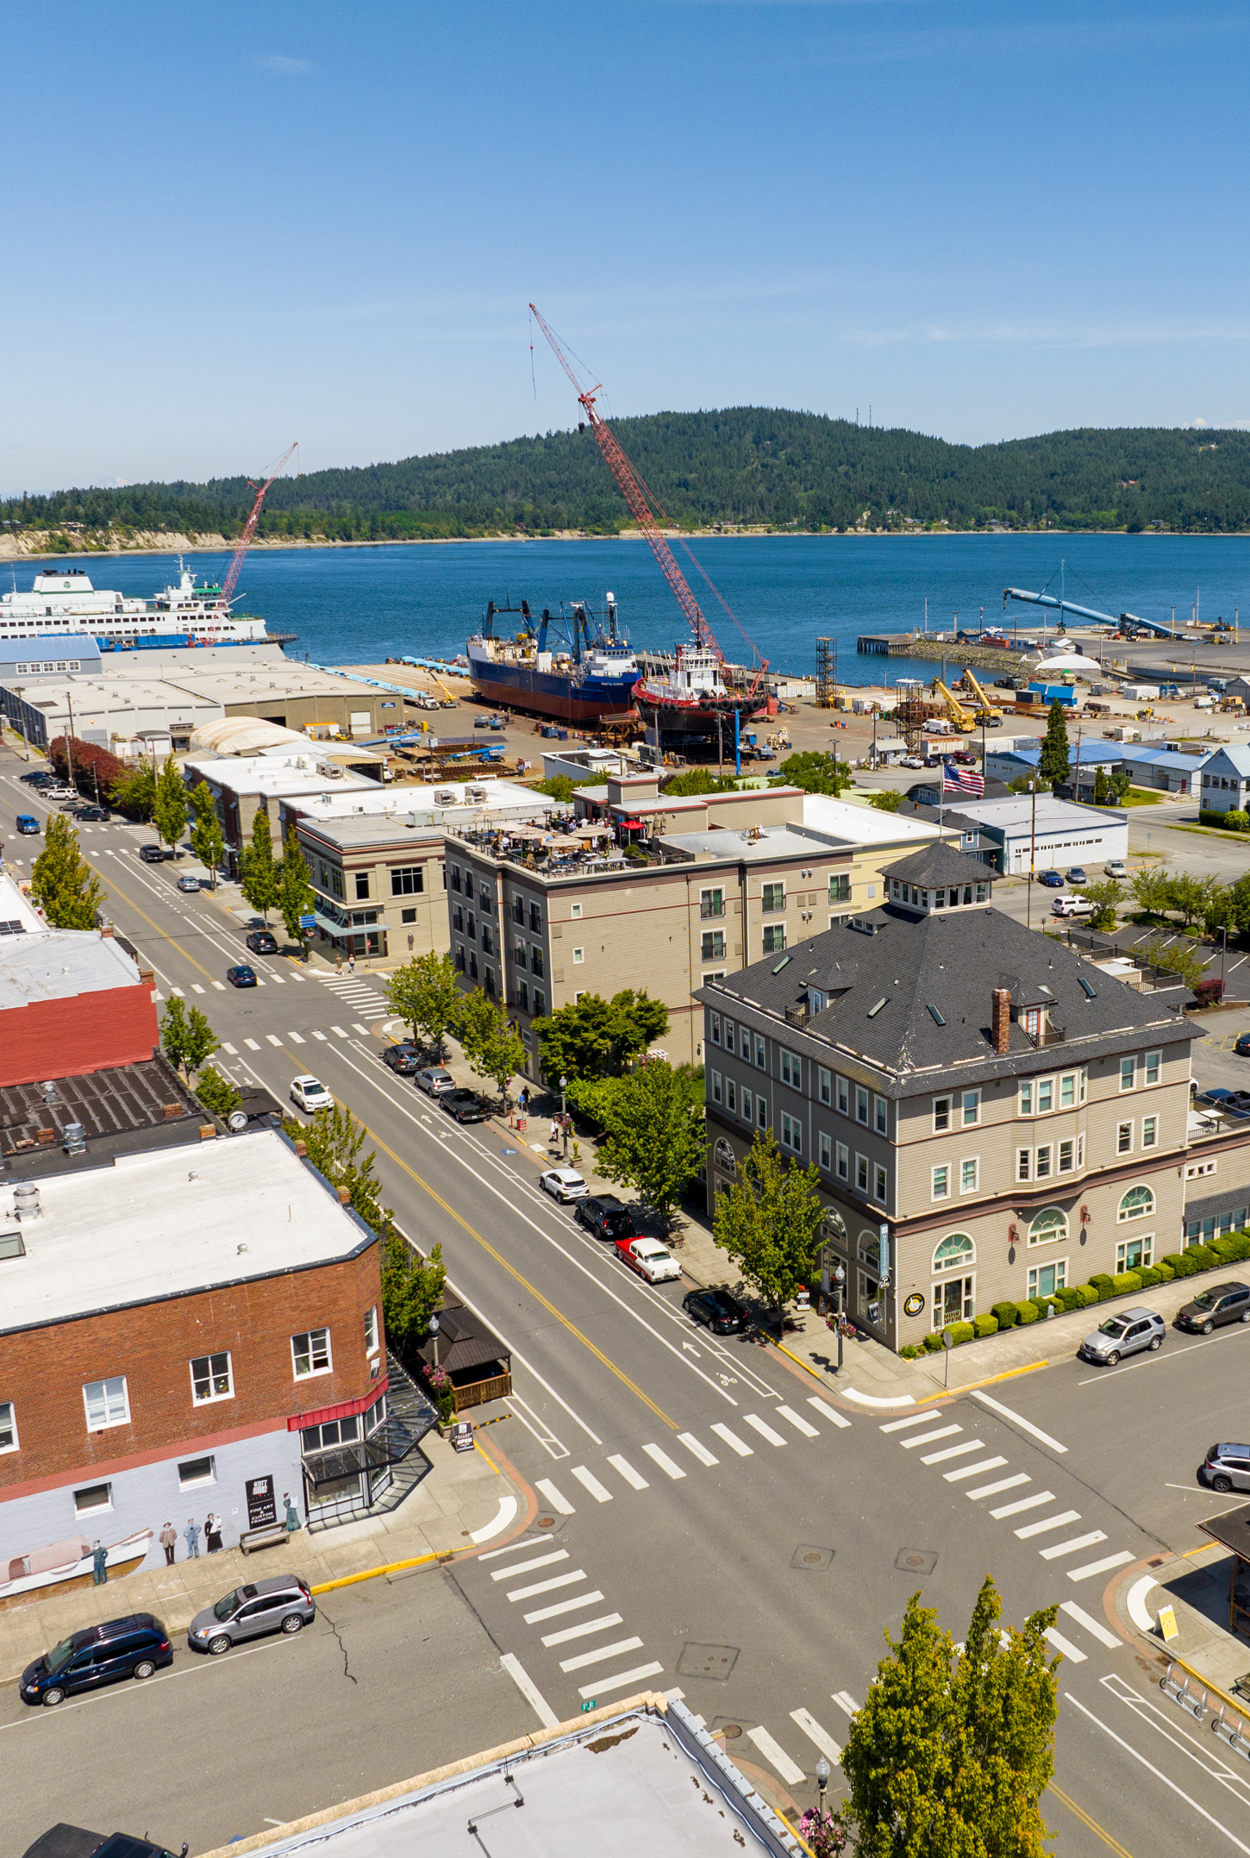
WASHINGTON STATE MAIN STREET PROGRAM
ESSENTIAL PARTNERS
Downtown business and property owners
City and county government
Residents
Regional economic developers, including ADOs, Ports, SBDC
Major employers, including universities, schools, health care, and other industries
Cultural and arts organizations, preservationists and historians, and civic clubs

Slide 6
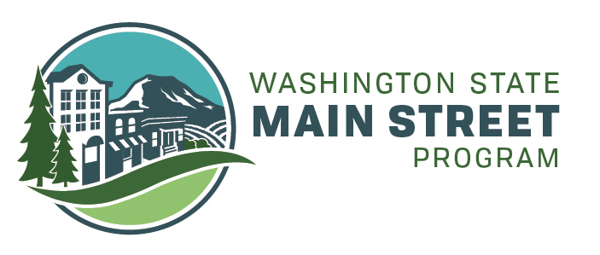


WASHINGTON STATE MAIN STREET PROGRAM
Breanne Durham
Washington Main Street Director
Breanne@preservewa.org
preservewa.org/mainstreet
206-624-9449
Notes:
Intro Luke if he’s staying for the coffee chat

