Slide 1


FREE WEBINAR
TUESDAY 28TH MARCH
2 – 3PM
THE WEBINAR WILL BEGIN SHORTLY

Slide 2
WELCOME FROM THE CHAIR
Denise Eaton
head of clinical, Nursing Times
THE WEBINAR WILL BEGIN SHORTLY

Slide 3
Prevention, diagnosis and management of pressure ulcers
Claire Spence
Tissue Viability Nurse
Calderdale & Huddersfield Foundation Trust
Notes:
Hello,
My name is Claire Spence and I am a Tissue Viability Nurse at CHFT
It’s a privilege to speak about a topic I am so passionate about
Thank you all for attending, especially in such pressure times.
Today I am going to speak about prevention, diagnosis and management of pressure ulcers

Slide 4
Learning Outcomes
Understand pressure ulcer formation and be able to correctly categorise damage
Use the ASSKING framework to support pressure ulcer prevention in practice
Distinguishing moisture associated skin damage from pressure damage

Slide 5
Why do we need to protect patients from Pressure Damage?
Pressure ulcers cost NHS £3.8 million every day (NHSE,2018)
Increase length of stay and increase community nurse caseload
Significant harm and distress to patients and their families Increase risk of infection, sepsis & death.
Many pressure ulcers are preventable
Notes:
No longer use terminology such as avoidable and unavoidable – this infers blame : Ceasing use of these terms will lead to all incidents being investigated to support organisational/system learning and appropriate actions. NHSE

Slide 6
Definition of a Pressure Ulcer
A pressure ulcer is localised damage to the skin and/or underlying tissue, usually over a bony prominence (or related to a medical or other device), resulting from sustained pressure (including pressure associated with shear). The damage can be present as intact skin or an open ulcer and may be painful.
(EPUAP, 2018)
Notes:
A pressure ulcer that has developed due to the presence of a medical device should be referred to as a ‘medical device related pressure ulcer’.

Slide 7
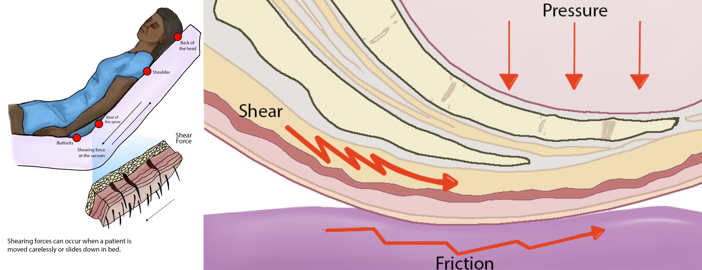
Pressure damage cycle
Occludes the blood and lymphatic vessels
Prevents the supply of oxygen
Prevents the removal of waste products
Prevents the supply of nutrients
Remove the pressure-
Break the cycle
Ischemia and tissue death
Notes:
Pressure is the vertical force of the weight of the patient's body on the surface. Shear is a horizontal force that causes the bony prominence to move across the tissue as the skin is held in place, and results from patient movement, nurse movement of the patient, and bed movement.
Shear causes stretching and tearing of blood vessels which reduces blood flow, increases blood pooling and can lead to cell damage.
We need to break the cycle

Slide 8
ASSKING Framework
(NHSE, 2018)
A = Assessment
S = Skin assessment
S = Support surface
K = Keep moving
I = Incontinence and moisture
N = Nutrition and hydration
G = Giving information
Notes:
What can we do to break the cycle and prevent pressure damage? Well this require holistic assessment and can be supported with the use of the ASSKING framework
This minimises variation in care practices NHSE 2018

Slide 9
A= Assessment
Multiple Pressure Ulcer Risk Assessment Tools (PURA)
NICE/NWCS recommend use of a validated PURA
WHY?
Identify those at risk
Plan, implement and evaluate interventions
Appropriate use of resources
ALL patients require a risk assessment

Slide 10

When should we risk assess?
Within 6hrs of admission or first community visit
On change of care setting
Post intervention
Changes in clinical presentation
Notes:
Pressure ulcers
Quality standard [QS89]Published: 11 June 2015
Changes in clinical presentation – this can happen both ways- our patient can become ill, pyrexia, reduced mobility or pt health and mobility may improve and interventions may need to be amended.
Safeguarding referral should be considered for patients who decline risk and skin assessments-
Check if your Trust/employer has a non-concordance pathway or patient contract which can support you and the patient in giving and receiving appropriate treatment.

Slide 11
Pressure Ulcers: Risk Factors
Age
Diabetes
Circulatory deficit
Incontinence
Nutrition / hydration
Moisture
Previous pressure damage
Presence of medical devices
Sensory deficit
Reduced mobility
Medication/ Polypharmacy
Long lie
Cognitive impairment
Notes:
This list is not exhaustive
Age – loss of elasticity, thinning skin, loss of connective tissue, reduced perfusion increasing risk of injury and pressure damage
Diabetes- nerve damage resulting in neuropathy and poor perfusion – increased risk of infection and amputation if pressure damage to heel or foot.
Circulatory deficit- delayed reperfusion of ischemic tissue and impaired lymphatic drainage, all reducing tissue tolerance and the threshold to develop PU
Moisture – if skin is already been insulted the risks are 30% higher
Sensory deficit- not able to respond to nociceptive stimuli as somebody with no deficit
Medication –
Long lie- exacerbated by ambulance and long waits in A&E
Cognitive impairment – again may not repond appropriately to stimuli, struggle to communicate needs- agitation, frustration, sometime medication is then used to ‘calm’ which then immobilises them further and increase risk of damage
You may be looking at this list and thinking this is all my patients- yes, we care for many of the vulnerable members of our communities. It is about looking at our patients holistically, identifying the risk factors and trigger interventions which will mitigate these risk factors.
Age –not reversible – optimise skin integrity with soap subsitutes and emollients.
Diabetes- Monitor HBA1c- refer to diabetes nurse if not controlled – be aware of the vulnerability of the foot – foot wear checks- liaise with podiatry-
Previous pressure damage – I have been in this situation before and my tissue tolerance is not great- interventions required to prevent this recurring
Long lie- increase repositioning/ visits to monitor skin as tissue has been insulted and increasing risk of further pressure damage and damage may not yet surfaced

Slide 12
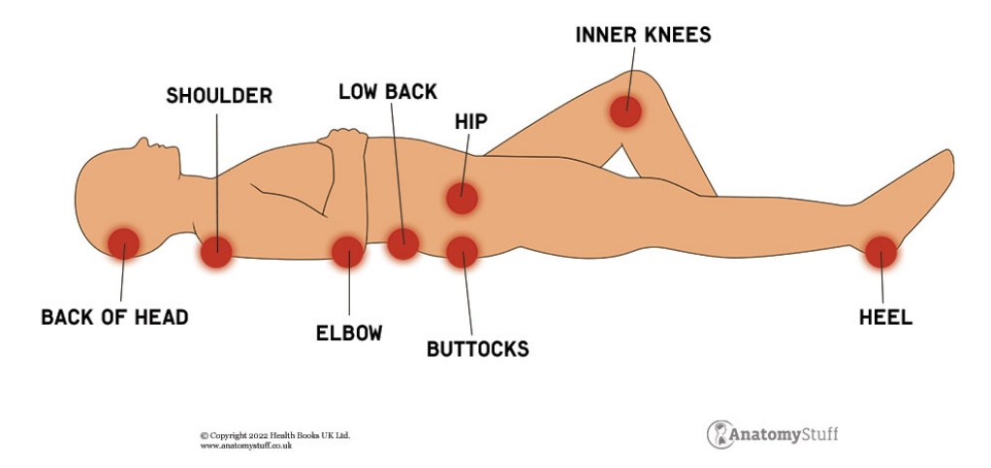
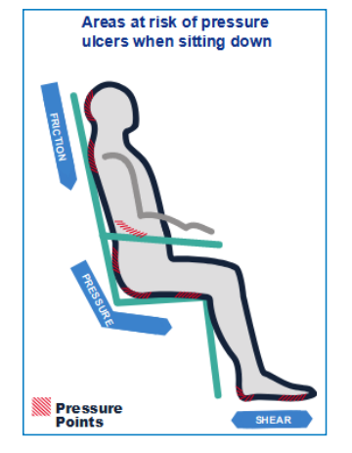
Vulnerable pressure areas –
A BEST SHOT
Ears
sacrum
Toes
A- Ankles
B- Buttocks
E- Elbows/Ears
S- Sacrum
T- Trochanter/hips
S- Spin/Shoulders
H- Heels
O- Occiput (back of head)
T – Toes
THINK MEDICAL DEVICES!
(University Hospitals of Leicester, 2010. Best Shot. Tissue Viability Service)
Adapted from Anatomystuff.com
Notes:
WHERE SHOULD WE BE LOOKING??
Many have skin bundles within your workplace to guide you.
We all love a good acronym to aid our memory
Remember – think medical devices – no only bony prominence
A Best SHOT

Slide 13

What are we looking for?
Change from the patients ‘norm’
Erythema/ discolouration
Changes in temperature
Induration
Oedema
Dry skin
Moist skin
Blistering
Pain
Notes:
I say this because we serve a diverse population and much of the education programmes and research has been implemented on individuals with light skin tone.
I would urge everybody to read the recent Best practice statement – hopefully this is just the start but this is ideal in creating conversations and instigating change in practice – it is a good starting block to improve practice and make this inclusive and representative of the population we serve.

Slide 14
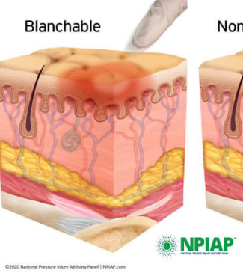
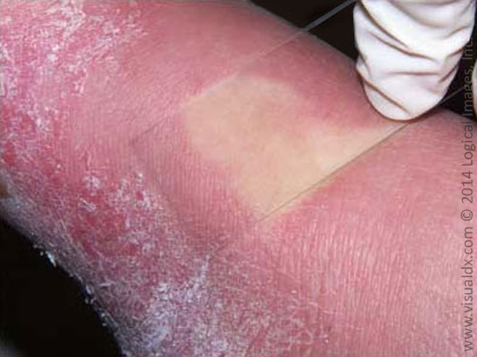
Blanching Erythema
Blanch Test – Apply light finger pressure to area of erythema ,this should turn white (blanch). On release tissue will re-perfuse
If positive test- indication microcirculation is intact
Notes:
To be able to categorise pressure damage – we must understand there are 3 layers to the skin
Epidermis
Dermis
Subcutaneous tissue
Beneath this is underlying structures including muscle, tendon, fascia and bone
The illustration shows inflammation of the Dermis with no damage to microcirculation within the dermis.
THIS IS A RED FLAG – this should be acted upon – trigger interventions

Slide 15
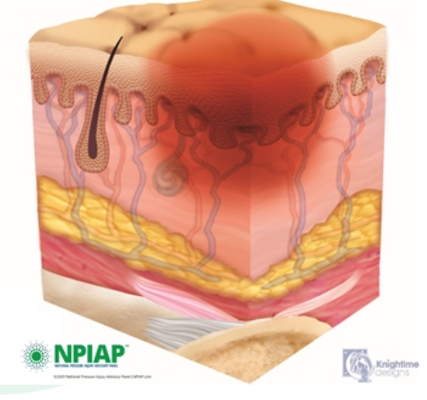

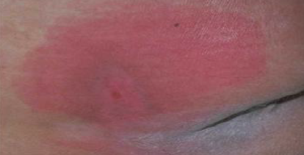
Category 1 Pressure Ulcer
Intact skin
Non-blanching or persistent erythema
Dark skin tone may not have visible blanching
Discolouration when compared with adjacent tissue (not deep purple)
Localised heat or coolness
Pain
Damage to underlying microcirculation
Damage is reversible
Notes:
Intact skin with non-blanchable redness of a localized area usually over a bony prominence. . Darkly pigmented skin may not have visible blanching; its color may differ from the surrounding area. The area may be painful, firm, soft, warmer or cooler as compared to adjacent tissue. Category I may be difficult to detect in individuals with dark skin tones. May indicate “at risk” persons.

Slide 16
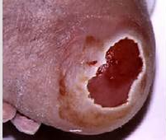
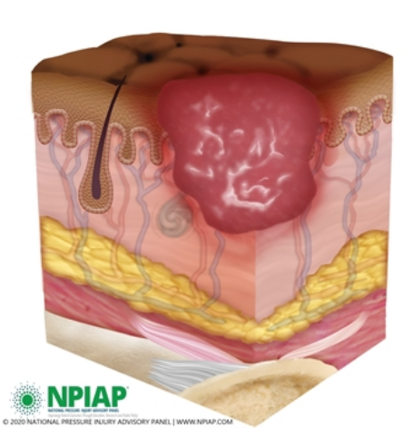
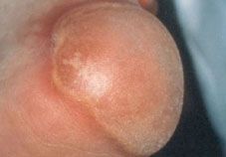

Category 2 Pressure Ulcer
Partial thickness loss
May present as intact/ruptured/ deroofed serous (clear/straw coloured fluid) filled blister.
Minimal slough
Notes:
Partial thickness loss of dermis presenting as a shallow open ulcer with a red pink wound bed, without slough. May also present as an intact or open/ruptured serum-filled or sero-sanginous filled blister.Presents as a shiny or dry shallow ulcer without slough or bruising*. This category should not be used to describe skin tears, tape burns, incontinence associated dermatitis, maceration or excoriation.

Slide 17

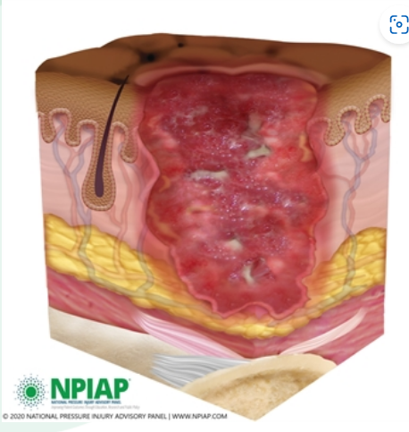
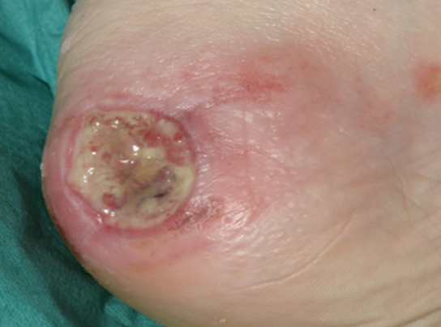
Category 3 Pressure ulcer
Full thickness tissue loss
Subcutaneous tissue may be visible
Slough does not obscure depth
Bone tendon is not visible or directly palpable
Depth varies according to anatomical location
Notes:
Full thickness tissue loss. Subcutaneous fat may be visible but bone, tendon or muscle are not exposed. Slough may be present but does not obscure the depth of tissue loss. May include undermining and tunneling.The depth of a Category/Stage III pressure ulcer varies by anatomical location. The bridge of the nose, ear, occiput and malleolus do not have (adipose) subcutaneous tissue and Category/Stage III ulcers can be shallow. In contrast, areas of significant adiposity can develop extremely deep Category/Stage III pressure ulcers. Bone/tendon is not visible or directly palpable.

Slide 18

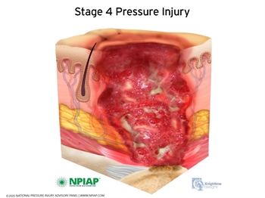
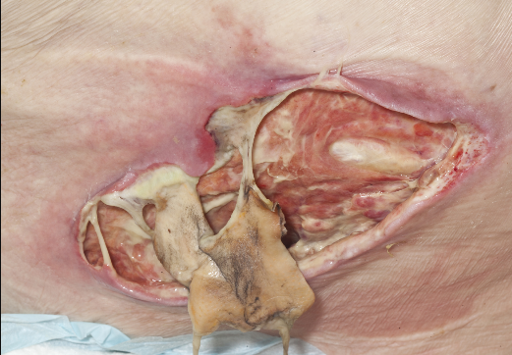
Category 4 Pressure Ulcer
Full thickness tissue loss with exposed bone, tendon or muscle or directly palpable.
Slough and eschar may be present
Undermining or tunnelling may be observed.
High risk of osteomyelitis
Depth will vary according to location
Notes:
Full thickness tissue loss with exposed bone, tendon or muscle. Slough or eschar may be present. Often includes undermining and tunneling.The depth of a Category/Stage IV pressure ulcer varies by anatomical location. The bridge of the nose, ear, occiput and malleolus do not have (adipose) subcutaneous tissue and these ulcers can be shallow. Category/Stage IV ulcers can extend into muscle and/or supporting structures (e.g., fascia, tendon or joint capsule) making osteomyelitis or osteitis likely to occur. Exposed bone/muscle is visible or directly palpable.

Slide 19

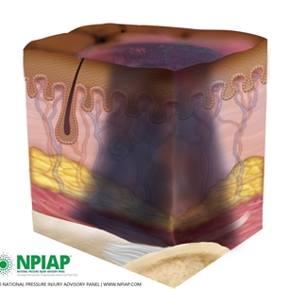
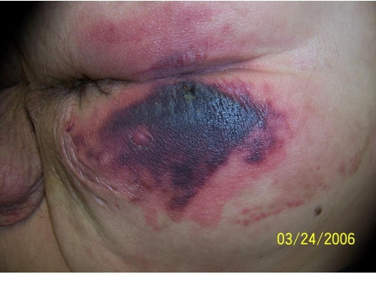
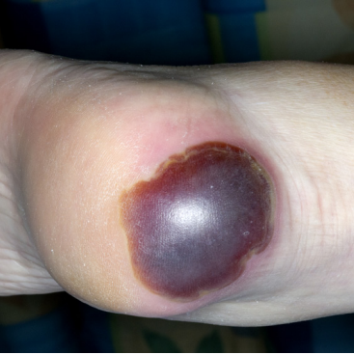
Deep Tissue Injury (DTI)
Purple/maroon localised discolouration
Intact skin or blood filled blister
May present as thin blister with dark wound bed
Damage to underlying tissue through pressure/shear
May evolve despite appropriate interventions
Notes:
Image wounds Uk 2014
Purple or maroon localized area of discolored intact skin or blood-filled blister due to damage of underlying soft tissue from pressure and/or shear. The area may be preceded by tissue that is painful, firm, mushy, boggy, warmer or cooler as compared to adjacent tissue. Deep tissue injury may be difficult to detect in individuals with dark skin tones. Evolution may include a thin blister over a dark wound bed. The wound may further evolve and become covered by thin eschar. Evolution may be rapid exposing additional layers of tissue even with optimal treatment.

Slide 20
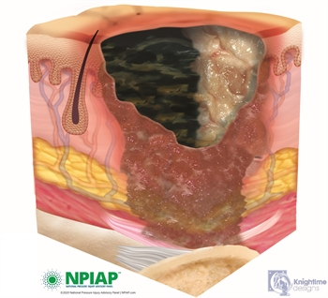

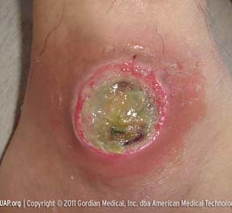
Unstageable Pressure Ulcer
Full thickness tissue loss
Ulcer obscured by slough/eschar
Unable to determine true depth until devitalised tissue removed.
Likely to debride to C3/C4 pressure ulcer.
Notes:
Full thickness tissue loss in which actual depth of the ulcer is completely obscured by slough (yellow, tan, gray, green or brown) and/or eschar (tan, brown or black) in the wound bed. Until enough slough and/or eschar are removed to expose the base of the wound, the true depth cannot be determined; but it will be either a Category/Stage III or IV. Stable (dry, adherent, intact without erythema or fluctuance) eschar on the heels serves as “the body’s natural (biological) cover” and should not be removed.

Slide 21
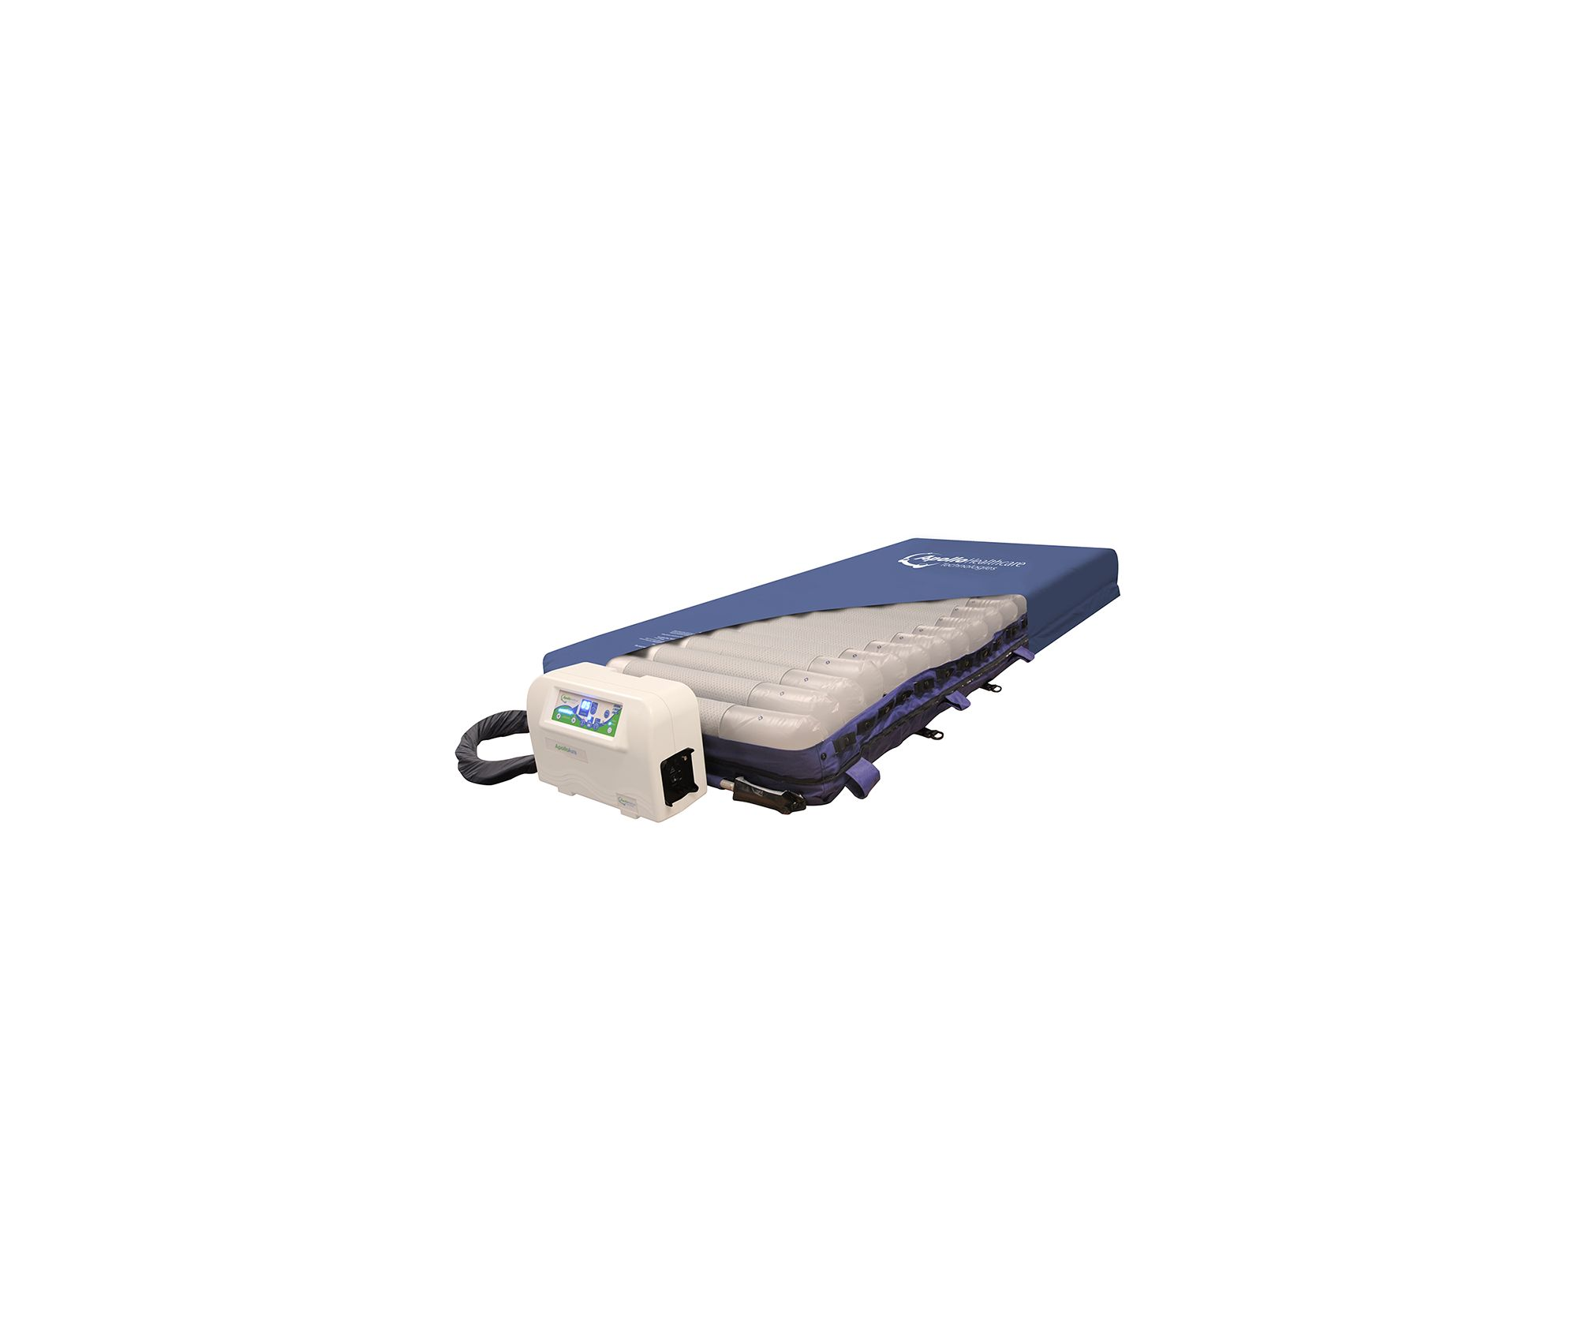
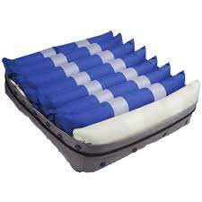
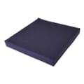
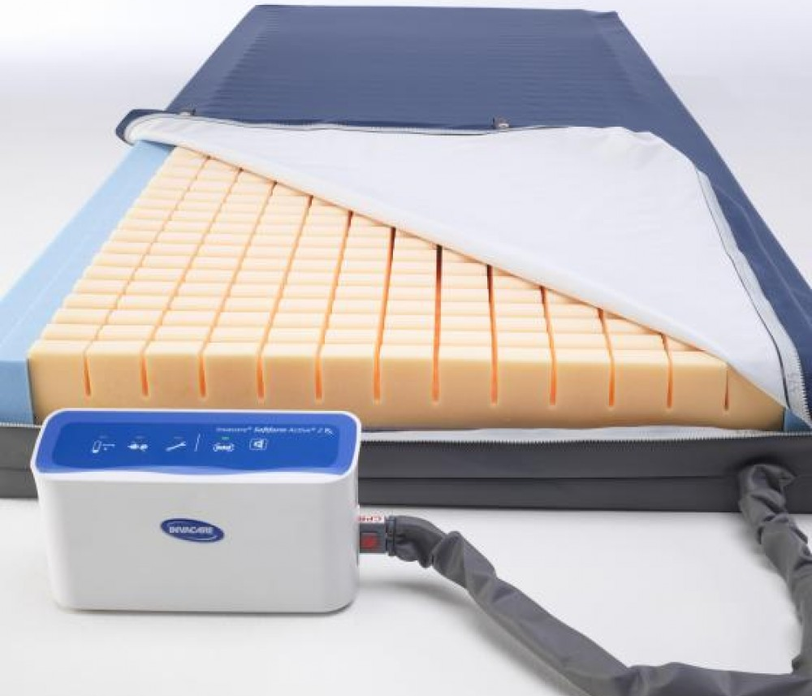
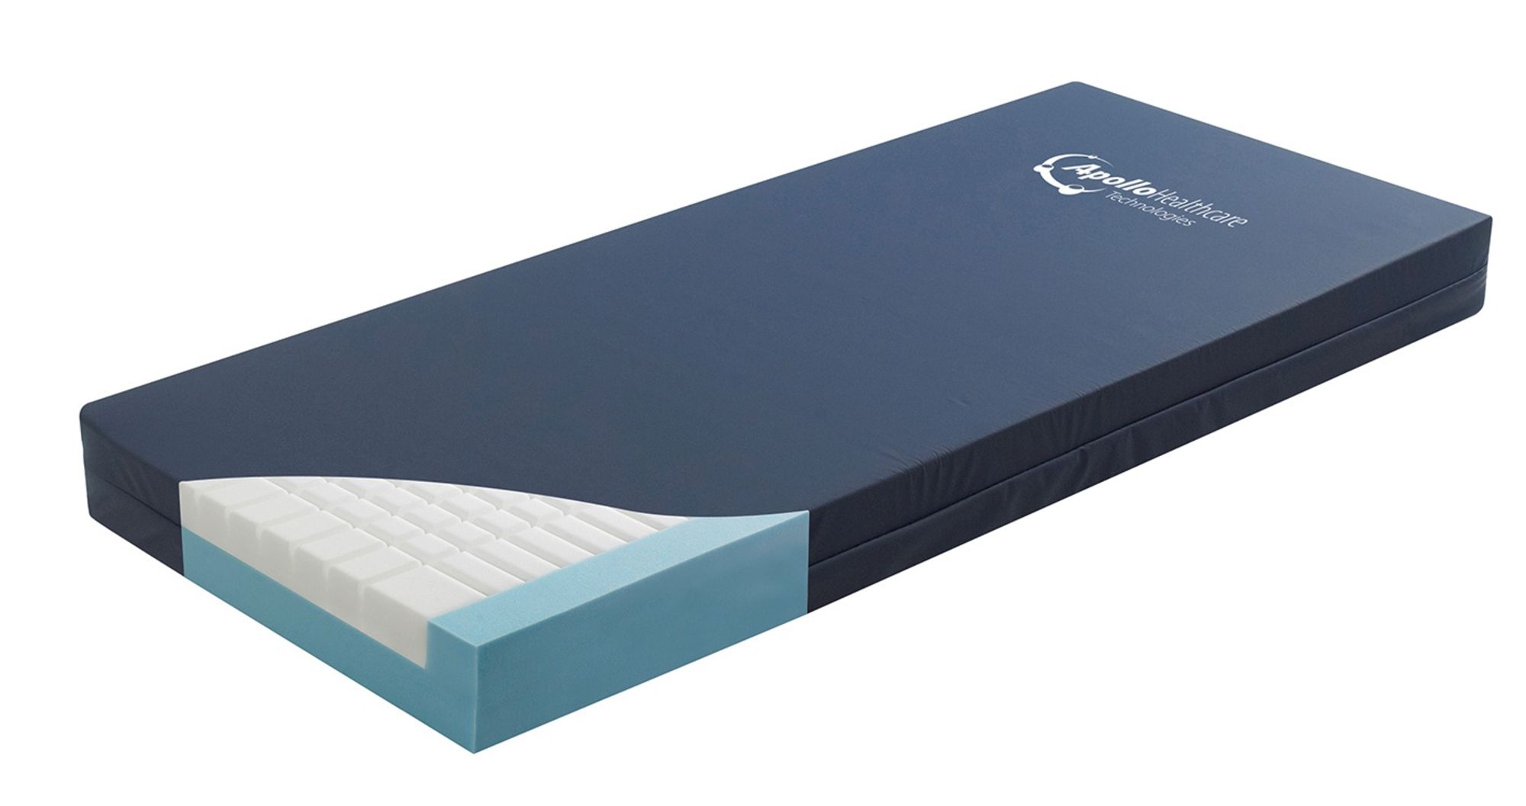
S = Surface
High specification foam mattress
Hybrid – powered/non-powered
Dynamic mattress
Lateral turning systems
Think seating – postural support
Notes:
Multiple different pieces equipment which can be used to aid pressure redistribution
High specification foam mattresses
Hybrid mattress- powered can be used as a static mattress with option to upgrade as clinically required.
Lateral turning systems – can be programmed to repositioning regime- requires risk assessment regarding entrapment.
Offloading devices – use repose – heel pro – consider referral to podiatry/orthotics/occupational therapy if offloading is challenging due to contractures etc.
Offloading footwear
Pressure redistributing devices
Choice of equipment will be mase according to holistic assessment- level of mobility, risk of power outage, cost of living and the risk of pt/family turning the mattress off, fall risk, amputees – smoking

Slide 22
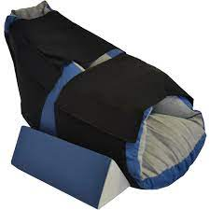
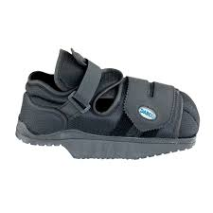
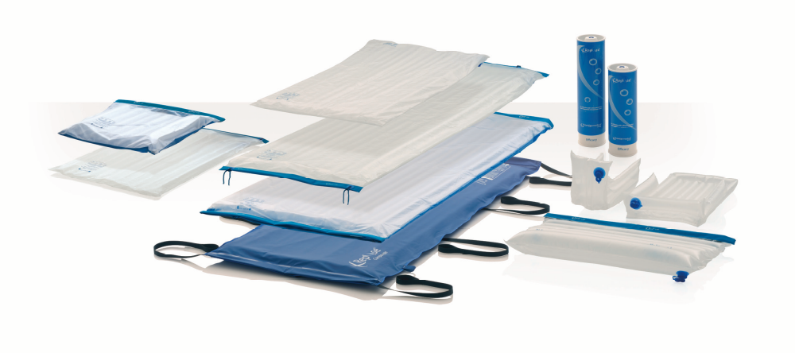
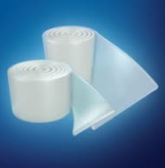
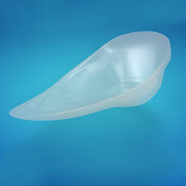
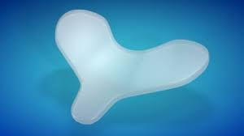
S= Surface continued
Offloading is the most effective pressure ulcer prevention intervention offering zero pressure
Silicone pressure redistributing devices
Think footwear – refer to orthotics/podiatry
Notes:
Silicone devices may be su

Slide 23
I = Incontinence
Moisture-associated skin damage (MASD) is caused by prolonged exposure to various sources of moisture, including urine or stool, perspiration, wound exudate, mucus, saliva, and their contents. MASD is characterized by inflammation of the skin, occurring with or without erosion or secondary cutaneous infection.
(Gray et al, 2011)
Notes:
Incontinence increases risk of MASD.
Say definition
Although evidence is lacking, clinical experience suggests that MASD requires more than moisture alone. Instead, skin damage is attributable to multiple factors, including chemical irritants within the moisture source, its pH, mechanical factors such as friction, and associated microorganisms. To prevent MASD, clinicians need to be vigilant both in maintaining optimal skin conditions and in diagnosing and treating minor cases of MASD prior to progression and skin breakdown.

Slide 24
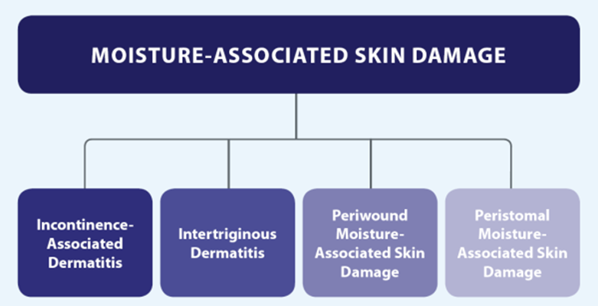
Beeckman, 2015
Notes:
We will be focusing on the prevention and management of incontinence associated dermaitits.
It is important we have a universal language regarding MASD to allow for appropriate management and to understand the prevalence and incidence of the problem. For this reason NHSI recommend this is incident reported.

Slide 25
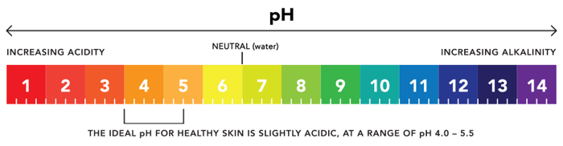
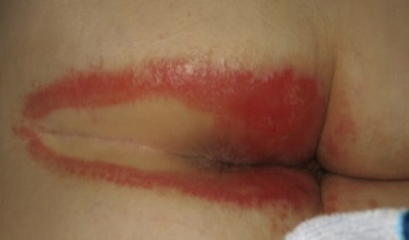
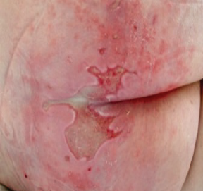
Incontinence Associated Dermatitis (IAD)
IAD is a form of irritant contact dermatitis caused by prolonged contact with urine and/or faeces.
Urine and faeces increase PH levels which weakens the barrier function
Friction causes physical irritation which weakens skin integrity further which can contribute to skin erosions and/or blistering.
Maybe symmetrical or asymmetrical
Painful
Increases risk of pressure damage
(Image courtesy of Ghent Global IAD Categorization Tool (GLOBIAD), Beeckman et al, 2015)
Notes:
The acidity of our skin is our first line of defence against infection
PH increases as this comes into contact with Urine and faeces creating an environment for bacteria to proliferate and cause infection
Faeces especially loose stools contain enzymes which are damaging to the skin
Combination of faecal incontinence with urine incontinence is the moat damaging as enzymes in stool exacerbate the effects of urine on the skin.

Slide 26
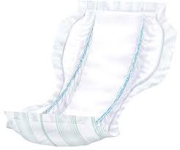
Prevention and Management of IAD
Identify the cause of incontinence
Optimise skin integrity –
  Soap substitutes/ PH balanced cleansers
  Emollient therapy
  Use barrier products to protect skin from moisture
Choose the least invasive continence product to meet patient needs:
  Incontinence pad secured with underwear or incontinence pants
  Sheath
  Intermittent/indwelling catheter (with fixation device)
  Faecal management system
Incontinence management frequency to be met according to individual need.
Refer to Bladder and Bowel/Continence team and/or Tissue Viability as per local policy.
Notes:
Incontinence is not an inevitable part of aging – does this need to be investigated is this temporary- C-diff
Some soap substitutes contain antimicrobial properties which may be beneficial where there a erosions with frequent contamination
Use incontinence pads of the correct size and absorbency of incontinence pads
Ensure incontinence pad contours to the body

Slide 27
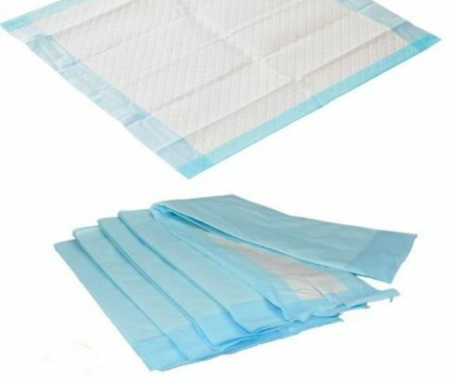

Avoid…
Baby wipes
Perfumed soaps/shower gels
Zinc oxide creams and
titanium dioxide ointments
Incontinence/procedure sheets
Occlusive dressings
Multiple incontinence pads
Notes:
We know this may be difficult in the community where intervention is guided by patient and/or family but its about education – to be foretold is to be forearmed.
Thick opaque creams are difficult to cleanse from the skin, unable to assess tissue integrity and may occlude incontinence pad reducing its effectiveness.
Incontinence sheets/procedure sheets- very minimal absorbence- do not have the technology to wick moisture away from the skin – which increases risk of MASD
Use usually to save bed sheets and prolong time between continence cares when in reality this patient likely requires increased frequency of continence care.
Occlucisve dressings – designed to create moist environment therefore increase moisture and risk of deterioration – a low adherent contact layer may be advised to prevent erosions adhring to incontinence pad.
Multiple incontinence pads are counterintuitive and increase risk of pressure damage – if multiple incontinence pads are used the size and absorvency is inappropriate – consider referral to the continence team .

Slide 28
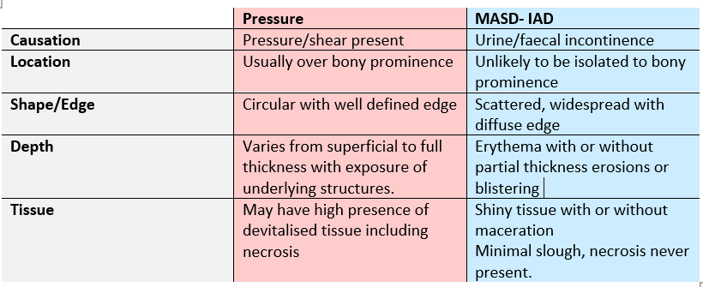
Incontinence Associated Dermatitis vs Pressure Damage
Tissue damage may be a combination of pressure with moisture – this should be categorised according to the level of pressure damage.
Notes:
If damage is assessed as being a combination of pressure and moisture – it is classified according to the level of pressure damage observed.

Slide 29

N= Nutrition
Optimising nutrition supports the immune system and tissue repair.
Malnutrition & dehydration increases risk of infection, delayed healing, falls and confusion
MUST assessment should be completed within 24hrs in the acute setting and weekly thereafter. It should be completed at first community visit and repeated where there is clinical concern.
Adults with a pressure ulcer should be offered referral to a dietician or clinician trained to complete a comprehensive nutritional assessment.
Individuals who are it risk of malnourishment should have an individualised care plan
Notes:
Adequate nutrition is vital, providing the body with energy, supporting the immune system and repairing skin and tissue. Malnutrition causes the individual to become weak, predisposes to infection and, if injured, the skin and tissue will struggle to heal.
Falls and confusion increase risk of pressure damage.
It is thought that a patient with a pressure ulcer requires up to 35 kcl/kg to aid wound healing.
Food diaries – carers /patient to complete- instigate in acute setting – follow local policy

Slide 30
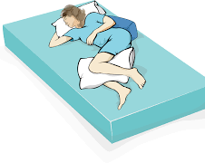
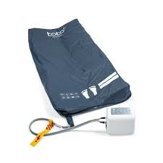
K= Keep Moving
Repositioning is one of the most effective interventions in pressure ulcer prevention
  Repositioning frequency based on individual assessment
Good moving and handling is crucial
  Full length slide sheets
  Utilise 30 degree tilt when reposition
  Apply knee brake to reduce shearing damage
  Consider lateral turning system to compliment repositioning regime
Refer to wider MDT
  Physiotherapy to optimise mobility
  Occupational therapy for adaptations to increase independence
Notes:
The 30° tilt' is used to promote patient comfort and reduce pressure over high risk areas

Slide 31
G= Giving information
Verbal and written pressure ulcer prevention education to patient and/or family/carers
Incident report MASD and Category 2 pressure ulcers and above
Consider referrals to wider members of the MDT
Tissue Viability, Podiatry, Bladder & Bowel/Incontinence team, Moving & handling, Safeguarding, SALT, Dietician, Physiotherapy
Clinical photography and wound assessment
Clear, concise documentation
Notes:
Pt has been admitted to your care with harm consider referring to safeguarding
Ensure information is given in a format the recipient can understand
Incident reports allow investigation to highlight learning which can be targeted to specific area or may highlight trust wide learning.

Slide 32
Summary
Many pressure ulcers are preventable with early intervention
ASSKING framework should be used to guide and support clinicians holistic assessment in the prevention of pressure ulcers
Result of assessment should trigger intervention.
Incontinence management is a crucial element of pressure ulcer prevention.
Differentiation of pressure damage from MASD IAD is challenging and requires holistic assessment.
Both pressure damage and MASD effect a patients quality of life.
MASD and category 2 pressure ulcers and above require an incident report.
MDT working is required to preserve patient safety and prevent pressure ulcers.

Slide 33
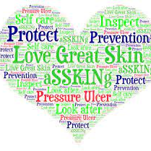
Thank you
Any questions?

