Slide 1

Serving Walla Walla and Columbia counties and the Milton-Freewater area

Slide 2
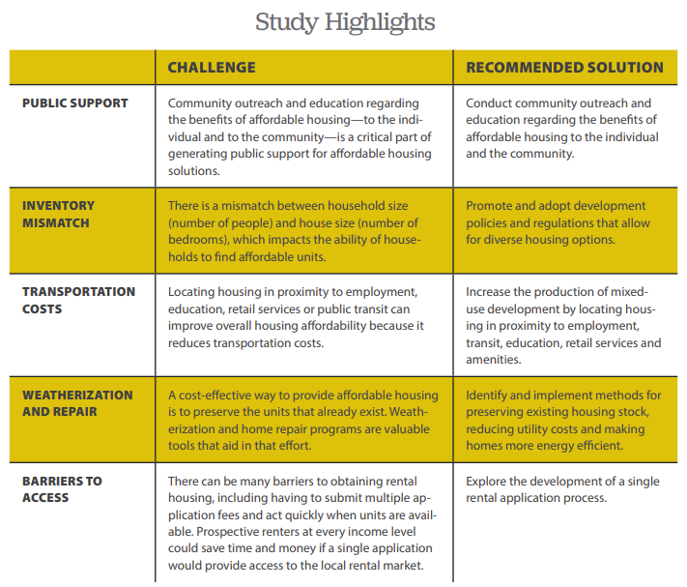
2019 Affordable Housing Study
Process
  Convened study committee
  Listened to resource speakers
  Developed the report
  Collectively wrote conclusions
Recommendations
  Collectively wrote recommendations
  28 Recommendations total
  A range of topics and solutions

Slide 3
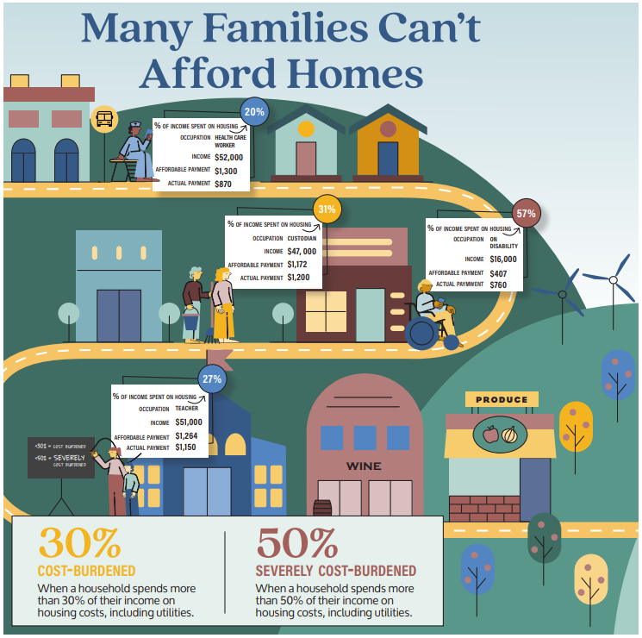
Affordability
Key factors driving the affordability crisis:
  We have a shortage of housing for rent and purchase
  There is a mismatch between the size of homes available and the size of homes needed
  Income levels have not kept pace with housing costs
Impacts
  More families moving to neighboring communities
  More reliance on multi-generational living
  Organizations struggling to recruit new talent

Slide 4
What we can do
Encourage housing development of “right size” housing
Encourage affordable rental options
Develop a mechanism for permanently affordable housing to help working families build wealth

