Slide 1
Fact-Finding Hearings (Private Law)
Post Re H-N
Laura Morley – Barrister at 4PB and
Simon Craddock – Partner at Brethertons LLP

Slide 2
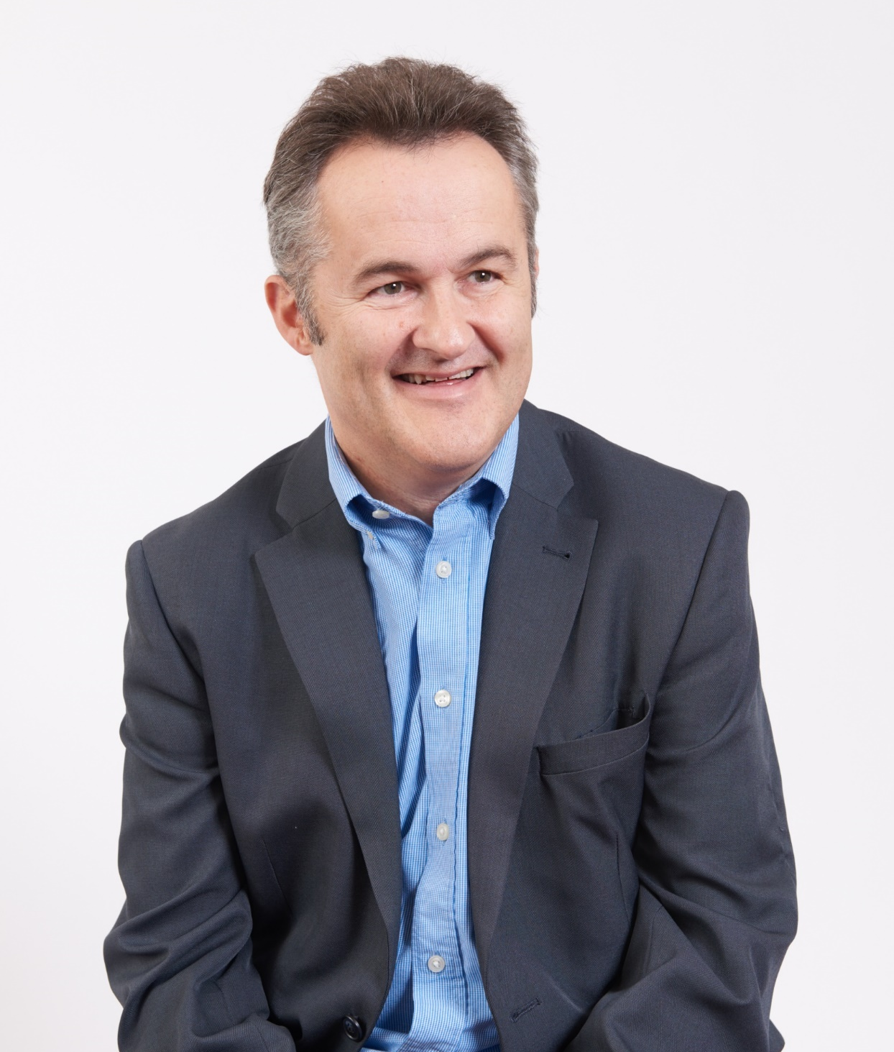

Speakers
Simon Craddock – Partner
Brethertons LLP
simoncraddock@brethertons.co.uk
Laura Morley – Barrister
4PB

Slide 3
Today we will discuss:-
Procedure
Evolution of fact-finding hearings through case law
Fact-finding hearings and domestic abuse in private law children proceedings – Guidance for Judges and Magistrates
Re H-N and others
Case Law post Re H-N
Outcome of Resolution survey
Practical tips and outcomes in real world examples

Slide 4
Case Management &
Relevant Legal Principles
Burden of proof – on the person making allegations
Standard of proof – “Balance of Probabilities”
Each allegation is proved or not proved – no fence sitting allowed

Slide 5
Evidence & Giving
Evidence in Court
Medical Evidence
Police Disclosure
Social Services
Propensity/Third Party evidence
Hearsay
LIES: R v Lucas[1982] QB 720 – Politician’s Defence
Similar Fact Evidence

Slide 6
Special Measures &
Vulnerable Witness
Part 3A FPR and PD3AA the court has the power to make special provisions to support vulnerable witnesses. E.g. Screens, separate waiting/conference rooms/exits or entrances, video link attendance and for shorter hearings simply turning the camera off
The importance of Part 3A FPR was highlighted in H v F [2020] EWHC 86 (Fam). On appeal Russell J found that there had been serious procedural irregularities at the hearing with regards to the witnesses

Slide 7
Evolution of Fact-Finding
Hearings through Case Law
L & Ors (children) [2000] EWCA Civ 194
  Children Act Sub-Committee of the Advisors Board of Family Law (see summary of Report in handout).
F v G [2020] EWHC
  Mrs Justice Judd highlights the importance of active case management/considering necessity of fact finding hearing at earliest opportunity and importance of PD 12J paras 16/17.
F v M [2021] EWFC 4 (Mr Justice Hayden)
  First known reported cases in the family courts that dealt comprehensively with allegations of coercive control. Very helpful list of paradigm (abusive) behaviours (see handout).

Slide 8
Impact of Re H-N on
Fact-Finding Hearings
Re H-N: Background
Four conjoined appeals, all of which involved women who had raised issues of domestic abuse in the context of private children proceedings
Main Points
  The court should examine the nature of the allegations and extent to which it is likely to be relevant in deciding whether to make a child arrangements order and in what terms
  the court should consider the purpose of a fact-finding hearing, namely to provide a basis of assessment of risk and the impact of the alleged abuse on the child
  the court should contemplate whether there is other evidence that provides a sufficient factual basis to proceed and the relevant to the issue before the court is the allegations are proved
  the court should consider whether a fact-finding hearing is necessary and proportionate bearing in mind the overriding objective

Slide 9
Re H-N: Comments on PD 12J
Purpose: to explain what the court is to do in any case where an allegation or admission is made in relation to domestic abuse perpetrated by the other party or there is a risk of such abuse being perpetrated.
PD 12J is focussed upon domestic abuse and harm in the context of child arrangements and contact orders; it does not establish a free standing jurisdiction to determine domestic abuse allegations which are not relevant to the determination of child welfare issues before the court (para 58)
Re-emphasises PD 12J para 16 - is a fact-finding necessary?
  To provide factual basis for any welfare report or other assessments
  To provide a basis for the accurate assessment of risk
  To consider any final welfare based order or
  To consider the need for domestic abuse - related activity

Slide 10
Re H-N: comments on PD
12J (continued)
Where court decides fact-finding hearing is necessary:
Only those allegations which are necessary to support the process should be listed for determination
Every case where domestic abuse is alleged both parents should be asked to describe in short terms their overall experience of being in a relationship with each other
Where one or both parties assert a pattern of coercive and/or controlling behaviour and where a fact find necessary, that assertion should be the primary issue for determination at the fact finding hearing. Any other more specific facts alleged should be selected for trial because of their potential probative relevance to the allegation pattern of behaviour and not otherwise unless any particular facts alleged are so serious that they justify determination irrespective of any pattern of coercive and /or control behaviour

Slide 11
Criticisms of
Scott Schedules
May prevent court from focussing on wider context where there has been patterns of coercive and controlling behaviour
By limiting allegations there is a risk that court presented with false portrayal of parties relationship
If the courts need to consider whether there was a pattern of controlling and coercive behaviour and determine specific allegations made, this may add to the length of proceedings (paragraphs [58] and [59] give guidance as to how this may be approached)
Serious thought needed to develop different ways of summarising and organising matters to be tried at fact-finding.

Slide 12
Fact-Finding Hearings and Domestic Abuse in Private Law Children Proceedings – Guidance for Judges and Magistrates (5th May 2022)
Hot off the press!
https://www.judiciary.uk/announcements/fact-finding-hearings-and-domestic-
abuse-in-private-law-children-proceedings-
guidance-for-judges-and-magistrates/

Slide 13
Key Points
The President asked Lady Justice Macur to engage with a small group of the judiciary to provide short/clear guidance of how the judiciary should approach Fact-Finding Hearings.
The summary of the points are:-
Very useful summary of the main points of PD 12J and the developments contained in PD 3AA and the Domestic Abuse Act 2021 Section 63.
Carpe-diem – make every hearing count – need for judicial continuity if possible – court to analyse and determine necessity of a fact find – extent of hearing and evidence required – views of parties/advocates/Cafcass persuasive but court should interrogate their reasoning
Consider time and place for determination of domestic abuse – must be relevant and necessary regarding child’s welfare

Slide 14
Key Points (continued)
MIAMS will not be waved through!
Has a MIAM taken place – if not, why not?
Duty of court to consider non-court Dispute Resolution
If MIAM exemption claimed on ground of domestic abuse - check evidence exists – FPR 38 (20)(akin to legal aid evidence list)
If appropriate invite mediator to advise whether mediation is possible – shuttle diplomacy/protective measures (but who pays for the mediator and what about mediator’s confidentiality?)

Slide 15
Key Points (continued)
Has a C1A been completed – if so is there a response – does the form and/or the response suggest a possible way forward without a fact find being necessary – if not – is it appropriate to obtain a verbal summary of any allegations and/or response during the hearing in order for progress to be made
Does the C100/C1A/Safeguarding letter suggest need for fact find
Reminder that the judgment in H v N cautioned against allowing a Scott Schedule to distort the fact finding process (by becoming the sole focus of the hearing) but the Court of Appeal did not rule out the use of a schedule as a structure to assist in analysing specific allegations
Identify real issues – is one party denying contact per se or are they seeking to add conditions
  - what issues relate to child’s welfare
  - what domestic abuse alleged

Slide 16
Key Points (continued)
In determining what further evidence/documentation is needed – nature of allegations will be important – allegations which can be clearly defined – ie. specific incidents of physical abuse (maybe suitable for reduction to a schedule) – others require patterns of behaviour and a statement ie. coercive and controlling behaviour
A hybrid of the two, dividing types of abuse into clusters maybe appropriate
Ensure the court obtains essential information of every allegation at a early stage – what, when, where – what was the affect on the children and the parent – were there witnesses – what other evidence might be available – is the behaviour complained of because of the breakdown of the relationship rather than a/the cause of the breakdown

Slide 17
Case Law since Re H-N
AB v CD [2021] EWHC 819 (Mrs Justice Roberts)
Handed down on the same day as Re H-N
cross allegations of domestic abuse in private law proceedings
F seeks contact with parties’ one child
M raises domestic abuse and two separate Scott Schedules
Judges findings:
F sexually abused M on 2 occasions
F emotionally abused M
From 2011 and ongoing F would insult, criticise and demean M
In December 2014 and ongoing F threatened to remove child to Pakistan
Such threats of removal were made in the context to embarrass her professionally
In respect of F’s claims – held M tried to snatch his credit card and subsequently so thrown items from her dressing table onto floor

Slide 18
AB v CD [2021] EWHC 819
(continued)
F appealed – eight grounds for appeal
Mrs Justice Roberts set aside judgment and remitted for early re-hearing. She sympathised with Judge as did not reserve her judgment and had limited time frame, but made the following findings:
  Insufficient reasoning to explain how the Judge conducted her assessment and credibility and which matters she did or did not weigh in the balance when reaching her conclusions
  Mistake to have included within the approved order a recital saying about “strength and power” of allegations which the Judge claims to have ignored in her survey of the evidence
  In a case where one party is alleging that allegations have been fabricated as part of the course of conduct designed to marginalise a parent from the life of the child of the family it is incumbent on the fact finder to explain carefully why that case is rejected
  Judge fell into error in compartmentalising much of the evidence – she did not have sufficient regard to how each piece of the evidence fell to be considered against the totality of the evidential canvas

Slide 19
Re JK (A child) [2021]
EWHC 1367 (Fam)
(Mr Justice Poole)
Parties had an arranged marriage in South Asia in December 2013. M moved to England to be with F in August 2017. Only child born December 2017. Parties moved to South Asian country in 2018.
M had removed child (then aged just under 2 years of age) from South Asian country to England in October 2019
F issued Wardship proceedings with Guardian (officer of Cafcass High Court appointed to act for the child)
F conceded child could stay with M in England, but did not agree on contact – hearing on 13th April 2021 utilised as fact-finding with Guardian to report further in light of findings made
Judge did not dispense with already completed composite Scott Schedules (including 18 allegations made by M) but also sought short narrative summaries from the parties about allegedly coercive and/or controlling behaviour

Slide 20
Re JK (A child) [2021] EWHC 1367 (Fam) (continued)
Judge’s Findings:
F had used physical violence versus M on numerous occasions from October 2014 – August 2019
Judge did not find it proved that M prevented F having contact with child between July 2019 – October 2019
Interest in case:-
  When the Judge asked for short narrative summaries of coercive and/or controlling behaviour of the other – said summaries were very different in style “and illustrated the complexities involved in presenting allegations for a Finding of Fact hearing such as this one where there are over lapping allegations by the Mother against the Father of coercion and control, physical violence against the mother, physical violence against the child, and allegations by the father against the Mother of control, fabrication and abduction. How can the party alleged a pattern of coercion and control over a relationship that has lasted several years present that case for a Finding of Fact hearing in a way that is proportionate and manageable and without giving a day by day account of the whole relationship”. (Paragraph 25)
  “Some specific instances of behaviour will not constitute abuse themselves and may appear to be relatively trivial if looked at in isolation but are in fact important evidence of a pattern of abuse, or the effects of abuse, when set alongside other findings”. (Paragraph 26)

Slide 21
A Child (Application of PD 12J)
[2021] EWFC B59
Parties started relationship in 2009 – parties married in Republic of Ireland in 2010 – 3 children of the family – parties moved to England in 2017 – residing in Dorset
M removed children to Yorkshire without F’s knowledge and took them to a refuge
24th August 2021 – F sought order for children to return to Dorset and a Prohibited Steps Order to prevent children from being removed from England and a spend time with Child Arrangements Order
1st September 2021 – M made application to transfer proceedings to Yorkshire and for a Prohibited Steps Order to prevent children from being wrongfully removed from the country. M accused F of sexual abuse and controlling and coercive behaviour

Slide 22
A Child (Application of PD 12J)
[2021] EWFC B59 (continued)
DJ noted children had lived and attended school locally for 4 years and uprooted and moved 300 miles away
DJ concerned about schools in Yorkshire – referred to PD 12J and F v M [2021] EWFC 4 – didn’t have children’s wishes and feelings
If M refused to return to the area there should be an order for children to live with F in the interim – conscious that safeguarding letter suggested no contact but was predicated on M’s allegations and no interview with F
Judge ordered shared care where F sought same and M sought no contact
Gave mother 48 hours to return children failing which transfer of residence on an interim basis “whilst we sort out PD 12J and directions that we can now go through”.

Slide 23
A Child (Application of PD 12J)
[2021] EWFC B59 (continued)
M appealed – heard on 30th September 2021 – appeal allowed
Considerable sympathy for DJ – faced with unclear and developing allegations – decision carried risk of harm to the children either way
Very thorough judgment – felt that the court needed a cautious approach to the question of orders that could and should be made and the potential for resulting harm including emotional and psychological harm
Whilst open to the DJ to take critical or sceptical approach to the allegations of domestic abuse made by the M in this case not open to the DJ to effectively dismiss them summarily or set them to one side or the purpose of making interim orders

Slide 24
A Child (Application of PD 12J)
[2021] EWFC B59 (continued)
DJ did not engage with PD 12J until very much as an after thought once he had determined the interim orders he would make
DJ dismissed the question of risk without sufficient analysis especially on the more subtle question of coercive or controlling behaviour
Gave insufficient weight to Cafcass recommendations
Whilst addressing welfare check list in relation to question of removal DJ did not apply it holistically in relation to question of return to the father whilst spending time with him
Interesting conclusion that W could move back into fmh with the children as F agreed

Slide 25
A Child (Application of PD 12J)
(No 2 Findings of Fact) [2022] EWFC B5
(appeal from A Child (Application of PD 12J) [2021] EWFC B59)
Second Hearing on 20th – 22nd December 2021 before His Honour Judge Dancey (Fact Find)
W made 4 sets of allegations
  Failure by F to disclose to M until 1st November 2017 that he has HIV positive
  Incidents of rape from 2013 and in 2018
  Coercive and controlling behaviour including economic abuse
  Unreasonable physical chastisement of the boys
Answer – F did not accept M’s findings – found that M had fabricated allegations against F
Made finding that whilst it was abhorrent and abusive in the terms of F’s non disclosure of his HIV positive status it did not create a risk to the children or to the mother and should not be seen as an impediment to ongoing or unrestricted relationship with the children through contact

Slide 26
A Child (Application of PD 12J)
(No 2 Findings of Fact) [2022] EWFC B5
(appeal from A Child (Application of PD 12J) [2021] EWFC B59)
Case helpfully reminds courts that the evidence of vulnerable witnesses is likely to be diminished by their vulnerability – deals with special measures including screens/separate waiting rooms, breaks during evidence (paragraphs 7 – 10)
Judge makes point that controlling and coercive behaviour is defined in PD 12J in terms of behaviour used (coercive) or designed (controlling) to harm a victim. He states at paragraph 179 “in my view, to prove controlling or coercive behaviour (rather than a more widely defined domestic abuse) does require an element of intent on the part of the perpetrator to bring about the harmful affects of their behaviour”.

Slide 27
Re B-B
(Domestic Abuse: Fact-Finding)
[2022] EWHC 108 (Fam)
(Mr Justice Cobb)
One of the hearings remitted to the Court of Appeal in Re H-N
Seventh occasion on which the case was listed for a fact-finding hearing – previous attempts for hearing – judicial unavailability – legal aid issues – M’s recent allegations of serious sexual assault and/or rape to the police

Slide 28
Re B-B
(Domestic Abuse: Fact-Finding)
[2022] EWHC 108 (Fam)
(Mr Justice Cobb)
Judge followed Court of Appeal guidance and Mr Justice Poole’s comments in Re JK and used subject headings of:
  Emotional control/coercion
  Physical abuse
  Infidelity
  Financial control
  Sexual assault
Not treated incidents as freestanding events but as part of wider pattern of alleged abuse for controlling or coercive behaviour
Judge talks about clusters of types of abuse:
  “Inevitably, the evidence relevant to each form of abuse overlapped in places, but in looking at the evidence by reference to the different forms of alleged abuse, a picture was built up of the nature of the relationship under scrutiny, and it was easier to see whether patterns of behaviour emerged.”

Slide 29
Re B-B
(Domestic Abuse: Fact-Finding)
[2022] EWHC 108 (Fam)
(Mr Justice Cobb)
Judge makes helpful comments on
  Delay in hearing evidence, compromised quality of evidence as well as taken toll on the parties
  Flexible arrangements needed to ensure participation directions truly meet needs of parties
  Advocates need to focus on issues necessary to determine the case – submissions and oral evidence must be cut down to what court needs to hear
  Evidence of the parties is always likely to be more valuable that third parties – Judge must rigorously test what value third party provides

Slide 30
RA v MA (Fact Finding) [2022]
EWFC B14 (HHJ Willans)
F issued proceedings to spend time with child
5 allegations of abuse alleged by F to M – Judge said he would not confine himself “rigidly” to the 5 allegations and took into account the witness statements
He referred to the case of B – B before Mr Justice Cobb highlighting and understanding that in cases where there is potential coercive and controlling behaviour the court must look to build up a picture of events which is not possible if constrained to rigid schedule – made finding that M had made false allegations with intention of obstructing contact – discharged continuance of non-molestation

Slide 31
K v K [2022] EWCA Civ 468
(lead judgment Sir Geoffrey Vos, Master of the Rolls)
Matter came before DJ Capon before Re H-N was handed down
Parties married 2005 – separated August 2017
3 children, boy aged 12 and twins aged 9 – F had unsupervised contact after disagreement over logistical arrangements – early 2018 the boy refused to see F
December 2019 F issues C100 complaining of parental alienation and seeking to formalise weekends and holidays

Slide 32
K v K [2022] EWCA Civ 468
(lead judgment Sir Geoffrey Vos, Master of the Rolls)
F claimed exemption from MIAM claiming urgency – M completed C1A with “a number of relatively minor allegations” versus the father but also controlling behaviour and rape – M’s C1A did not object to F spending unsupervised time with children – Safeguarding letter raised alleged rape as issue and advised court to consider a Fact Find – Judge directed 2 day Fact Find hearing – issues were:
  Allegations of rape during the marriage
  Verbal abuse and bullying exemplified by WhatsApp exchanges between the father and mother on 18 June 2019 (the June 2019 WhatsApp)
  Controlling behaviour
  An incident on 23 January 2018 where the father had allegedly upset A by asking questions about what the mother had said about him
  An allegation of encouraging the children to get into bed with the father whilst he and his partner were naked
  Physical abuse of the children exemplified by flicking B’s ear
  Financial control

Slide 33
K v K [2022] EWCA Civ 468
(lead judgment Sir Geoffrey Vos, Master of the Rolls)
Conclusions from Court of Appeal:
  Unfortunate court did not take advantage of the MIAM (Paragraph 6)
  At the FHDRA M’s C1A where she did not object to contact should have been explored (Paragraph 7)
  Fact-finding only needed if alleged abuse is likely to be relevant to what the court is being asked to decide relating to the children’s welfare (Paragraph 8)
  Finding that F raped M is unsafe – Judge focused too heavily on question of whether M had a conversation complaining about F’s conduct rather than all evidence including untrue assertion by M that she had reported version of incident to her GP (Paragraph 9)
  Judge ought to have considered all the allegations – was the F demonstrating coercive and controlling behaviour affecting the children’s welfare after separation (Paragraph 10)
  Judge found no evidence of financial control but relied on WhatsApp messages on one day. He had not found ear flicking amounting to child abuse yet his order said he found physical abuse of all 3 children to be proven (which he had not)
  The appeal is allowed and sent back to Circuit Judge as to whether a fresh Fact Finding is required but successful mediation or other consensual resolution would be very much for the benefit of the children

Slide 34
K v K [2022] EWCA Civ 468
(continued)
“It seems that a misunderstanding of the court's role has developed. There is a perception that the Court of Appeal has somehow made it a requirement that in every case, in which allegations of domestic abuse are made, it is incumbent upon the court to undertake fact-finding, involving a detailed analysis of each specific allegation made. That is not the case. As Re H-N explained and we reiterate here, the duty on the court is limited to determining only those factual matters which are likely to be relevant to deciding whether to make a child arrangements order and, if so, in what terms”. (paragraph 67)
“All judges hearing children cases will know that there will almost inevitably be emotional fallout following the separation of adults who have been in a close relationship. Whilst the court will not hesitate to adjudicate upon parental behaviour where this impacts upon the protection or welfare of a child, it is not for the court to hear about, much less to resolve, issues between the parents relating to their time together, unless to do so is likely to be necessary for, and proportionate to, the resolution of a dispute relating to the protection of a child” (paragraph 89)

Slide 35
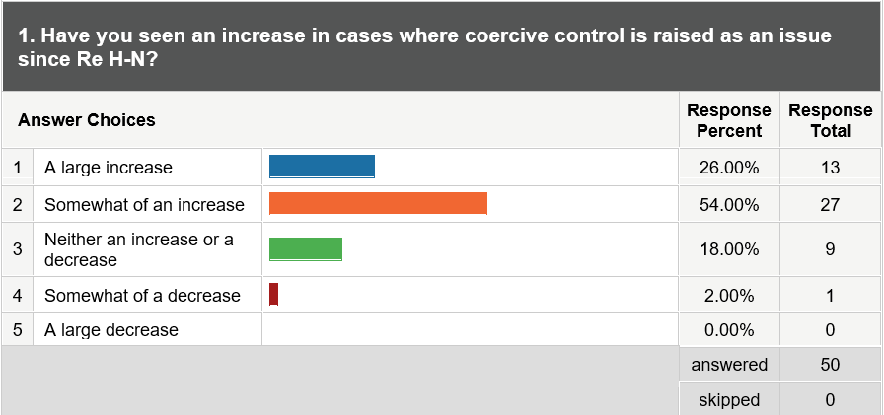
SURVEY RESULTS

Slide 36
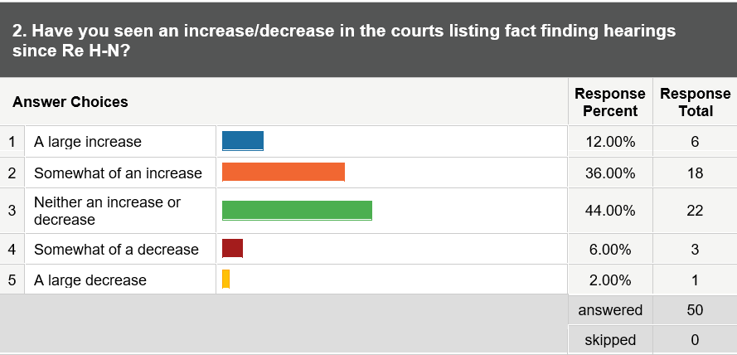
SURVEY RESULTS

Slide 37
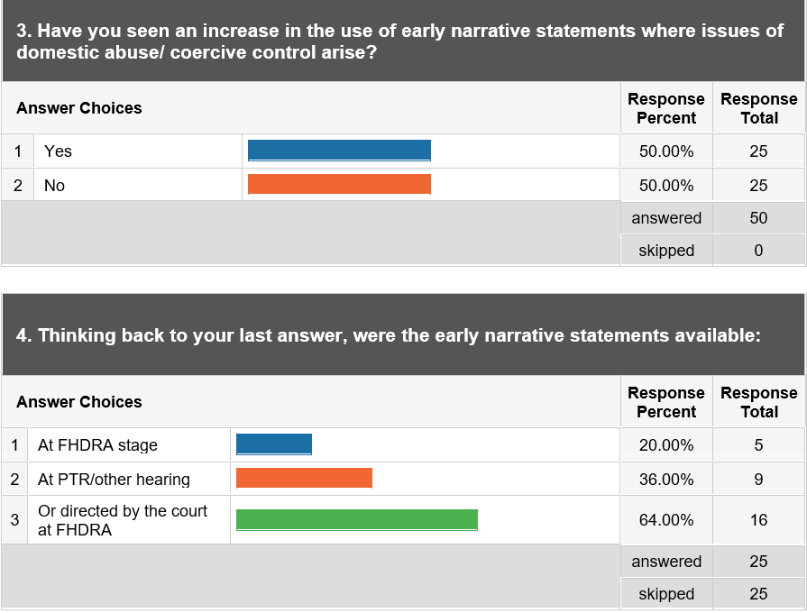
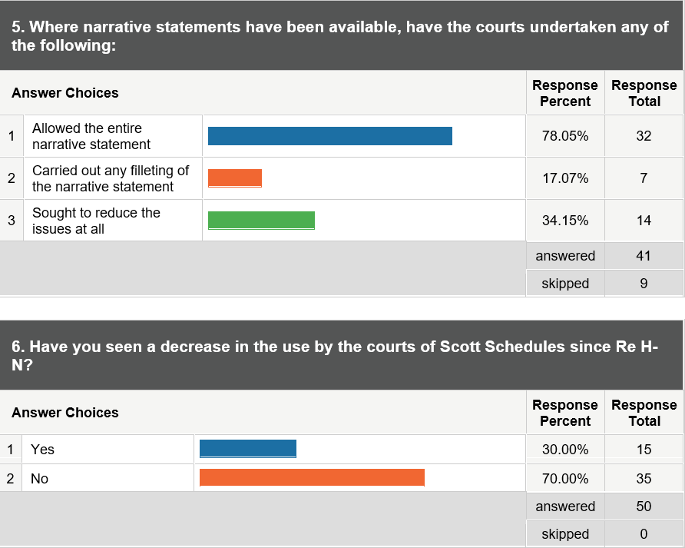
SURVEY RESULTS

Slide 38
Practical Issues
When to consider applying for permission against the decision of a fact-finding hearing:
  New information ie. police information/foreign court documents
  Change of allegiances
  Failure by trial Judge to follow PD 12J
  Failure by court tribunal to follow guidance in – Fact-Finding Hearings and domestic abuse in Private Law children proceedings – Guidance for Judges and Magistrates – 5th May 2022

Slide 39
Practical Issues (continued)
2. Costs
Helpful case by Mrs Justice Arbuthnot published 4th April 2022 (C v S [2022] EWHC 800 (Fam)
F pursued costs versus M after various hearings including Finding of Fact hearing
Mrs Justice Arbuthnot found had erred/or was wrong to conclude that Respondent’s conduct in the relevant proceedings had been “anything other than unreasonable” and/or reprehensible

Slide 40
Practical Issues (continued)
Mrs Justice Arbuthnot stated that whilst costs were not the norm in these proceedings the court must consider whether it was reasonable for a party to raise a concern of allegation or issue and whether it has exaggerated it’s claim.
F had spent £370,000 on legal costs
Judge should not have excused mother’s psychological or emotional presentation for her conduct during the Fact Find
Paragraph 179 “It would be wrong too for a party to behave in this way with impunity as it comes with a tremendous cost to the privately funded litigant, the legal aid fund when the party is legally aided and the court in terms of the length of time this case ended up taking”.
Costs order made for £37,000

Slide 41
Practical Issues (continued)
3. What advice do you give to someone who either says that they are the victim of domestic abuse and intends to flee with the children to a refuge in a different part of England and Wales or is about to do so?
4. What is the position of a legally aided client who engages in a Finding of Fact hearing on the basis that the other party is domestically abusive and no findings are made against the other parties and/or findings are made against the legally aided client?
5. Get your paperwork in order early – C100 & C1A!
6. Adjourn FHDRA – narrative statements whilst obtaining further disclosure

Slide 42

Any questions?

