Slide 1
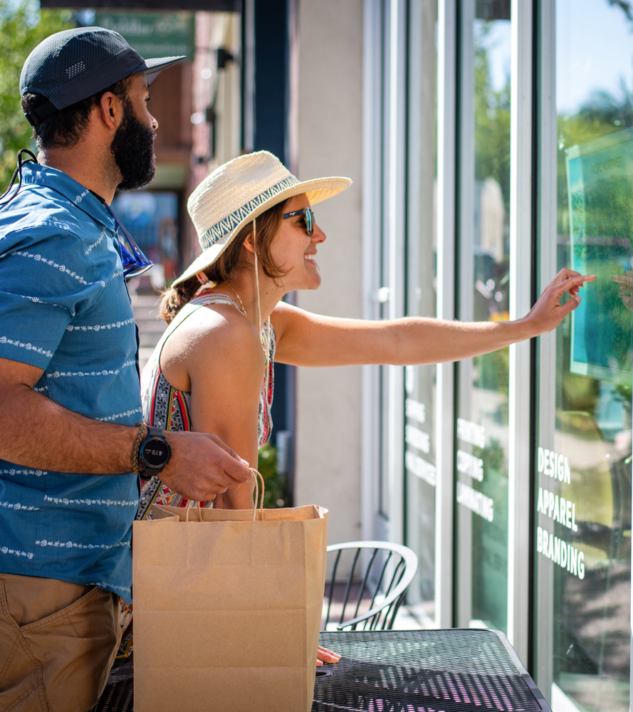

2022 state tourism statistics
VISITOR VOLUME
102.2 million (+7.3%) – 93% of 2019
VISITOR EXPENDITURES
$22.1 billion (+24%) – 101% of 2019
VISITOR GENERATED TAX RECEIPTS
$3.1 billion (+19.6%) – offsets average household tax burden by $1,047 (+16%)
TOURISM EMPLOYMENT
145,305 direct jobs supported (+10.5%)
Source: Tourism Economics, 2022
Notes:
Body copy size may need to increased or decreased to accommodate content. The current size of 16pt. is a general size.
The side image can be quickly replaced by selecting it and deleting. Then a small picture icon will appear in the middle of the picture box. Click on it and you can then browse to a new image to use.

Slide 2
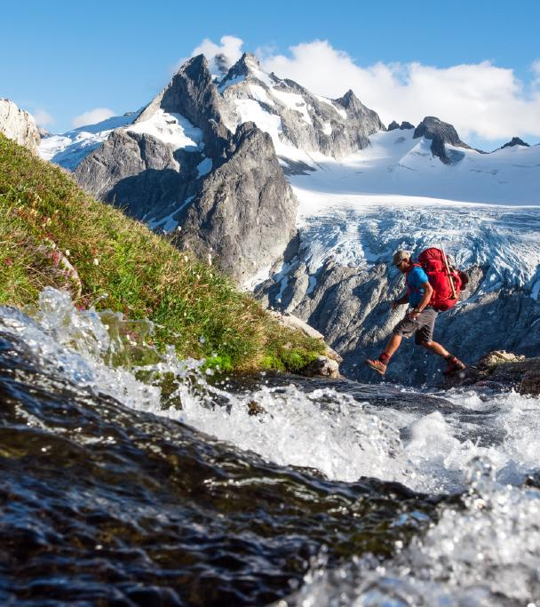
Out-of-state (non-resident) visitation
Status: 47% of the total annual domestic visitor volume in Washington is non-resident (44 million out-of-state visitors annually)
Overnight visitor spending breakout:
Hotel guests spend twice as much as visitors staying with friends and family, and 1.5 times more than vacation rental guests
Source: Tourism Economics, 2022
Photo via Port of Seattle

Slide 3
Rebuilding state tourism program
2011 State tourism office closed in Great Recession
2018 Base funding/2:1 private/public match = $3M/biennium
2021-22 Port of Seattle recovery partnership = $1.5M
2021-23 Legislative proviso (federal relief funds) = $12M
2023-24 Port of Seattle overseas marketing contract = $800,000
2023-25 Biennial base funding increase, match lowered to 1:1 = $9M
Notes:
Body copy size may need to increased or decreased to accommodate content. The current size of 16pt. is a general size.

Slide 4
Tourism Recovery index
Growth in expenditures and tax revenue – 2019 to 3/31/23
Destination Biennial Tourism Travel Spending Tax Revenue
Budget Growth Growth
U.S. (nat. average) $400M +4.3% +3.8%
Oregon $91M +0.7% +0.7%
Montana $80M +27.2% +26.0%
Utah $70M +20.3% +19.7%
Colorado $61M +7.3% +6.9%
Arizona $53M +10.0% +9.6%
Washington $9M -3.0% -2.8%
Source: U.S. Travel Association/Tourism Economics
Notes:
Body copy size may need to increased or decreased to accommodate content. The current size of 16pt. is a general size.

Slide 5
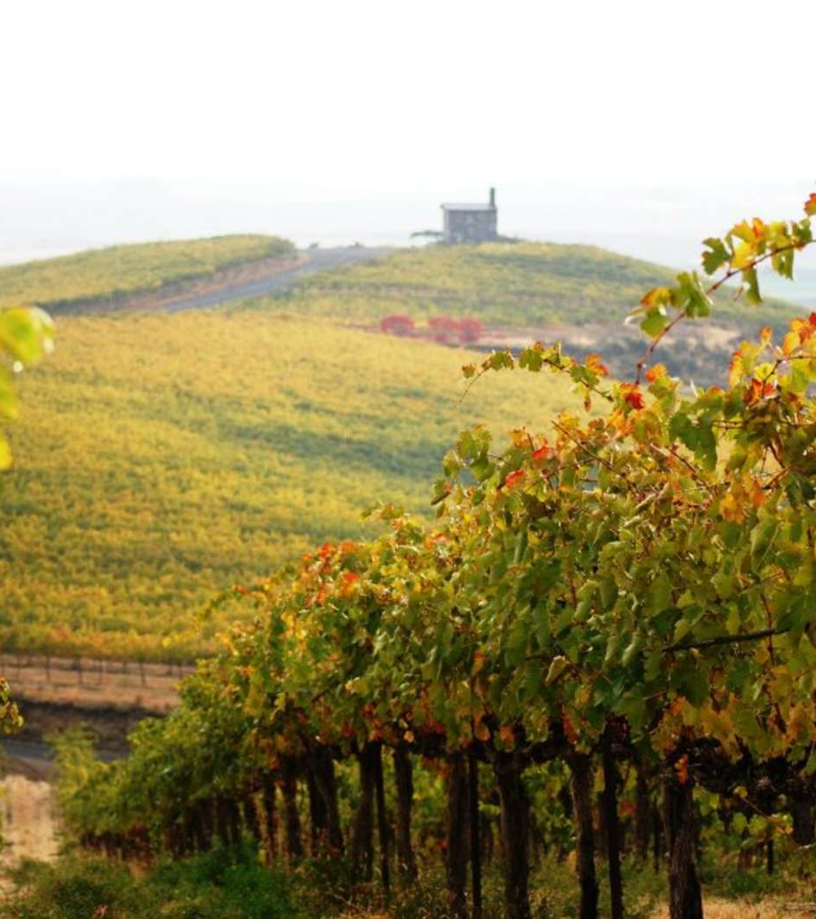
State Tourism Program Rebuilt
Industry development, recovery & education – rural/underserved focus
Destination Management strategies
Rebranded state destination
Consumer advertising campaigns
Responsible travel focus
Travel publicity program
International marketing and tour development
Notes:
Body copy size may need to increased or decreased to accommodate content. The current size of 16pt. is a general size.
The side image can be quickly replaced by selecting it and deleting. Then a small picture icon will appear in the middle of the picture box. Click on it and you can then browse to a new image to use.

