Slide 1

Designing Open Standards-Based Safety Critical Communications for
Future Airborne Systems
Thijs Brouwer
Senior Field Application Engineer, Real-Time Innovations (RTI)

Slide 2
Complexity in Avionics
©2024 Real-Time Innovations, Inc
Notes:
10:00 Any questions so far?
Now I will start with the overview of the concepts behind the DDS standard.
What was DDS designed for?
Distributed real time systems.

Slide 3

The Avionics Challenge
Platform Transition from Hardware-Defined to Software-Defined Systems
Increased Complexity of both Hardware and Software Solutions
Evolution of Higher Autonomy in Airborne Systems
Global Competitiveness
Adherence to Industry Standards and Conformance
Cost and Time for Airworthiness and Safety Certification
Portability across platforms, especially new autonomous platforms
Rapid Integration with Industry / Platform Solution Stack Suppliers
©2024 Real-Time Innovations, Inc.
Notes:
Central computing for optimized cost, weight, power distribution, security, flexibility
The trend started with the consolidation of ECUs and domains, Trend points towards centralization In one high-performance computer.

Slide 4

DDS is the Foundation of Open Standards
DDS is the software connectivity foundation for over 20 cross-industry open standards, enabling the rapid integration of Open Systems Architectures (OSA) and deployment of Modular Open Systems Approach (MOSA) platforms
ALMAS
CMS Alerts
AUTOSAR
Automotive
CMOSS
Vehicular EW
CARACaS
Marine Robotics
CIGI
MS&T
FACE
Military Avionics
GCIA
Military Vehicle
GVA/NGVA
Military Vehicle
LOSA
Military Vehicle
MOCU
Robot Control
NOA
Naval Ship
OMS
Military Avionics
New!
ROS2
Robotics
SOSA
Military Avionics
TMSC
Power Microgrids
UMAA
Maritime Robotics
UCS
UAS Control
More…
DDS
Notes:
CMS = Combat Management System
MS&T = Modeling, Simulation, and Training
UAS = Unmanned/Uncrewed Air System
ALMAS -- ALert MAnagement Service in Combat Management Systems (CMS), consisting of a standard alerts data model, a model for an alert delivery and a lifecycle management service
https://www.omg.org/spec/ALMAS/1.1/About-ALMAS
AMSM -- Application Management and System Monitoring – Naval Combat Management System (CMS)
https://www.omg.org/spec/AMSM/
AUTOSAR Adaptive
Connext DDS supported as a network binding in the AUTOSAR Adaptive Platform beginning with the 18.03 release
https://www.autosar.org/standards/adaptive-platform
CMOSS -- C4ISR/Electronic Warfare Modular Open Suite of Standards (CMOSS) is a modular open systems architecture (MOSA) intended to converge select Army warfighting capabilities – such as mission command, movement and maneuver, and fires – into one system vs. integrating a multitude of separate capability “boxes” into vehicles.
https://www.army.mil/article/219848/armys_investments_for_the_future_yield_common_open_architecture
CARACaS -- Control Architecture for Robotic Agent Command and Sensing
Connext DDS is used as the connectivity framework in MOCU
https://ieeexplore.ieee.org/document/6107312
CIGI -- Common Image Generator Interface
CIGI Next will be built on DDS and Connext DDS as the interface
https://en.wikipedia.org/wiki/Common_Image_Generator_Interface
FACE -- Future Airborne Capability EnvironmentRTI is an Open Group FACE Consortium member and RTI Connext TSS was the world’s first certified conformant FACE Transport Services Segment (TSS) for both FACE Technical Standard 2.1 and FACE Technical Standard 3.1. RTI also offers commercial RTCA DO-178C DAL A certification evidence for Connext TSS 3.1
http://www.opengroup.org/face
GCIA -- Ground Combat Systems' Common Infrastructure Architecture integrates multiple systems and eliminates redundancies in fighting vehicles by using open architecture
https://www.army.mil/article/210117/reusable_and_refresh_able_open_systems_architecture_for_fighting_vehicles
GVA -- Generic Vehicle Architecture
The UK MoD GVA (DEF STAN 23-09) requires DDS
https://en.wikipedia.org/wiki/Generic_Vehicle_Architecture
LOSA -- Land Open Systems Architecture
The UK MoD GVA is part of LOSA and therefore requires the use of DDS
https://ui.adsabs.harvard.edu/abs/2013SPIE.8742E..0CP/abstract
MOCU -- Multi-Robot Operator Control Unit
Connext DDS is used as the connectivity framework in MOCU
https://apps.dtic.mil/sti/citations/ADA449450
NGVA -- NATO Generic Vehicle Architecture
The NATO version of the GVA (NGVA) standard (STANAG 4754) requires DDS
https://www.natogva.org/
NOA – Navy Open Architecture
https://www.usni.org/magazines/proceedings/2010/june/naval-systems-open-architecture-versatility-through-flexibility
OMS -- USAF Open Mission Systems
DDS is a supported publish/subscribe protocol in the Critical Abstraction Layer (CAL)
https://www.vdl.afrl.af.mil/programs/oam/oms.php
ROS2 -- Open Robotics Robotic Operation System V2 (ROS2 / ROS-Military)
ROS2 is built on top of DDS as a connectivity framework, with RTI Connext DDS as an option
ROS-Military (ROS-M) is built on top of ROS2
https://www.ros.org/
SOSA -- Sensor Open Systems Architecture
RTI is an Open Group SOSA DDS/RTPS is a SOSA Interaction Binding
https://www.opengroup.org/sosa
TMSC -- Tactical Microgrid Standards Consortium
TMSC requires DDS for communication
https://www.nationalacademies.org/documents/embed/link/LF2255DA3DD1C41C0A42D3BEF0989ACAECE3053A6A9B/file/D75F0F083ECEDF19C44CADF56755799FF6216E08625F?noSaveAs=1
UMAA -- Unmanned Maritime Autonomy Architecture
DDS is a supported transport protocol
https://www.dsp.dla.mil/Portals/26/Documents/Conference/2020-StateofDSPConf_Rothgeb.pdf?ver=lofexQym-3TE8qM4Tkqn6w%3D%3D
UCS -- Unmanned Systems (UxS) Control Segment Architecture
The UCS Architecture supports DDS. Most UCS implementations use DDS
https://www.sae.org/standards/content/as6512b/
More…

Slide 5
Software Defined Everything (SDx)
©2024 Real-Time Innovations, Inc.
Notes:
10:00 Any questions so far?
Now I will start with the overview of the concepts behind the DDS standard.
What was DDS designed for?
Distributed real time systems.

Slide 6
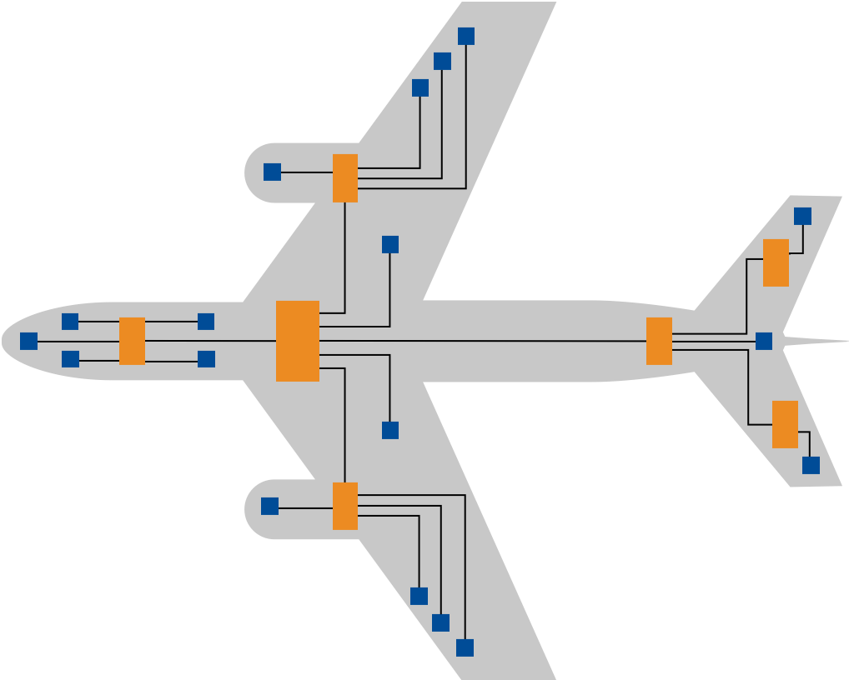
Federated Avionics
App 0
DAL ‘X’
Kernel/RTOS
Single/Multi-Core Hardware
Stand-alone distributed hardware base
Dedicated physical nodes and communication channels
Traditional architecture pattern for avionic systems
Typically aircraft platform-specific
  Reduced portability and reusability of software
High Size, Weight and Power (SWaP) requirement
  Every box needs power, cabling, cooling, etc.
SLS -- Single level of Safety and Security
  All code tests at system high

Slide 7
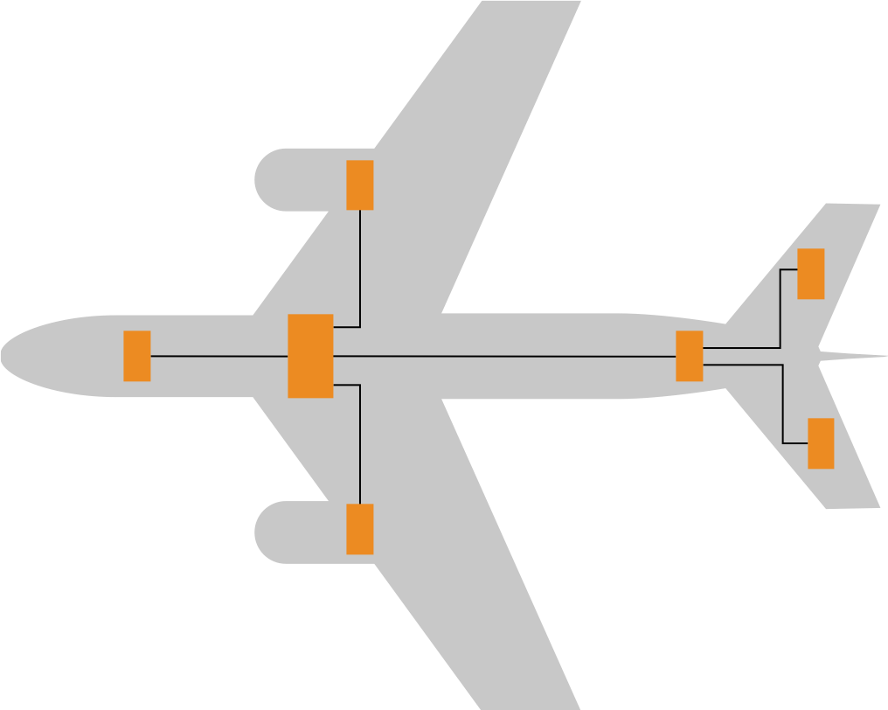
Integrated Modular Avionics (IMA)
App
0
App
1
App
2
App
3
Kernel
Single/Multi-Core Hardware
ARINC 653 standard invented by Honeywell for Boeing 777
ARINC OS Partitioning
Reduces SWaP footprint; Improved software reuse
Can be challenging to certify on more complex microprocessors
  Multicore Certification Ongoing
DDS can decrease data coupling, essential to robust partitioning
Deterministic Ethernet: AFDX / TSN
Notes:
Increased complexity of software to address consolidation of sub-systems
Standards-based interfaces (ARINC 653) Removed this
Reduced SWaP footprint
Promotes modular, portable, and reuse of software

Slide 8
Data Centricity
©2024 Real-Time Innovations, Inc.
Notes:
10:00 Any questions so far?
Now I will start with the overview of the concepts behind the DDS standard.
What was DDS designed for?
Distributed real time systems.

Slide 9
Database
Databus
Application
Application
Data store & retrieve
Data send & receive
Homogeneous API
Types - Tables
Homogeneous API
Types - Topics
QoS
integrity - redundancy
QoS
integrity - redundancy
Security
auth - auth - encryption
Security
auth - auth - encryption
Data at rest
Data in motion
Notes:
DB: What is a database and why is it so successful?
Slower than raw data => still successful
Robust design pattern:
Decoupling the what from the how
Data + types is the smallest interface and (almost) never changes!
Examples:
Avionics: (Roll, Pitch, Yaw) (Position, Altitude, Air Speed)
Navy: Position, Bearing, Speed.
Medical: Pulse, Temperature, Blood pressure
Homogeneous API across a wide range of platforms and programming languages
Message-based systems are dependent on the ‘language’ : protocol, format, serialization.

Slide 10
PoC 1: DDS + TSN
Notes:
50:00

Slide 11
Dataflow Challenge
Data Source
Data Type
Data Volume
Data Frequency
Cameras
Video Stream
Lidar
Data List
Radar
Point cloud
GPS
Bin data struct
Control Cmd
Bin data struct
Error
Text String
What if you could use a single solution for all your dataflows?
Notes:
Large data from cameras
Control commands,
Without DDS:
- Different dataflow requirements lead to different transports being used.

Slide 12
Solution: Dataflow QoS
DDS QoS Features
Reliability
In-Order Delivery
Batching
Resource Limits
Partition
Deadline
Content Filtering
Presentation
Ownership
Transports
Time Based Filter
Durability
Lifespan
Flow Control
Multi-Channel
Liveliness
Latency Budget
History
User, Group, Topic Data
Async Publisher
Transport
UDP
TCP
Shared Memory
Ethernet

Slide 13
What is Time Sensitive Networking (TSN)?
Deterministic Time Division Multiplexing on the Network
Critical applications have guaranteed bandwidth + latency
IEEE TSN Avionics Profile being defined
TSN Configuration Cumbersome and Error-Prone
©2024 Real-Time Innovations, Inc.

Slide 14
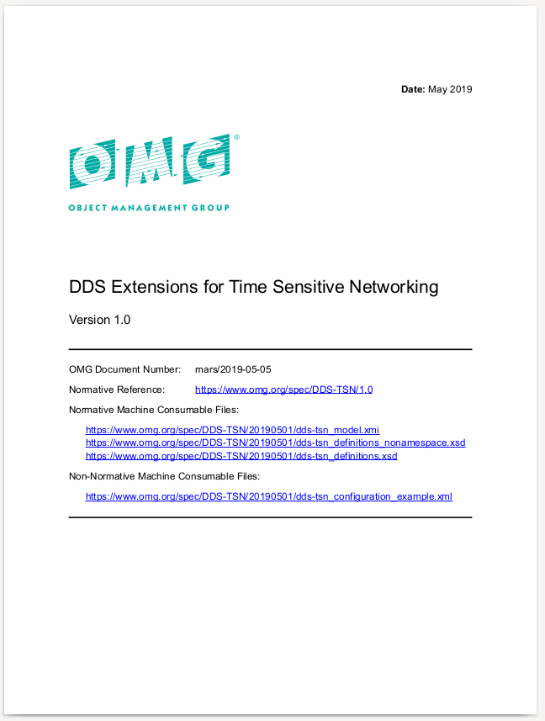
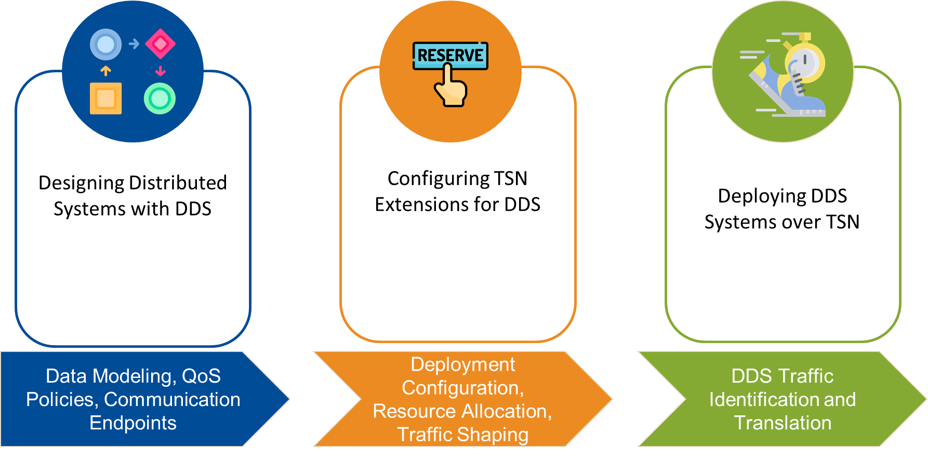
DDS-TSN Standard
RTI was lead author for the newly-released OMG® DDS-TSN spec (multi-vendor effort).
The standard covers:
  Configuration of DDS-XML systems
  Operation of RTPS over TSN
  QoS Policy consideration when operating over TSN

Slide 15



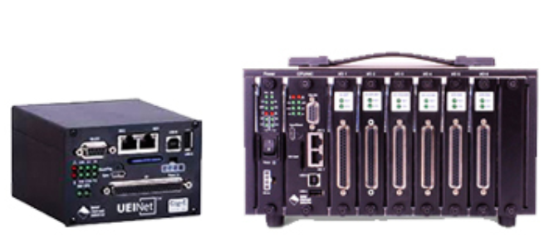
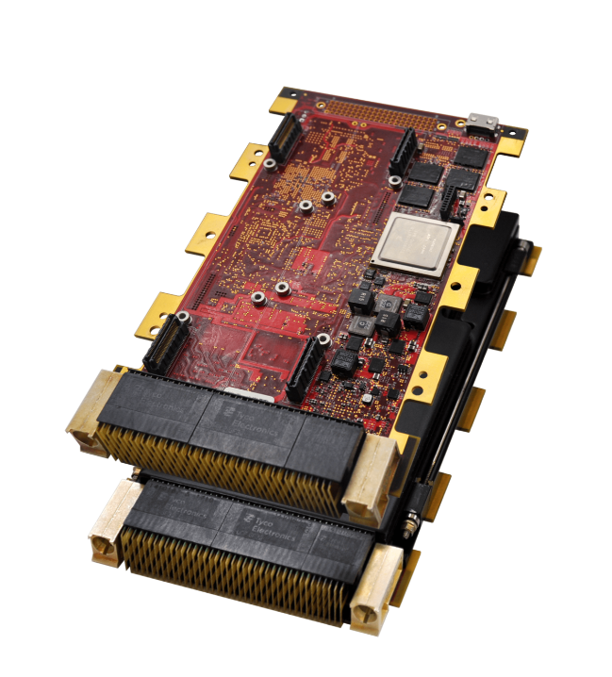
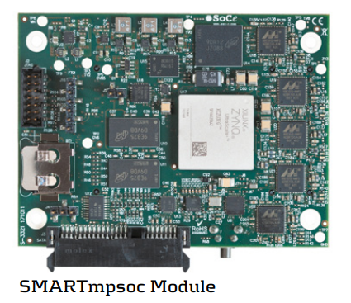
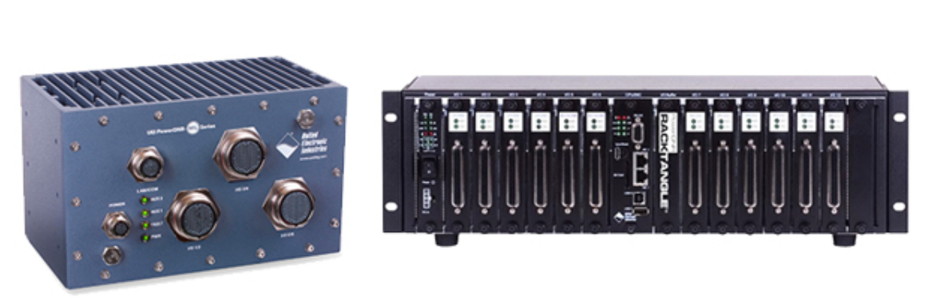
DDS-TSN Partners for Avionics
©2024 Real-Time Innovations, Inc.

Slide 16
PoC 2: COTS DO-178C DAL A
HW + RTOS + Software
Notes:
50:00

Slide 17
DDC-I, NAI and RTI Integrated Solutions Stack
RTI
RTI Connext TSS
RTCA DO-178C
Deos ARINC 653 Safety RTOS
RTCA DO-178C
DDC-I
NAII
68PPC2-2 3U VPX SBC
RTCA DO-254
NXP
PPC QorIQ T2080
RTCA DO-254

Slide 18





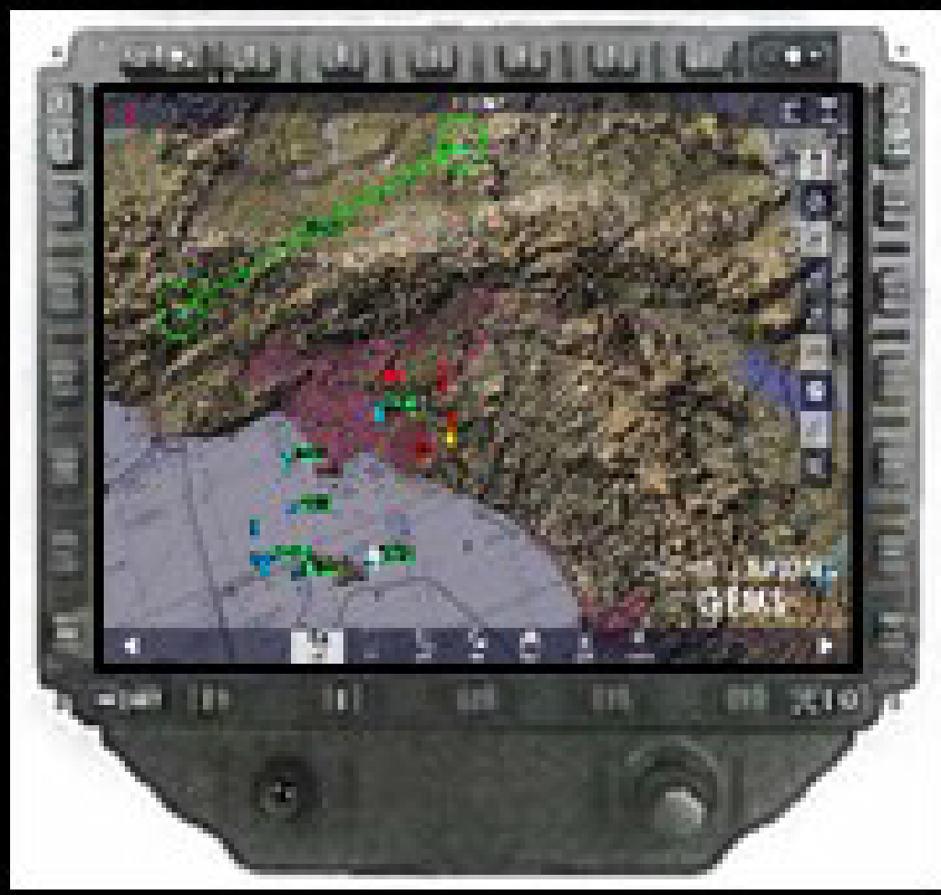
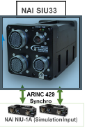
FACE Demonstration
FACE Boundary
Operating
Portable Components Segment
System
Transport Services
Segment
OS
TS
Segment (TSS)
Engine Monitoring
ATC Manager
Transport Services
OS
TS Capability
Distribution
Platform Specific Services Segment
Capability
Platform Device
Services
Platform Common Services
Platform Device Services
Platform Common Services
Configuration
OS
System Level Health
Monitoring
Aircraft Config
Capability
Engine
System Level Heath
Monitoring
EGI Controller
TS
Data Transformation
Centralized Configuration
Services
ADS-B Out
ADS-B In
Capability
Operating
System
IO
Language
I/O Services Segment
Hardware Platform & IOSS
Run
-
time
ARINC 429
Service
EGI I/O Adapter
UDP Writer
UDP Reader
OS
Component
Framework
Configuration
Health
ARINC 429 Driver
Device Driver
Ethernet Device
Driver
Services
Monitoring
IVHMU
FMS
Engine
GPS Sim
Interface Hardware
(Ethernet)
KEY
FACE Defined Interface
External Interface
Non
-
Conformant Interface

Slide 19
Key Takeaways
Notes:
50:00

Slide 20
Key Takeaways
DDS for (hard) Real-Time Communication Reduces Cost
  Data Centricity (Dramatically) Improves Modularity / Reusability
  COTS DO-178C / ED-12C DAL A Certification
  Improve Time-to-Market / Reduce Program Risk
Wide Platform Support
  RTOS: DDC-I/Deos, INTEGRITY-178, LynxOS, PikeOS, Wind River, QNX, more
  Hardware: ARM, Intel, NXP, TI
  Transports: TSN / AFDX / ARINC 653 APEX
Open Standards
  Ensure Interoperability
  Avoid Vendor Lock-In
©2024 Real-Time Innovations, Inc.

Slide 21
Want to learn more?
Meet with me at RTI booth 618!
Thijs Brouwer
Senior Field Application Engineer A&D, Real-Time Innovations.
tbrouwer@rti.com
©2024 Real-Time Innovations, Inc
Notes:
10:00 Any questions so far?
Now I will start with the overview of the concepts behind the DDS standard.
What was DDS designed for?
Distributed real time systems.

